Slide 1
Measuring is reassuring?!
Young Professional Challenge Kring
Reducing piping risk through embankment monitoring

Slide 2
Piping and embankment monitoring
Flood risk assessment in NL
What is piping
Pictures: problem or not?
Solution
Case area
Challenge

Slide 3
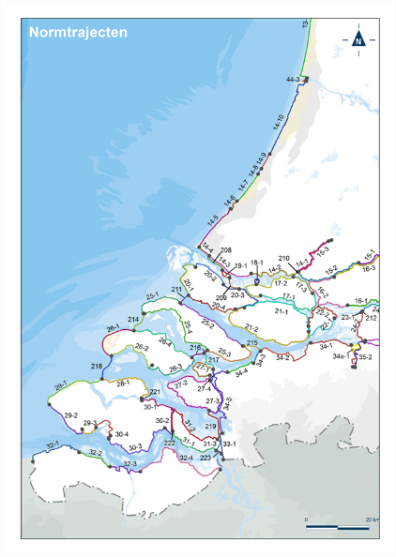
Flood risk assessments NL
Flood risk assessment: probability(embankment failure) compared to probability(required by law)
Every 12 years
December 31st, 2022
New approach since january 1st 2017
https://wetten.overheid.nl/BWBR0025458/2021-01-01#BijlageI

Slide 4
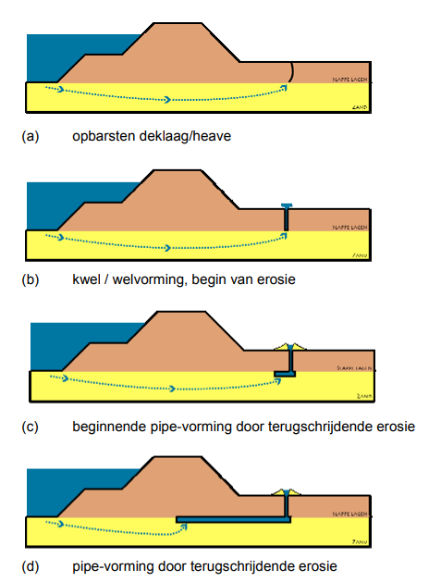
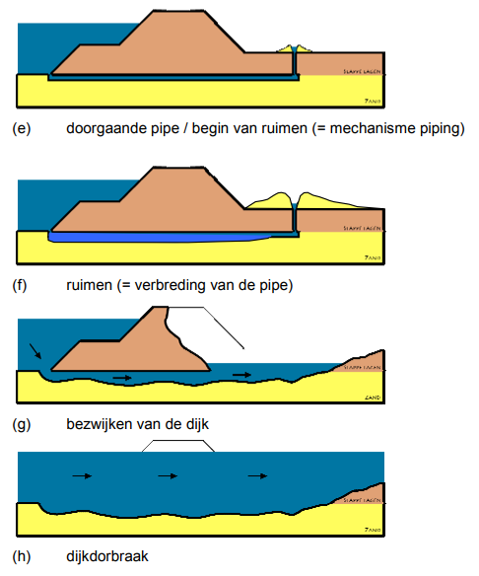
>video: principe of piping (HWBP)<
What is piping
>video: laboratory test (Fugro)<

Slide 5
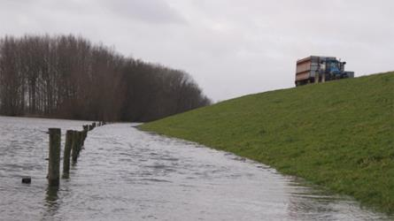
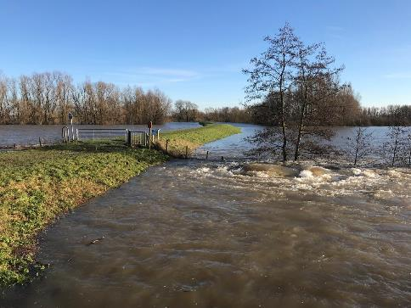
Pictures: problem or not?
1)
2)

Slide 6
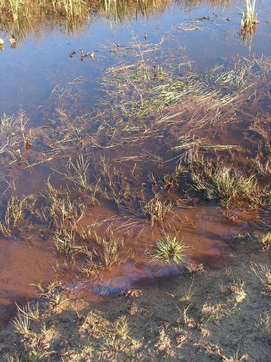
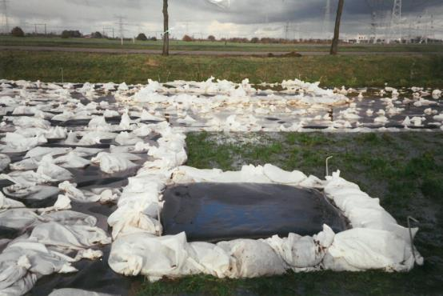
Pictures: problem or not + solution
3)
4)

Slide 7
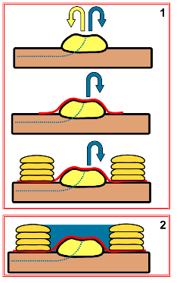
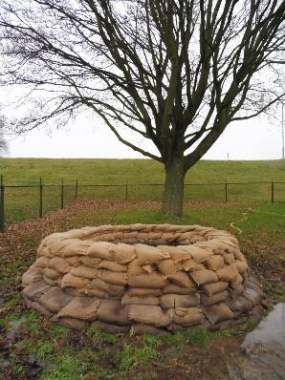
Solution
preventing sand transportation
if this has been signalled

Slide 8
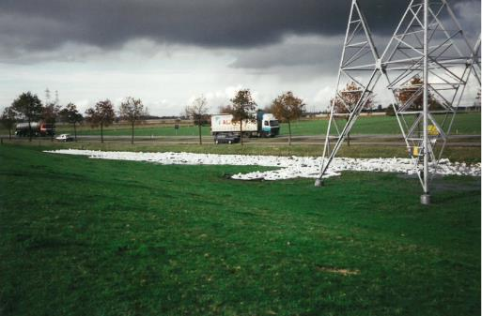
Solution
Credits: Jana Steenbergen (SWECO)

Slide 9
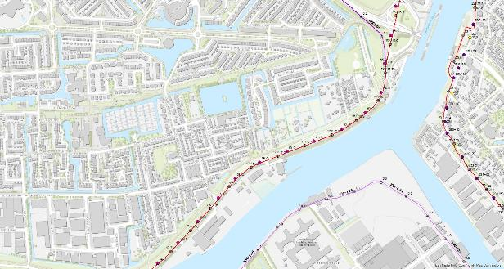
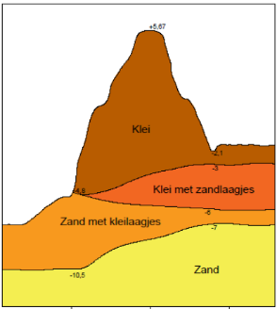
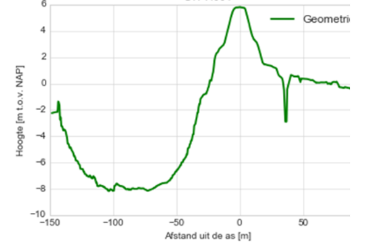
Case area
Max allowed total flood probability:
1:100.000 per year
Which means
1:11.000.000
for piping
>Available data<

Slide 10
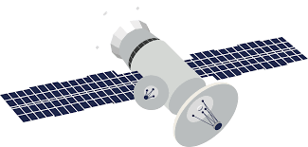
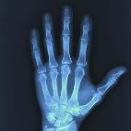
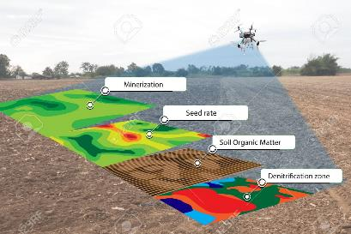
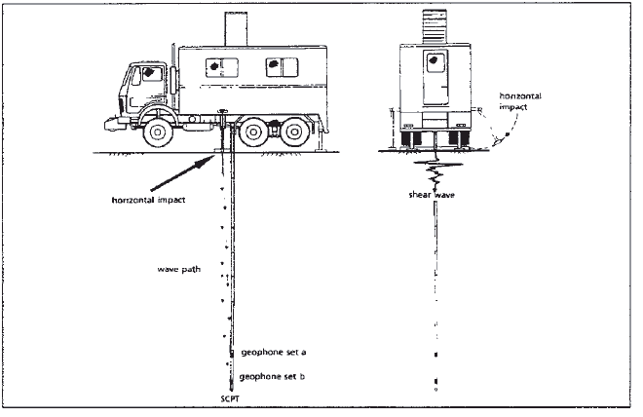
Challenge
Assume: piping risk cannot be reduced by calculations
How would you monitor for piping?
Notes:
All pictures found on google

