Slide 1
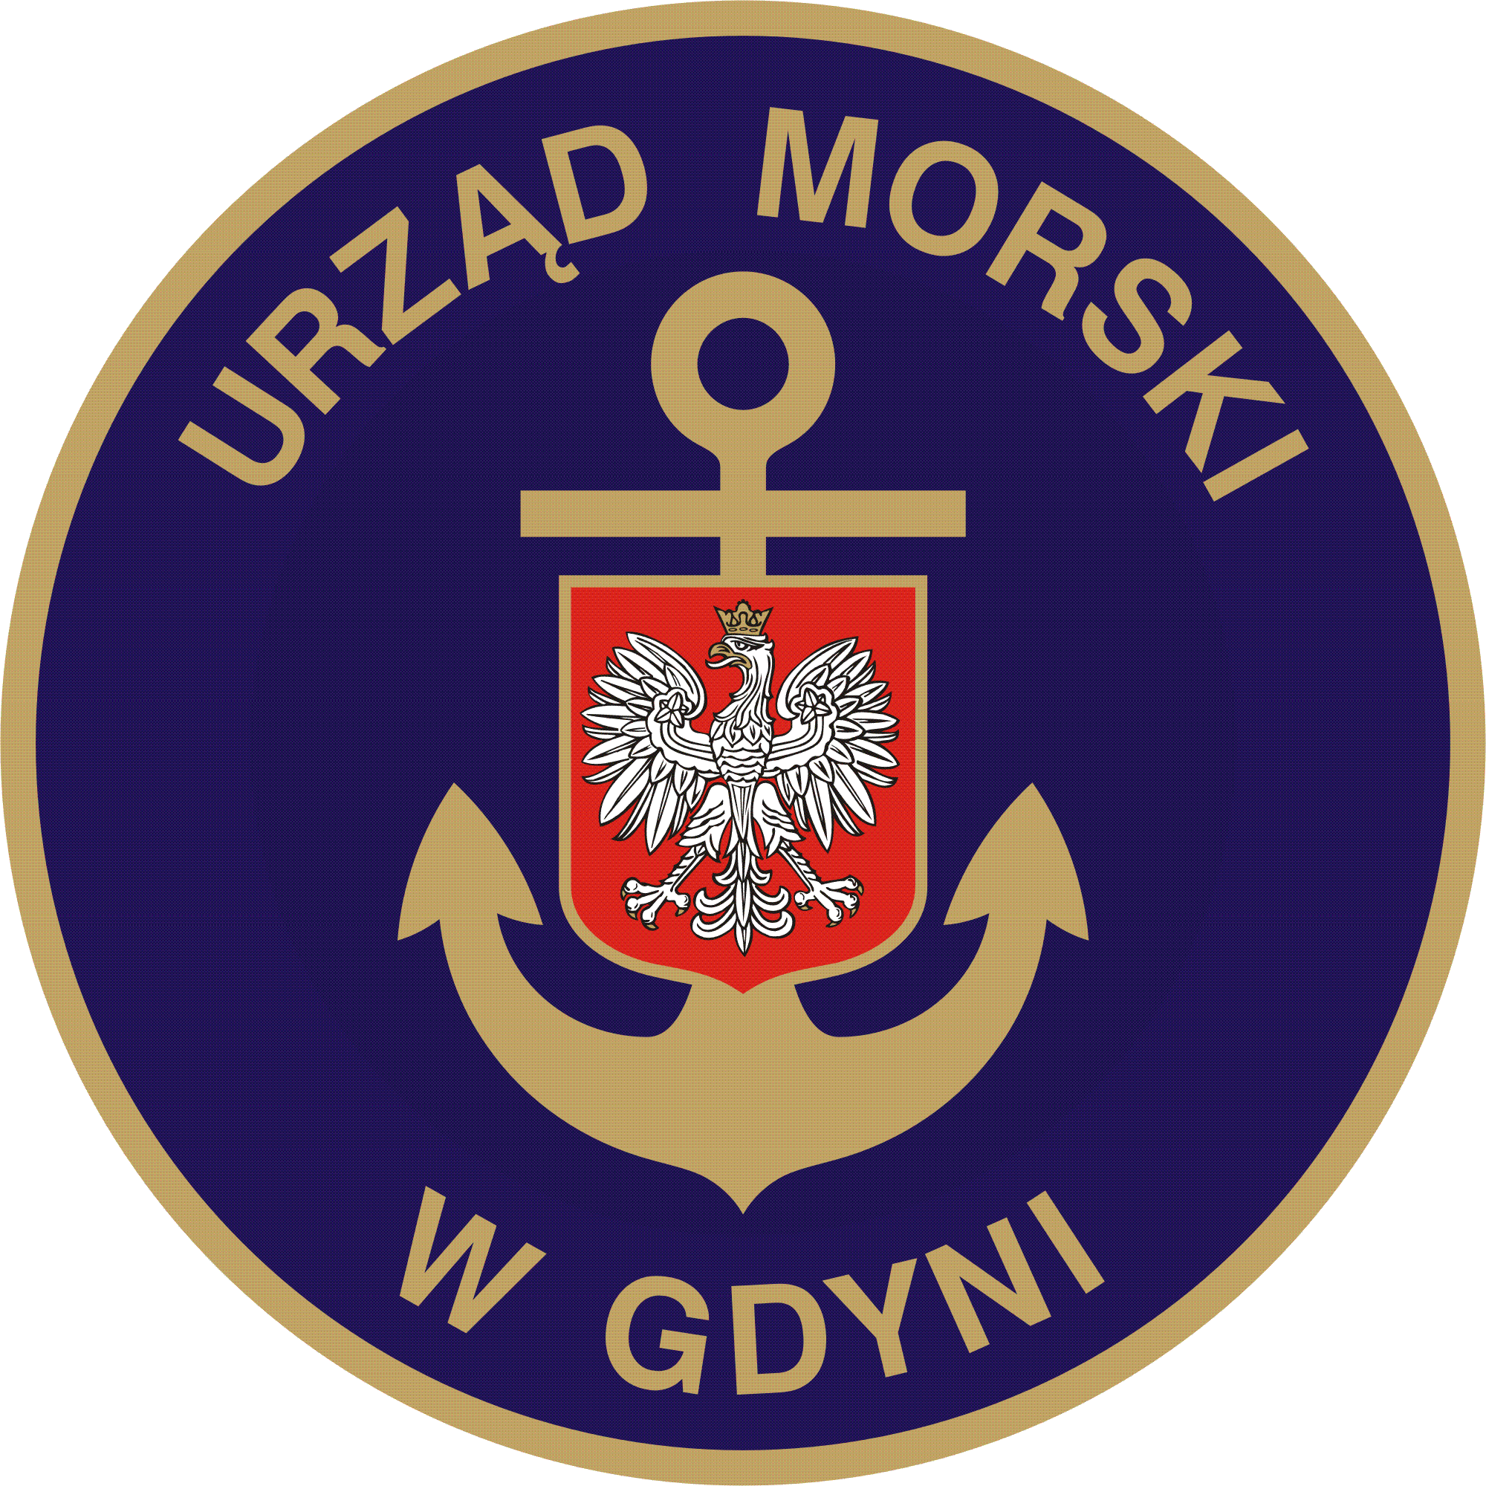
Project co-funded by the European Union out of the Cohesion Fund as part of the Operational Programme Infrastructure and Environment.
Execution of costal protection at the area of Hel Headland with the associated infrastructure and terrain adaptation
11 739 190,40 PLN gross

Slide 2
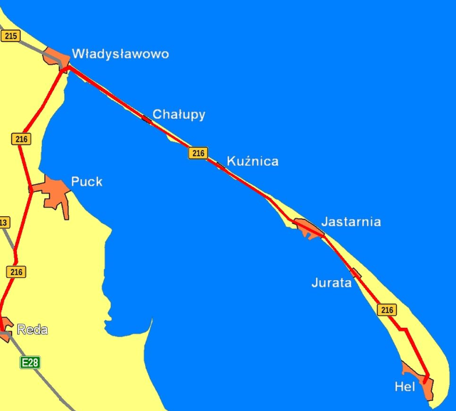
Execution of costal protection at the area of Hel Headland with the associated infrastructure and terrain adaptation INVESTMENT LOCATION
HEL HEADLAND– We may say it the end or the beginning of Hel Peninsula and Poland.
Formation of Hel peninsula is estimated at 5.5 thousand years ago.
It is an uniqe geomorphological form built only from sand transmited by the costal currents
Hel Headland with the Hel city is presently
an important fishing and Turism center.
In recent history has played an important
Military role.

Slide 3
Execution of costal protection at the area of Hel Headland with the associated infrastructure and terrain adaptation
THE MAIN INFORMATION ABOUT THE PROJECT :
Client: Maritime Office in Gdynia
Project Manager: Head of the Costal Protection Department– Roman Kołodziejski
Contract Engineer: Przedsiębiorstwo Usług Inwestycyjnych EKO-INWEST S.A.
Resident Engineer: Tadeusz Heyda
Design Office: REVETMENT CONSTRUCTION - Zespół Rzeczoznawców Stowarzyszenia
Inżynierów i Techników Wodnych i Melioracyjnych – Terenowa Grupa
Rzeczoznawców w Gdańsku. FOOTBRIDGES AND PATHWAYS - Biuro Architektoniczne – Andrzej Basiński
Contractual System: Agreement with FIDIC conditions of contract
Contractor: HYDROBUDOWA GDAŃSK S.A.
Construction Site Manager: Marcin Wróblewski
Execution: March 2012 – June 2013

Slide 4
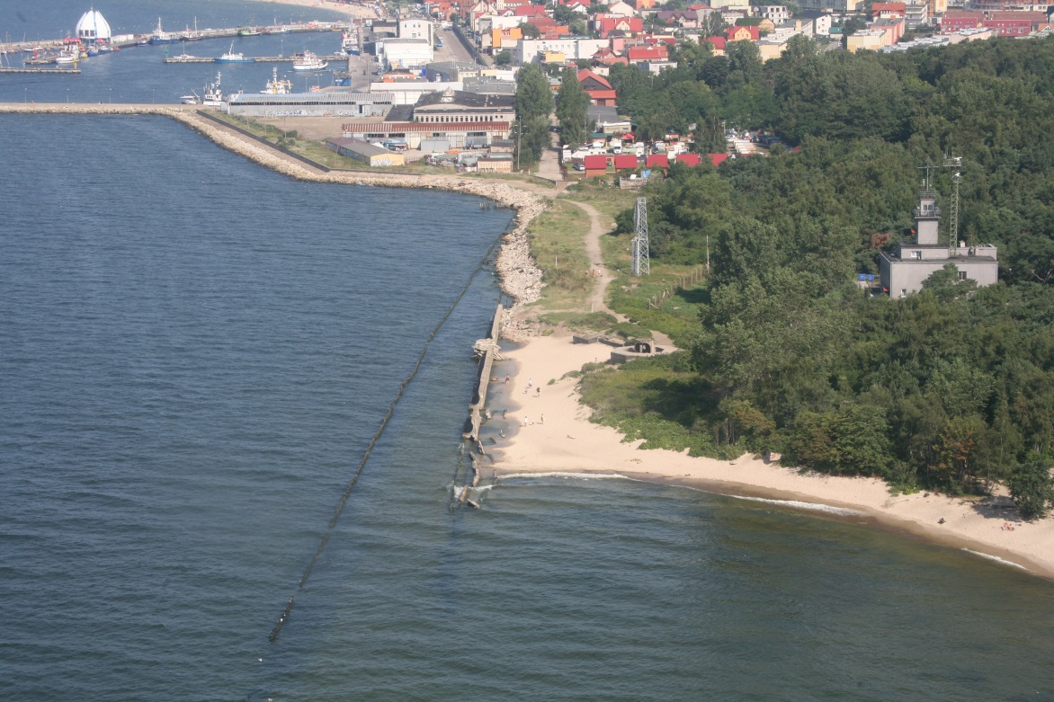
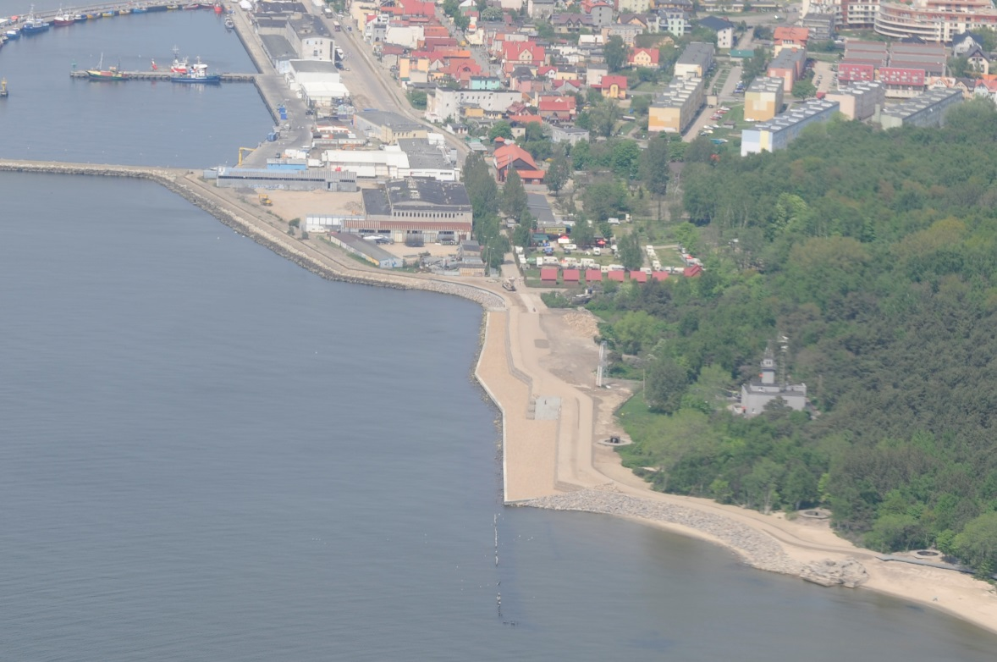
Execution of costal protection at the area of Hel Headland with the associated infrastructure and terrain adaptation
Before After
AUGUST 2010 OCTOBER 2012
CONSTRUCTION OF COSTAL REVETMENT

Slide 5
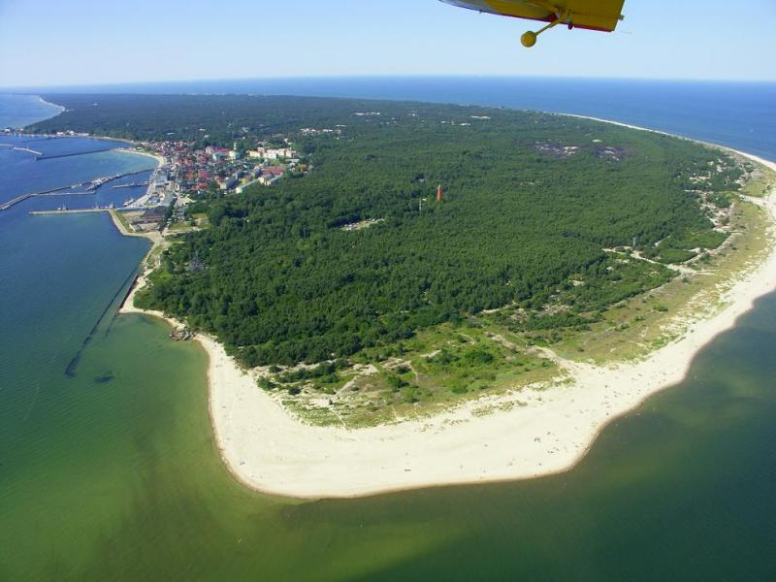
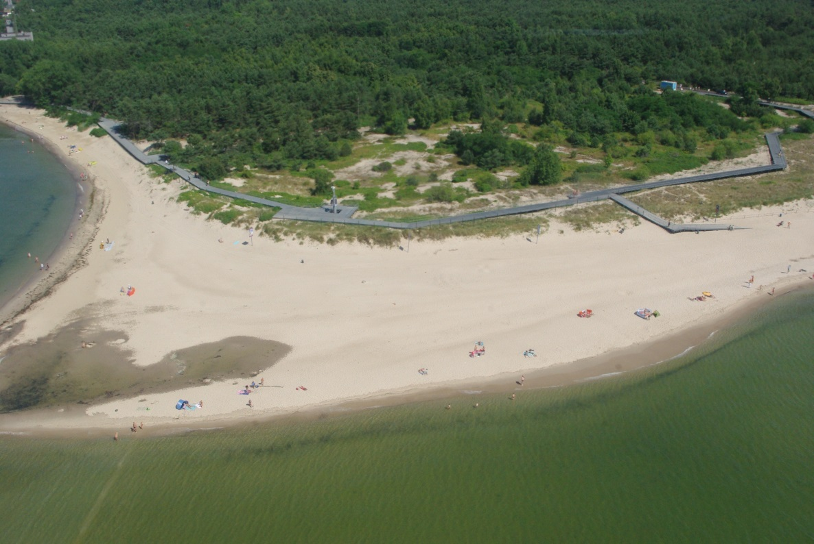
Execution of costal protection at the area of Hel Headland with the associated infrastructure and terrain adaptation
Before After
AUGUST 2010 OCTOBER 2012
ASSOCIATED INFRASTRUCTURE - FOOTBRIDGES AND PATHWAYS

Slide 6
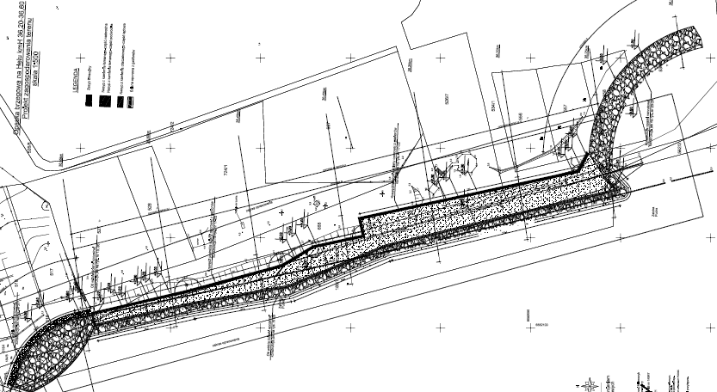
Execution of costal protection at the area of Hel Headland with the associated infrastructure and terrain adaptation
PLAN – SEA WALL

Slide 7
Execution of costal protection at the area of Hel Headland with the associated infrastructure and terrain adaptation
MAIN INFRASTRUCTURE FACILITIES AND COMPONENTS OF THE PROJECT :
SEA WALL:
- SECTION A TYPE - 65,4 m
- SECTION B TYPE - 316,2 m
- SECTION C TYPE - 116,20 m
CONSTRUCTION OF GABION COSTAL REVETMENT - 304 m
THROUGHFARE BETWEEN SEA WALL AND GABION REVETMENT
FOOTBRIDGES AND TERRACES CONSTRUCTION, MADE OF RECYCLED MATERIALS, ON THE DUNES AREA - 702 m
FOREST PATHWAYS REVITALIZATION- 480 m
PATHWAYS ALONG THE REVETMENT – 450 m
REVITALIZATION OF ADJACENT AREAS WITH SAFETY BARRIERS

Slide 8
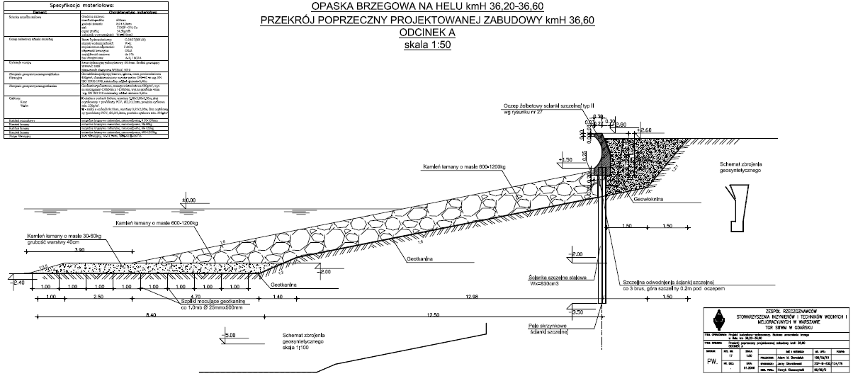
Execution of costal protection at the area of Hel Headland with the associated infrastructure and terrain adaptation
CROSS SECTION - SEAWALL TYPE A

Slide 9
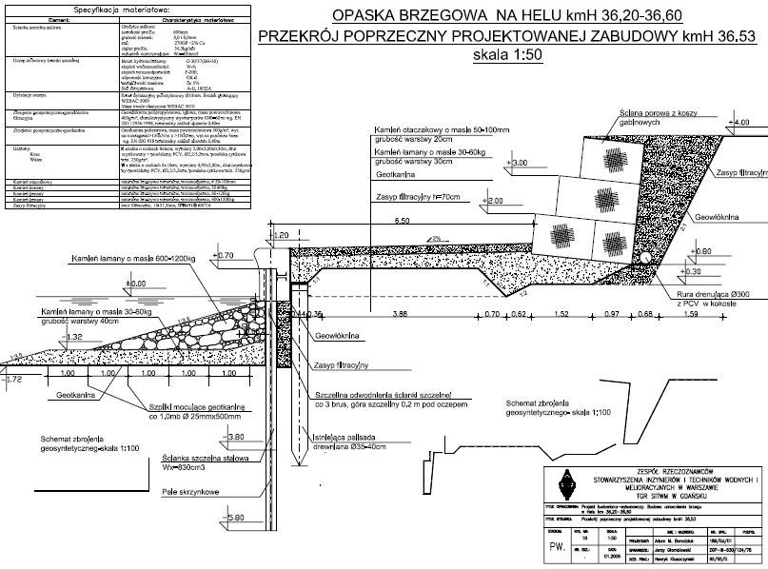
Execution of costal protection at the area of Hel Headland with the associated infrastructure and terrain adaptation
CROSS SECTION - SEAWALL TYPE B

Slide 10
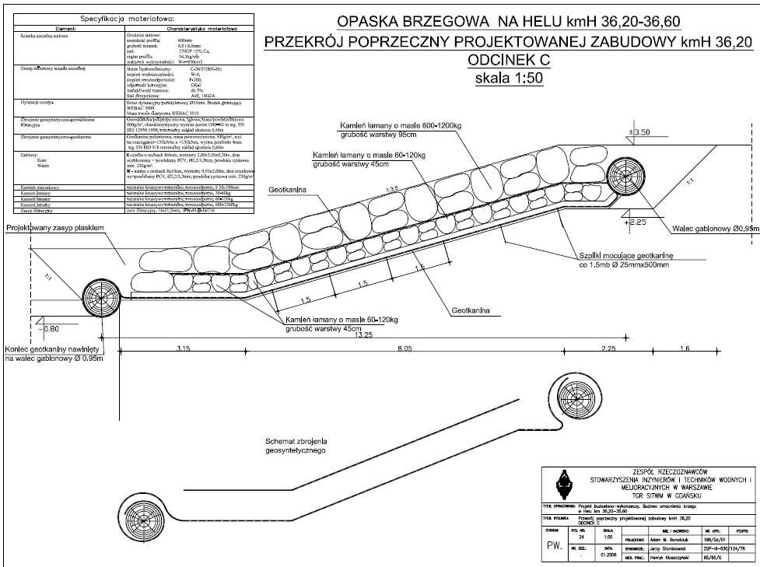
Execution of costal protection at the area of Hel Headland with the associated infrastructure and terrain adaptation
CROSS SECTION - SEAWALL TYPE C

Slide 11
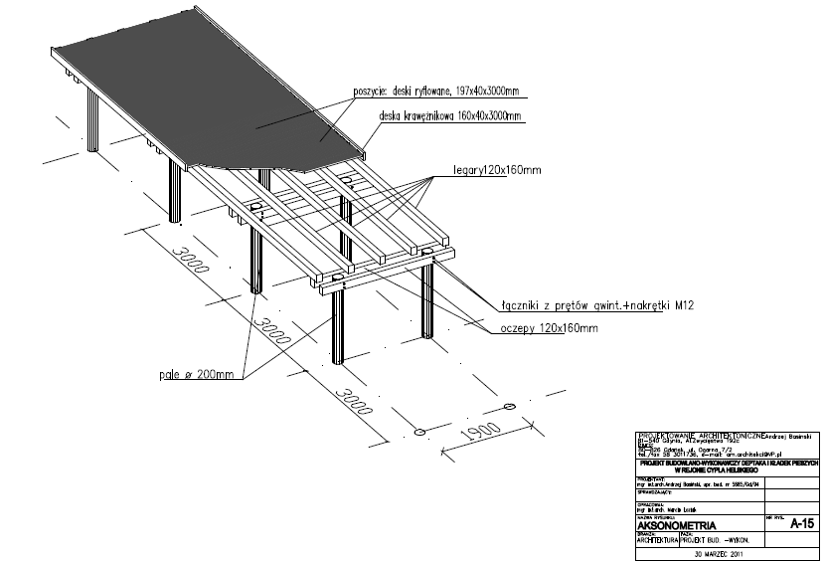
Execution of costal protection at the area of Hel Headland with the associated infrastructure and terrain adaptation
FOOTPATHS AND VIEW POINTS CONSTRUCTION

Slide 12
Execution of costal protection at the area of Hel Headland with the associated infrastructure and terrain adaptation
Coastal revetment at the area of Hel headland – Achievements:
PROTECTION OF THE SEA SHORE FROM THE ACTION OF WAVES
REVITALIZATION OF THE COASTAL LINE AND ADJACENT AREA
CLEARING THE AREA FROM EXPLOSIVES
IMPROVING THE ENVIRONMENT – CLEARING THE AREA FROM WASTE AND RUBBLE
RESTORATION OF TOURISM AND IMPROVING PEDESTRIAN SAFETY
IMPROVING THE LANDSCAPE AND DUNE PROTECTION BY CHANNELING THE PEDESTRIAN COMMUNICATION
PROTECTION OF HISTORICAL MILITARY FACILITIES AGAINST ENVIRONMENTAL DEGRADATION

Slide 13
Execution of costal protection at the area of Hel Headland with the associated infrastructure and terrain adaptation
MAIN SCOPE OF WORKS PERFORMED DURING CONSTRUCTION :
Driving of sheet pile wall – total length – 381,6 m,
Pile Driving, lengths- 2 - 6 m, for the footpaths – 600 pcs.,
Concrete beam on the sheetpile wall – total length - 375 mb
Rock armour / RIPRAP with total volume- about 9000 m³,
Drainage Filters with total volume– about 7500m³,
Gabion costal revetment with total volume ok. 2000 m³
THE BIGGEST PROBLEMS ENCOUNTERED DURING CONSTRUCTION:
Very diverse and different state of the Site in relation to the assumptions in the design due to the direct action of the marine environment,
The construction site throughout the execution was exposed to direct wave action
During the tourist season big difficulties in transport and delivery of materials

Slide 14
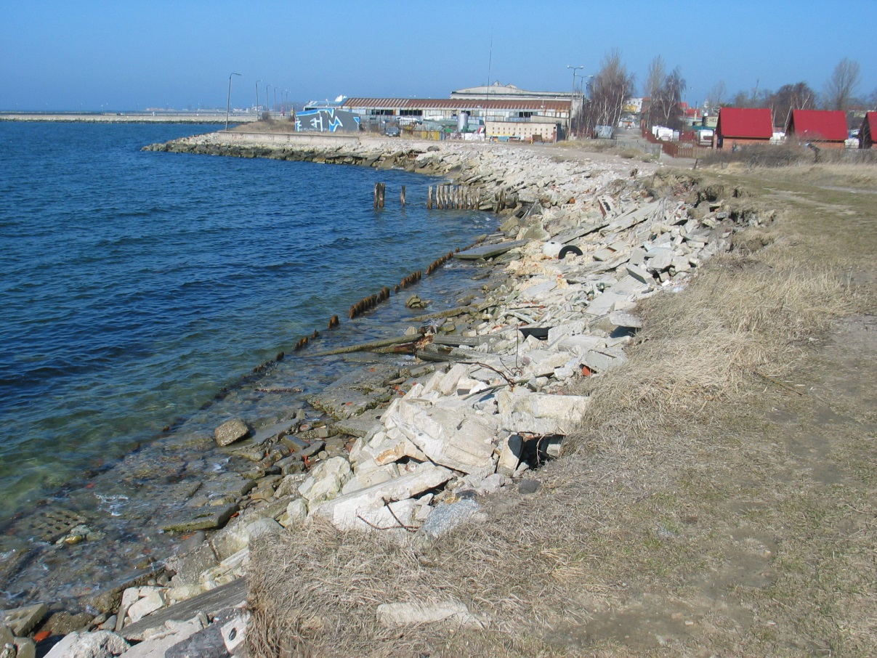
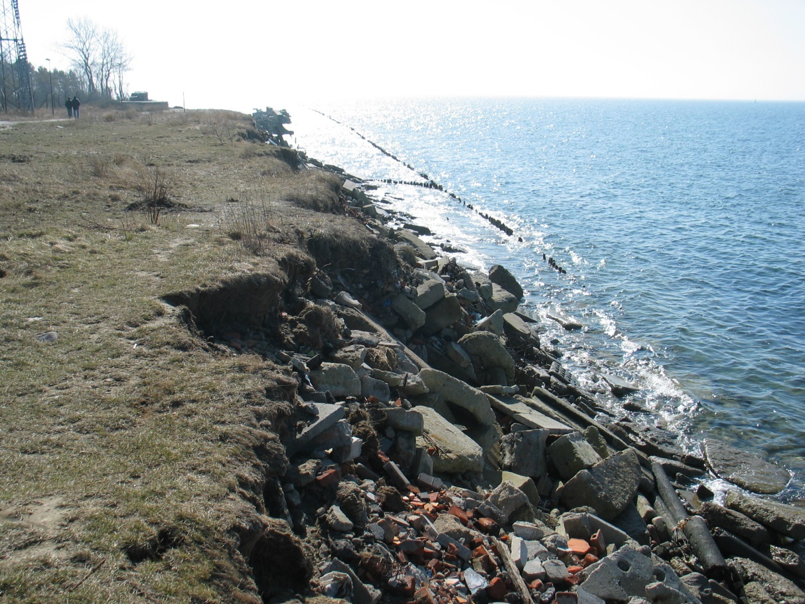
Execution of costal protection at the area of Hel Headland with the associated infrastructure and terrain adaptation
Realization Photos
APRIL 2012

Slide 15
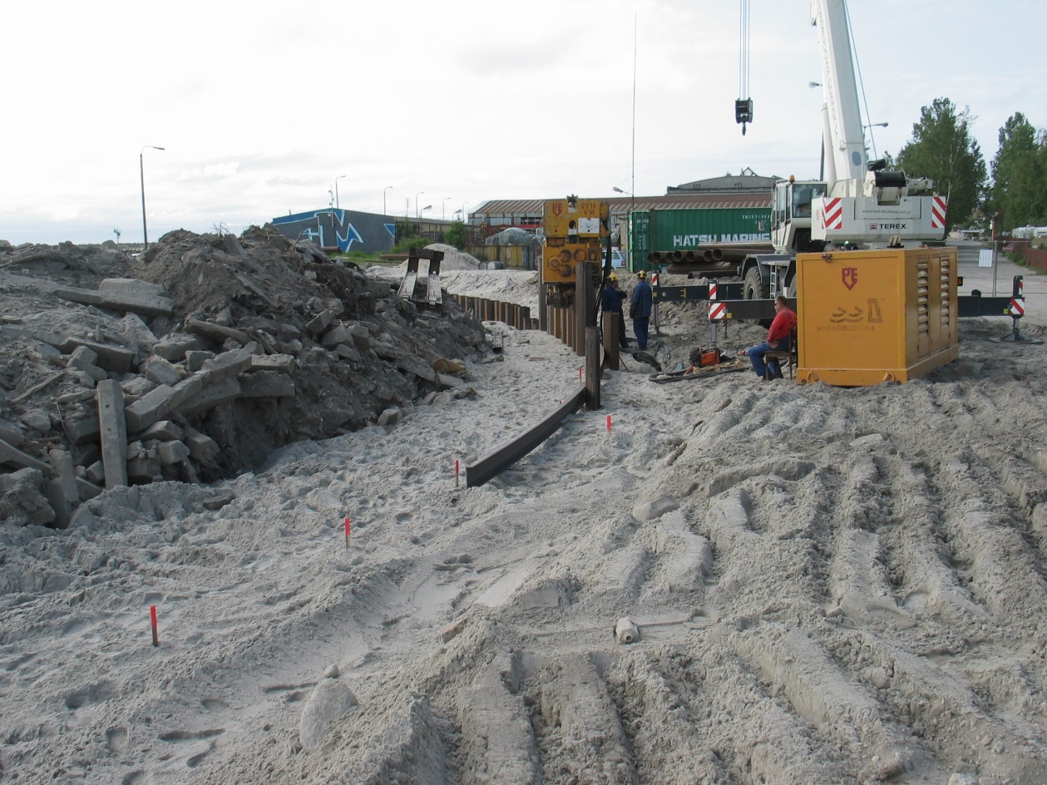
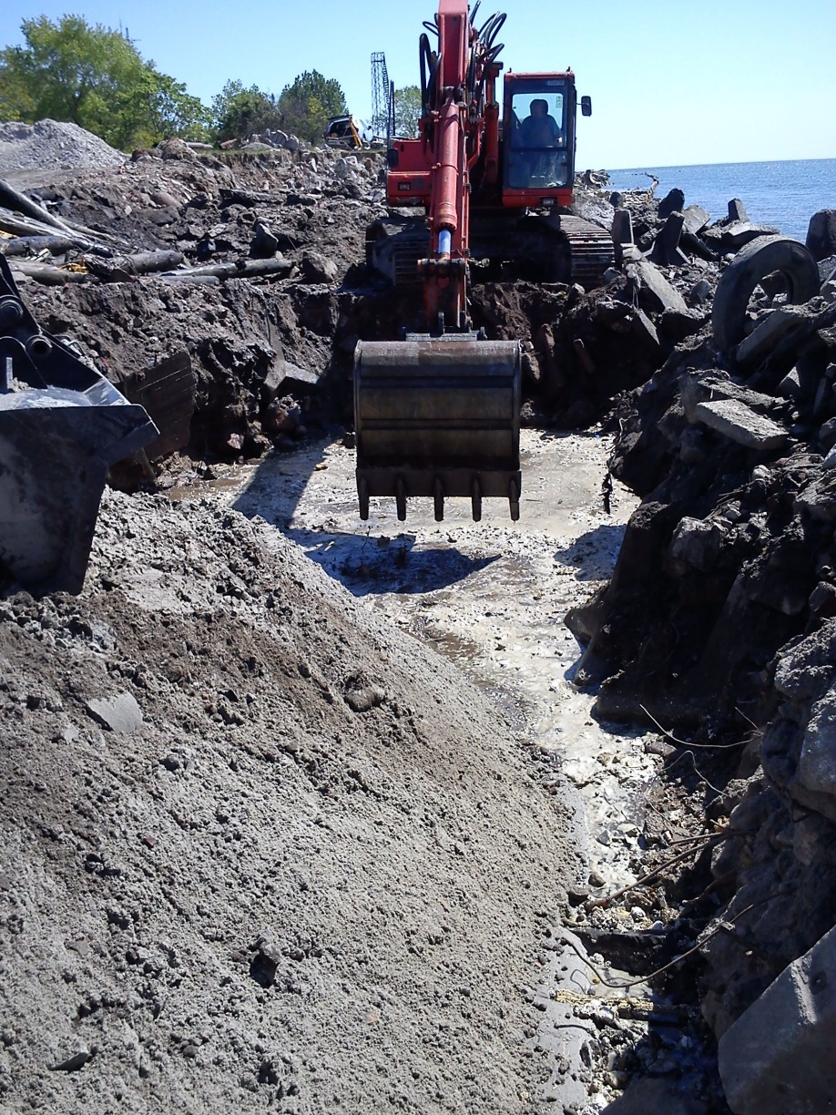
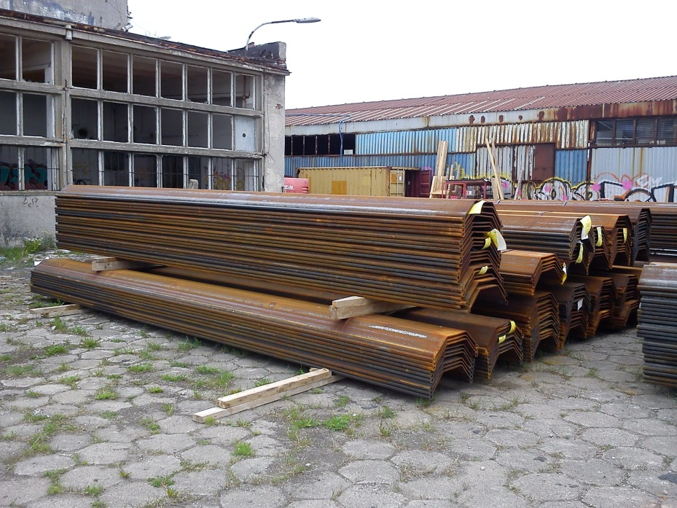
Execution of costal protection at the area of Hel Headland with the associated infrastructure and terrain adaptation
Realization Photos
MAY 2012

Slide 16
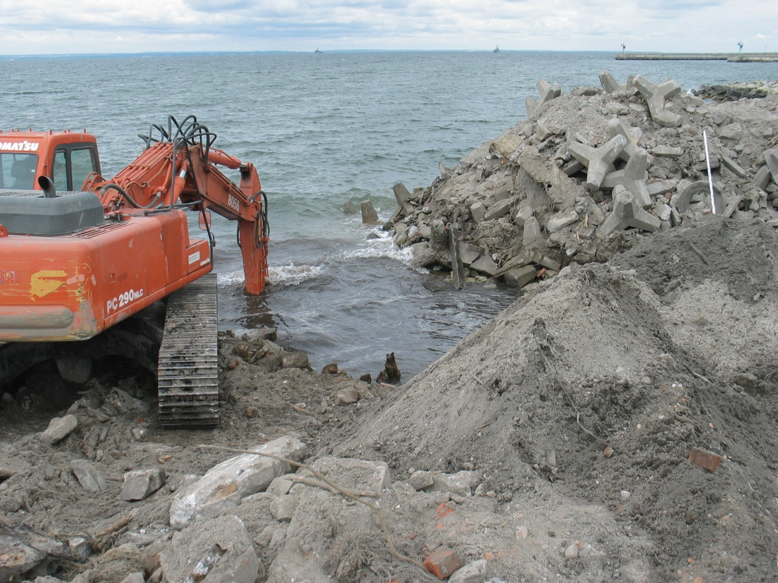
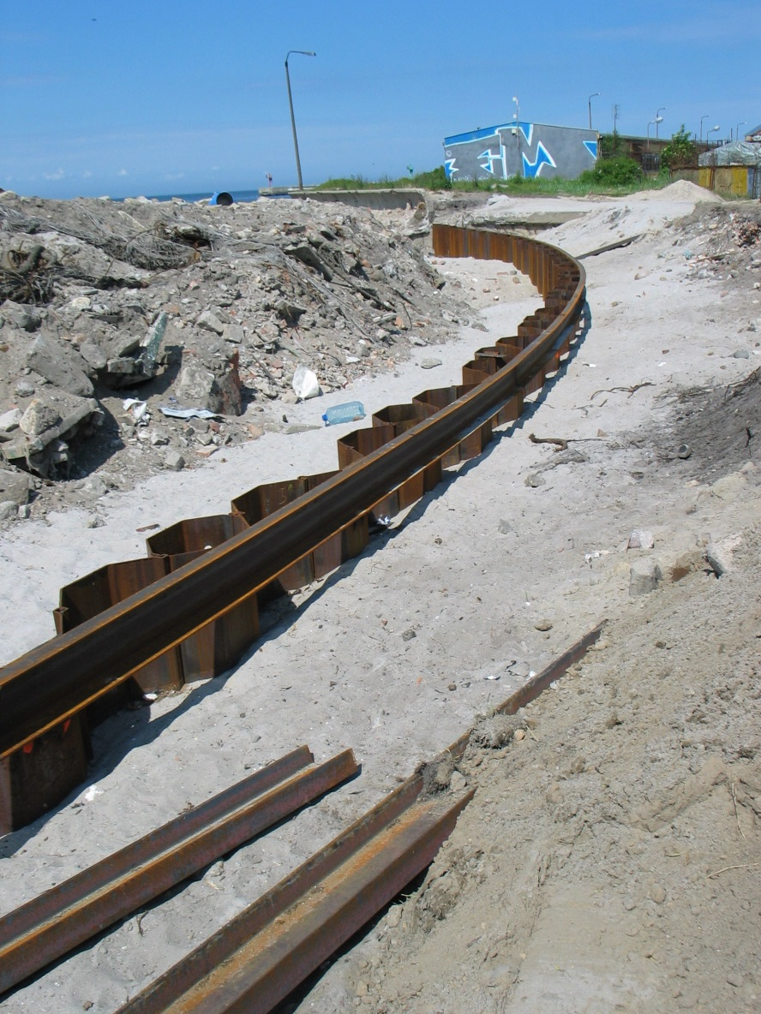
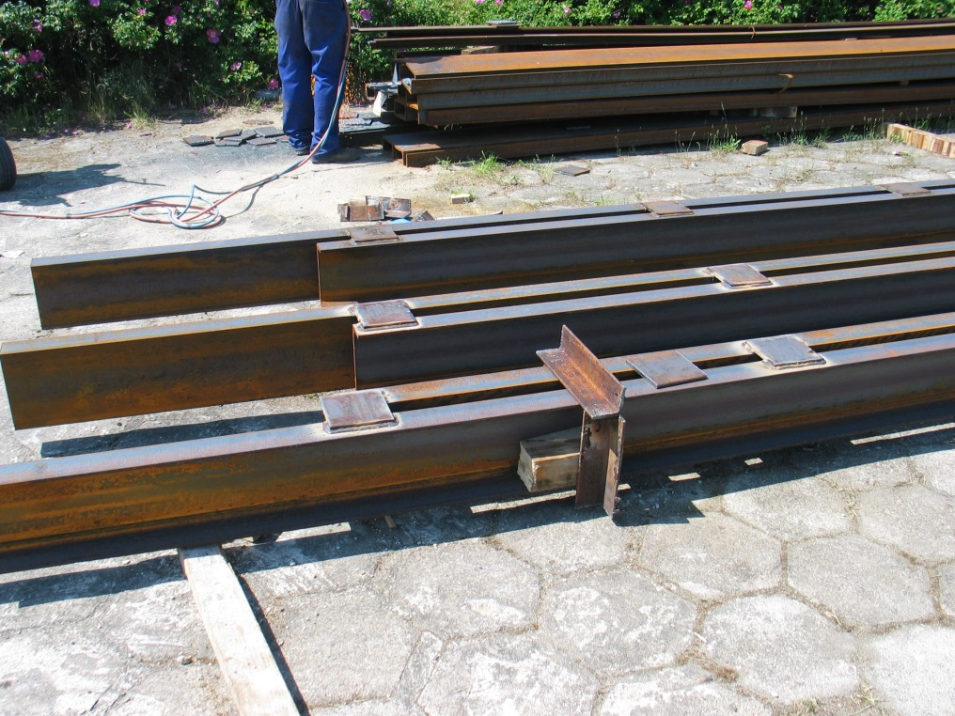
Execution of costal protection at the area of Hel Headland with the associated infrastructure and terrain adaptation
Realization Photos
JUNE 2012

Slide 17
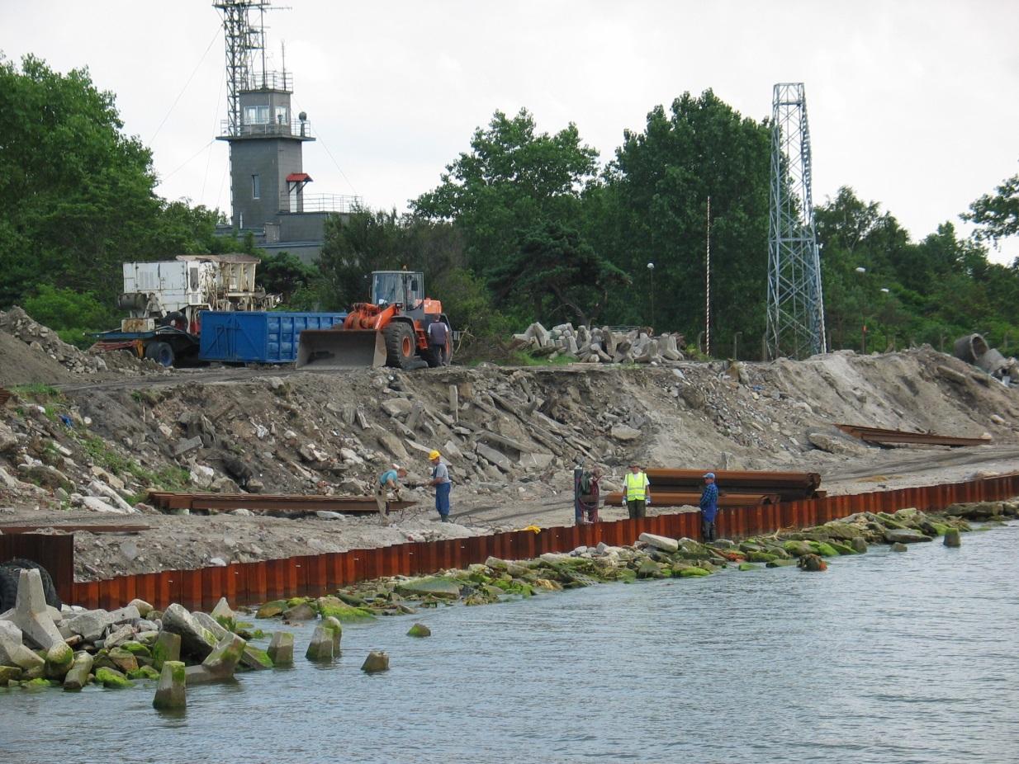
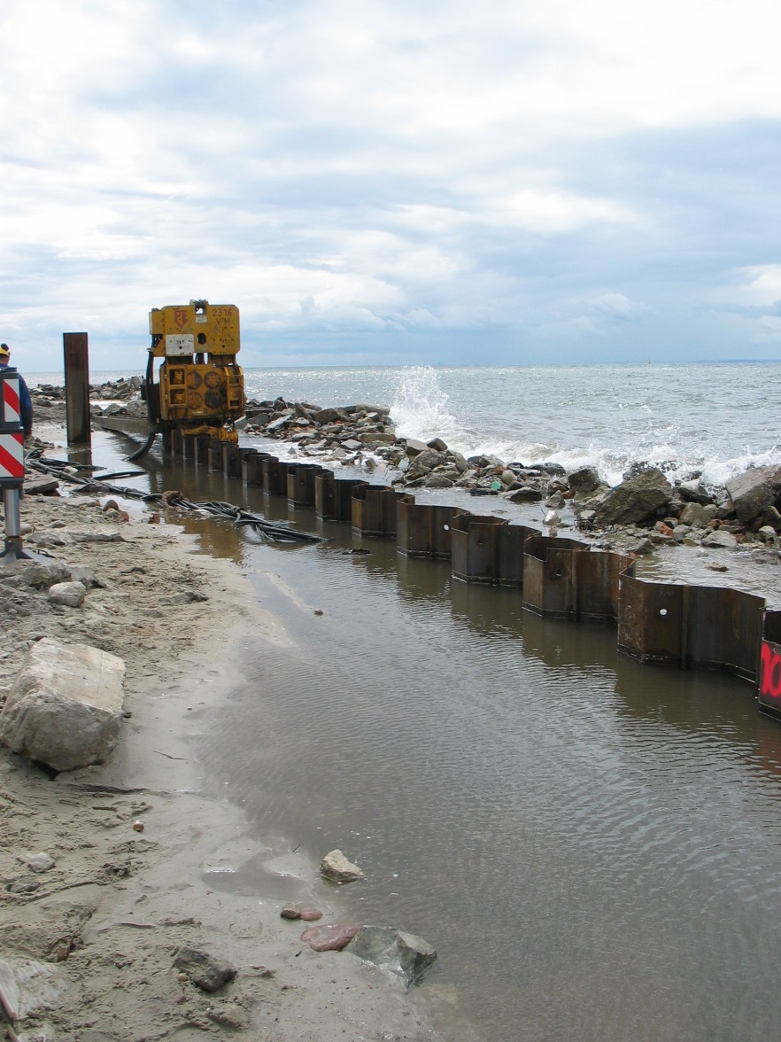
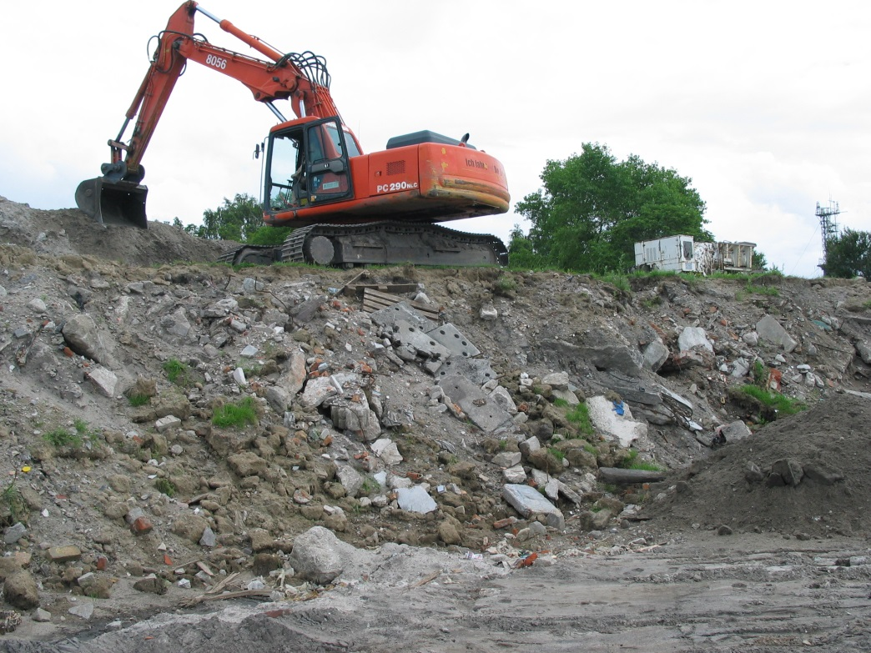
Execution of costal protection at the area of Hel Headland with the associated infrastructure and terrain adaptation
Realization Photos
JULY 2012

Slide 18
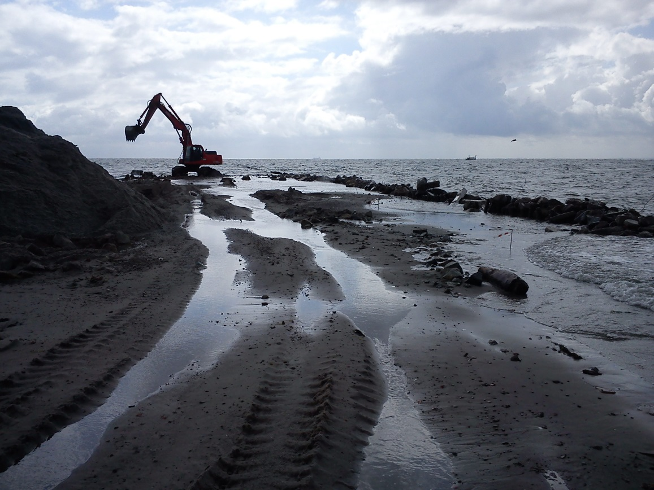
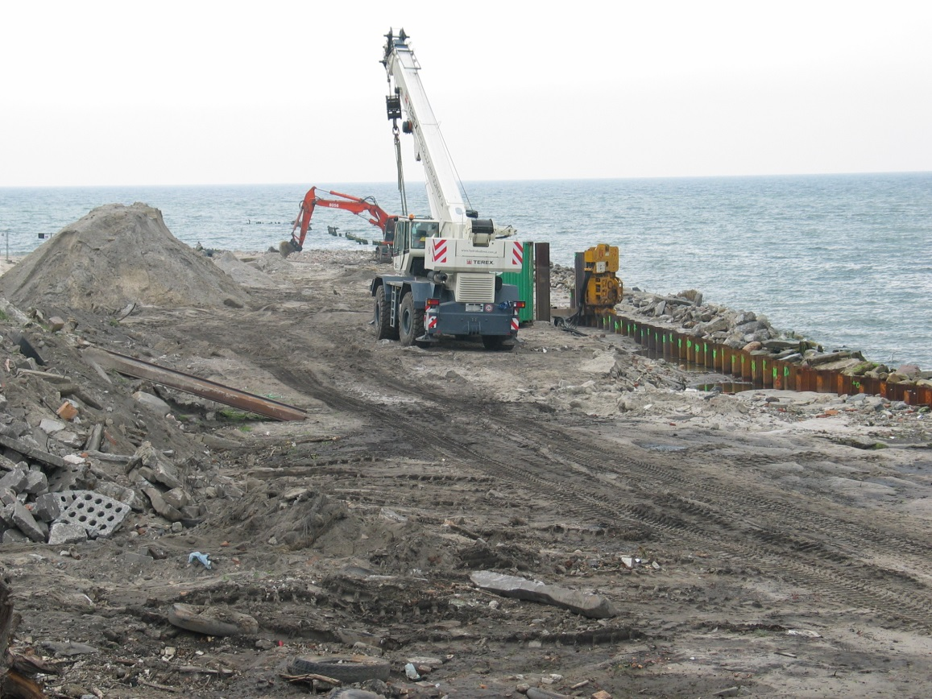
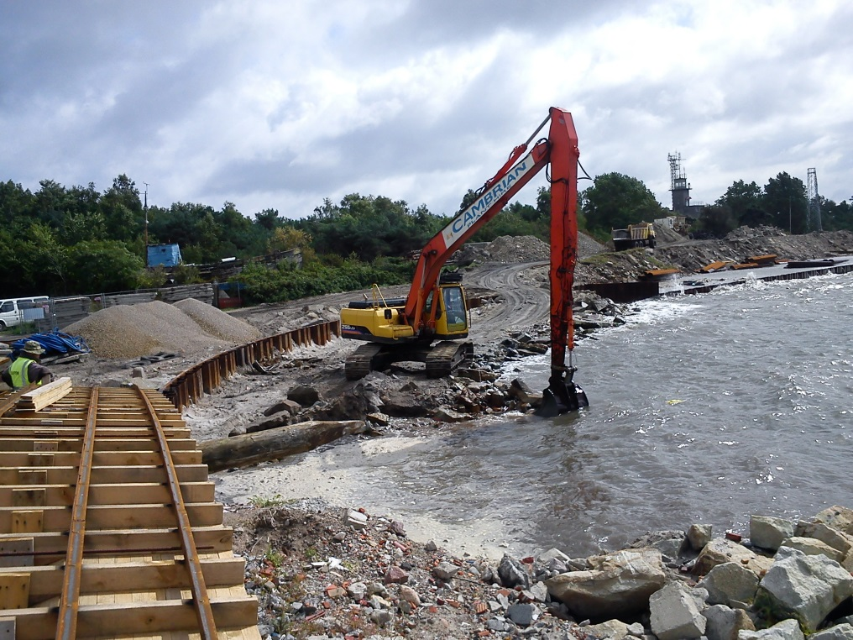
Execution of costal protection at the area of Hel Headland with the associated infrastructure and terrain adaptation
Realization Photos
AUGUST 2012

Slide 19
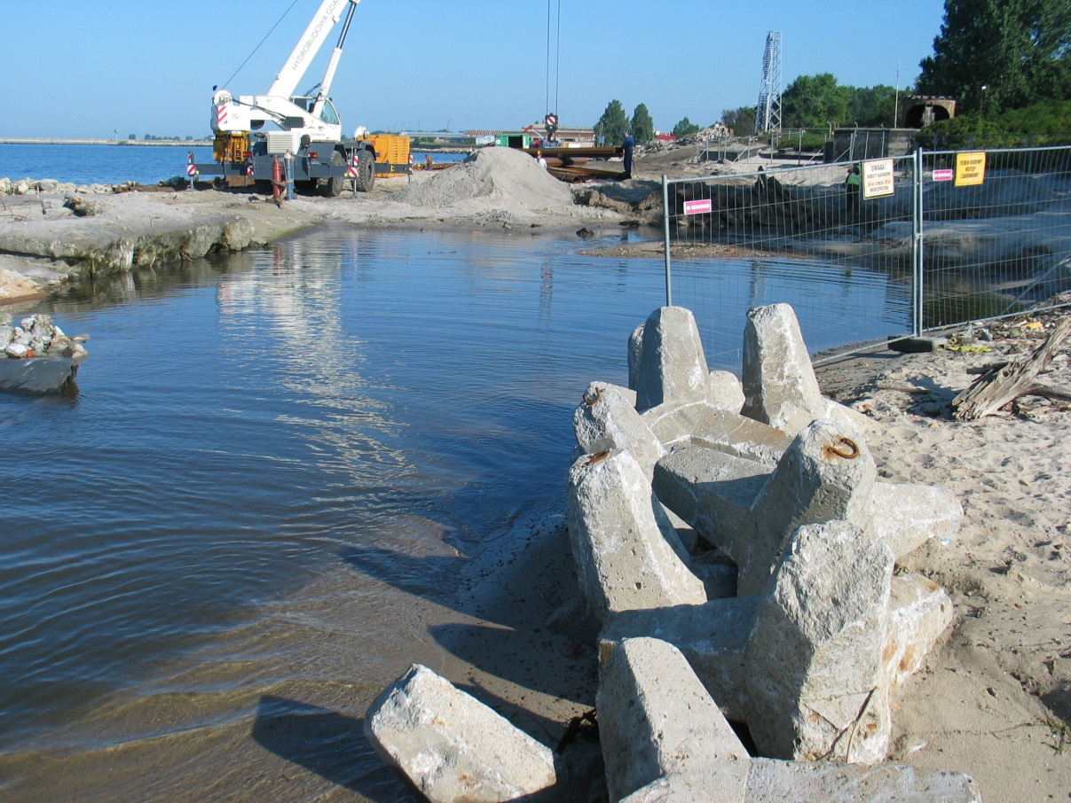
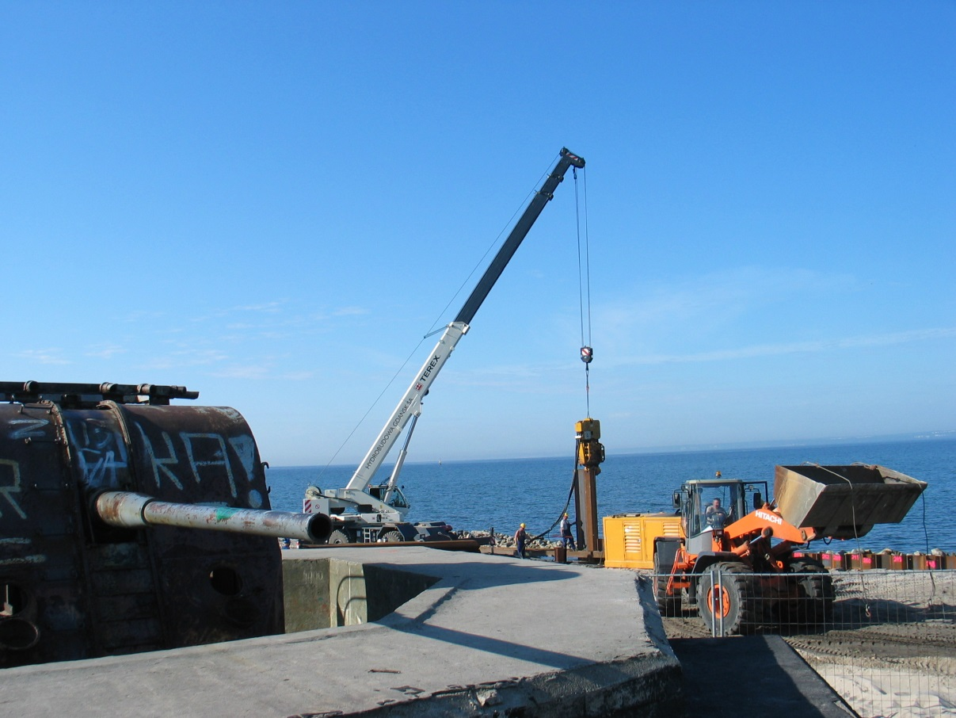
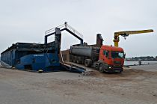
Execution of costal protection at the area of Hel Headland with the associated infrastructure and terrain adaptation
Realization Photos
SEPTEMBER 2012

Slide 20
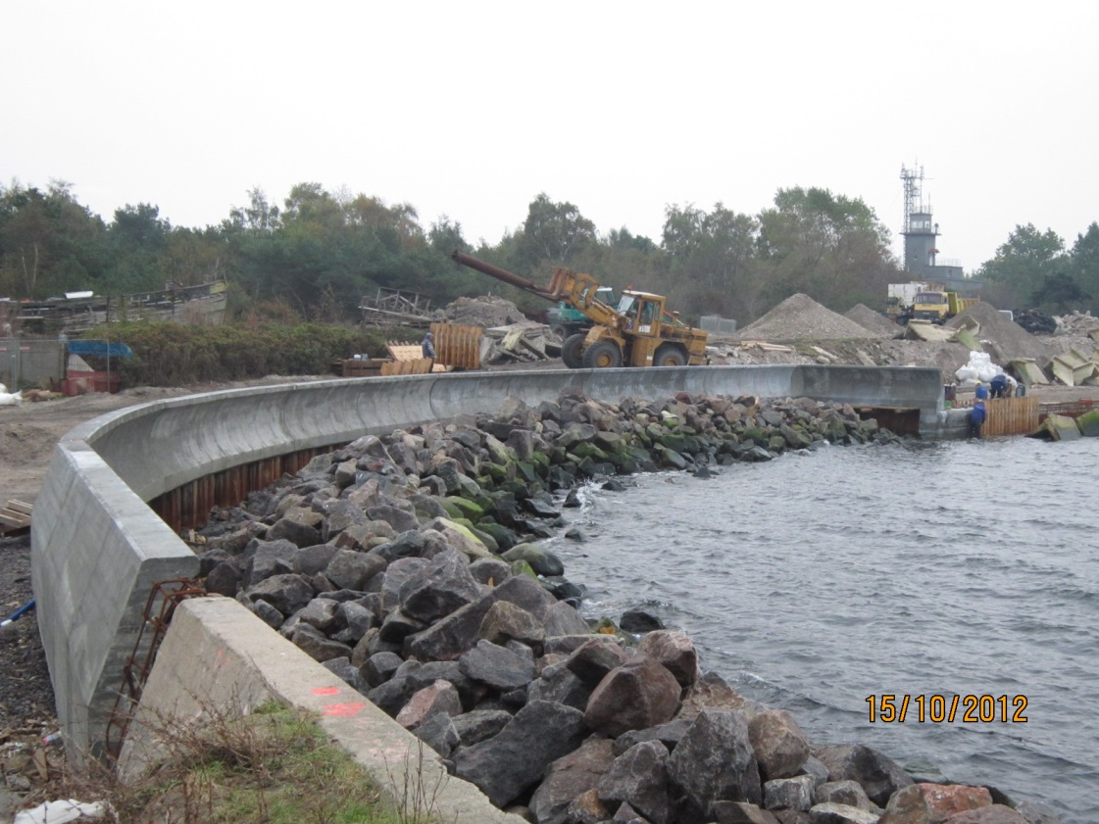
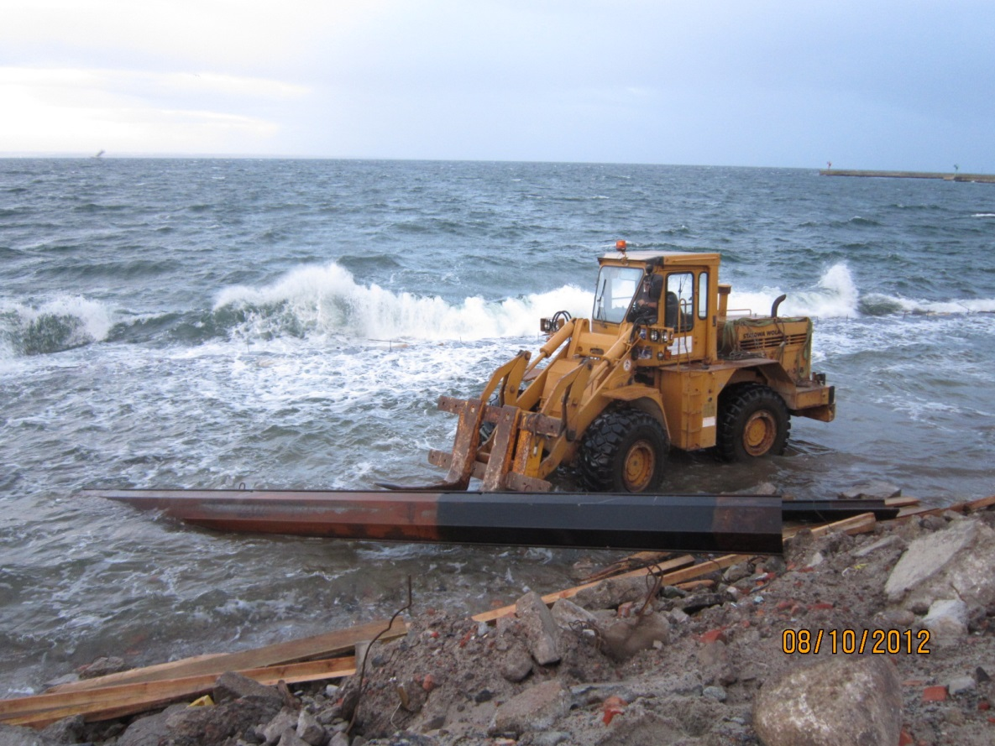
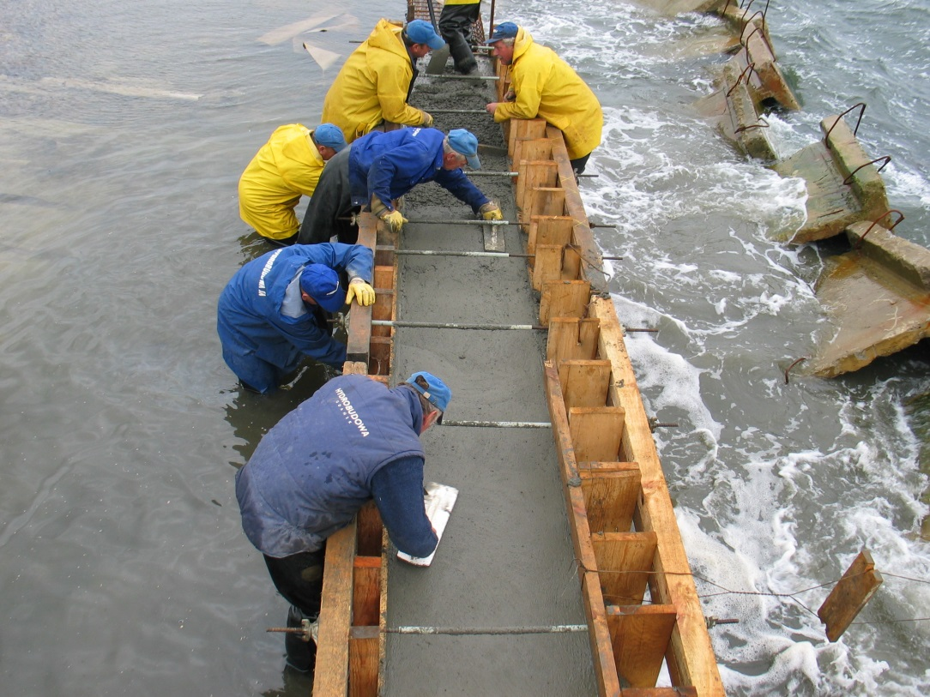
Execution of costal protection at the area of Hel Headland with the associated infrastructure and terrain adaptation
Realization Photos
OCTOBER 2012

Slide 21
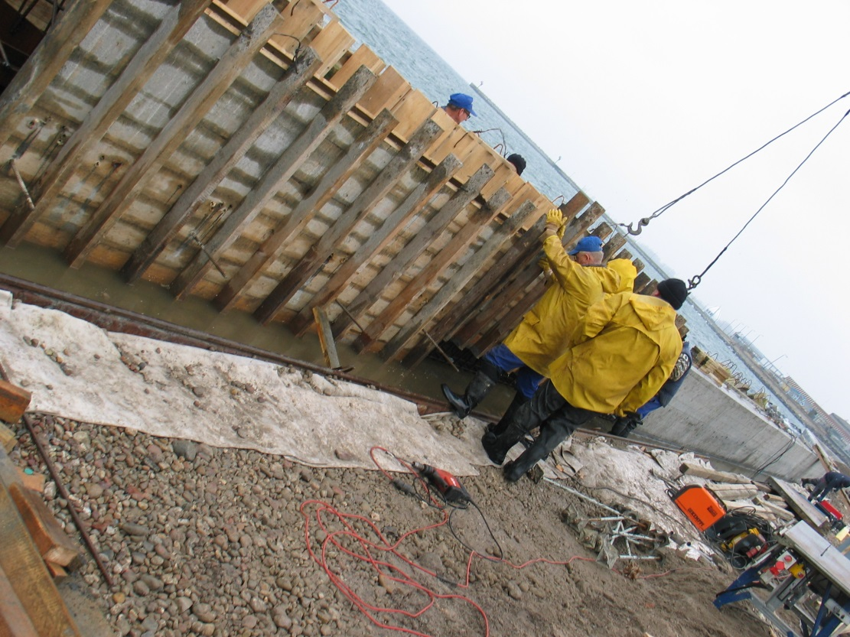
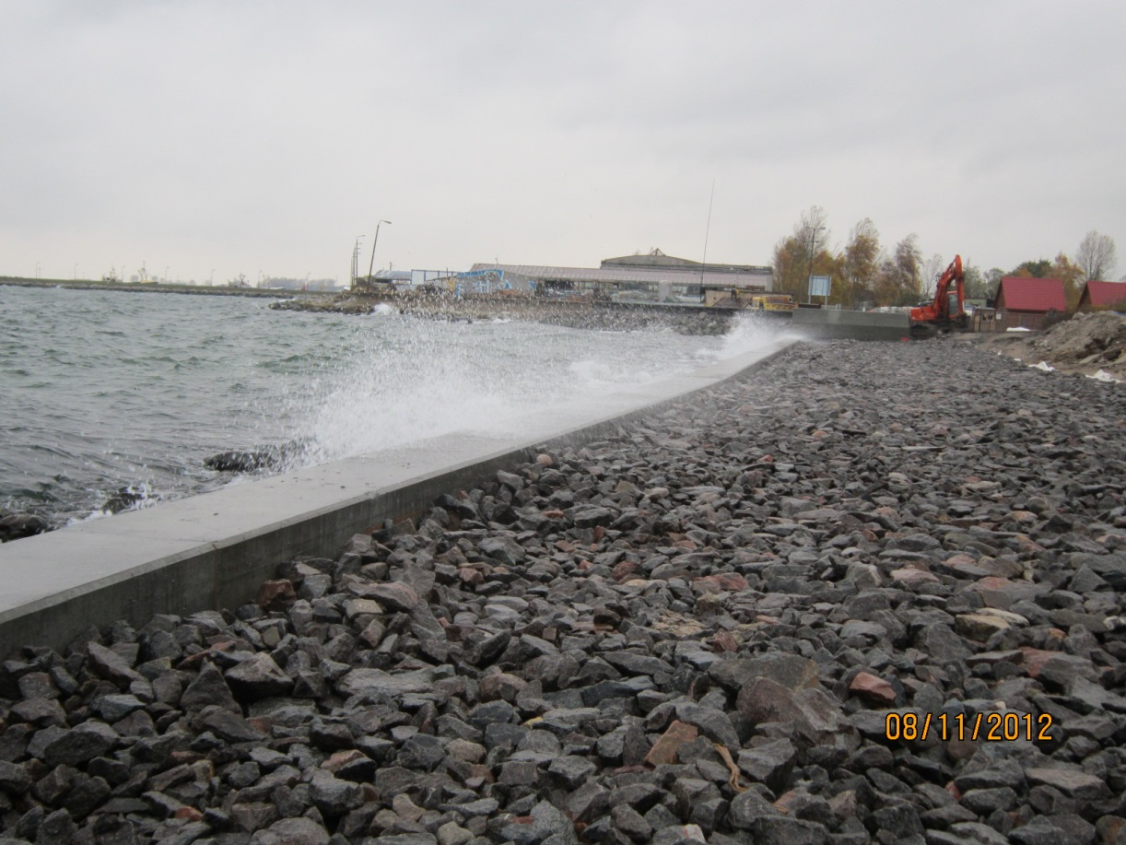
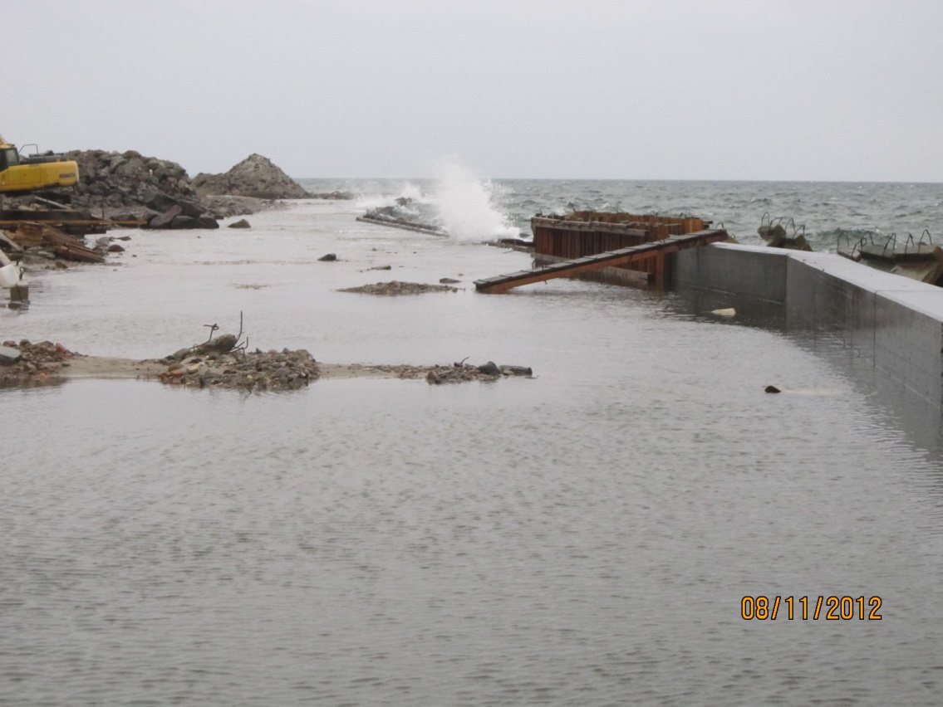
Execution of costal protection at the area of Hel Headland with the associated infrastructure and terrain adaptation
Realization Photos
NOVEMBER 2012

Slide 22
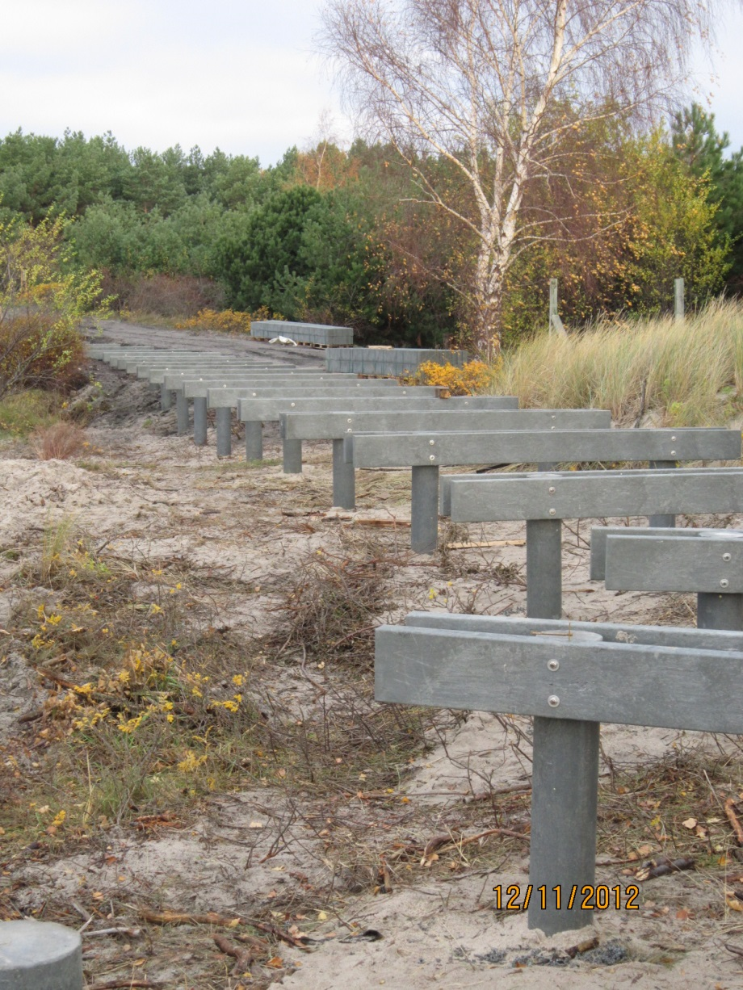
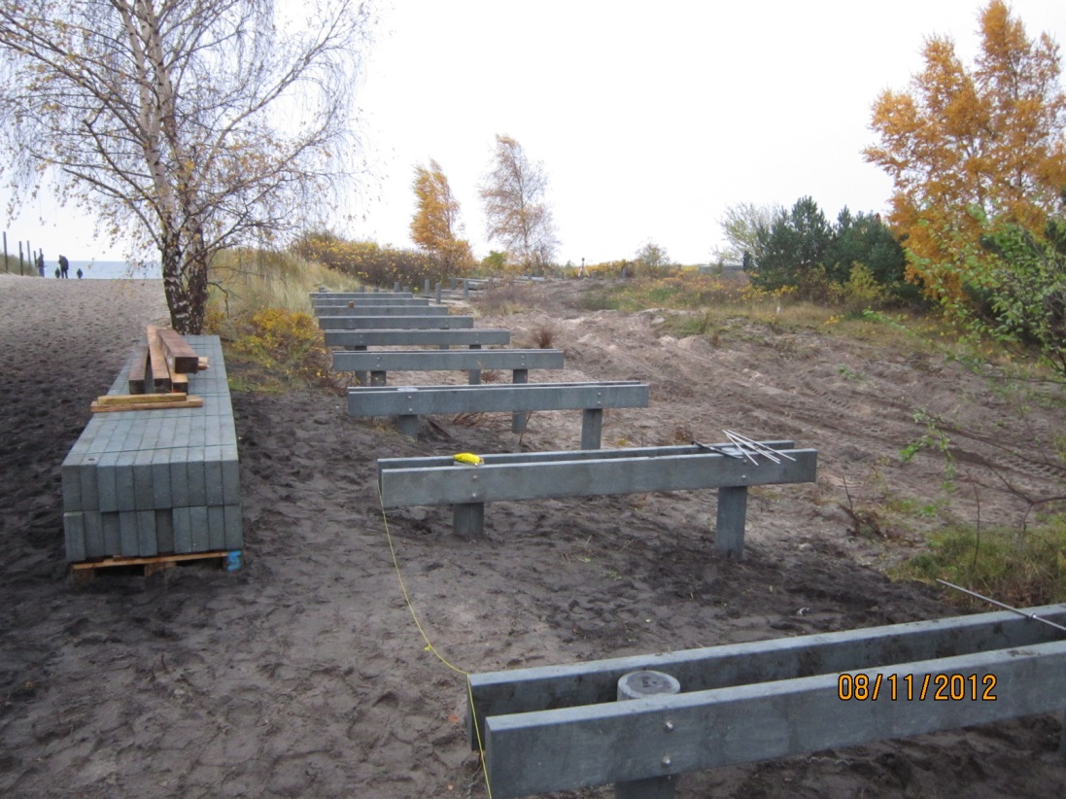
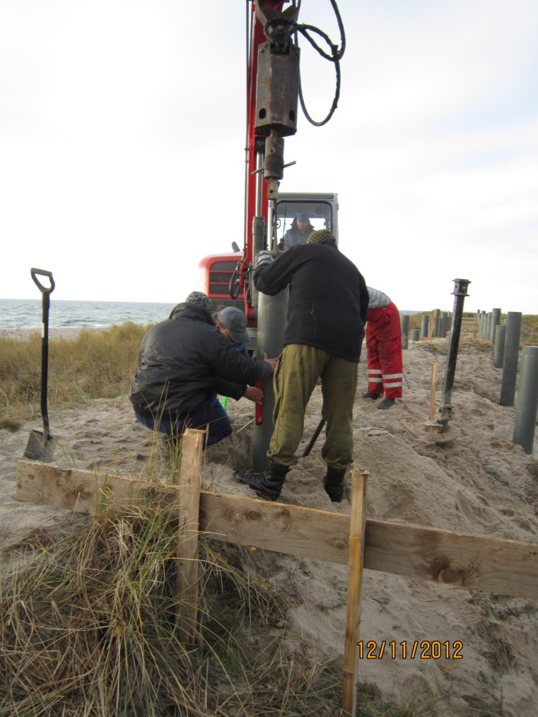
Execution of costal protection at the area of Hel Headland with the associated infrastructure and terrain adaptation
Realization Photos
NOVEMBER 2012

Slide 23
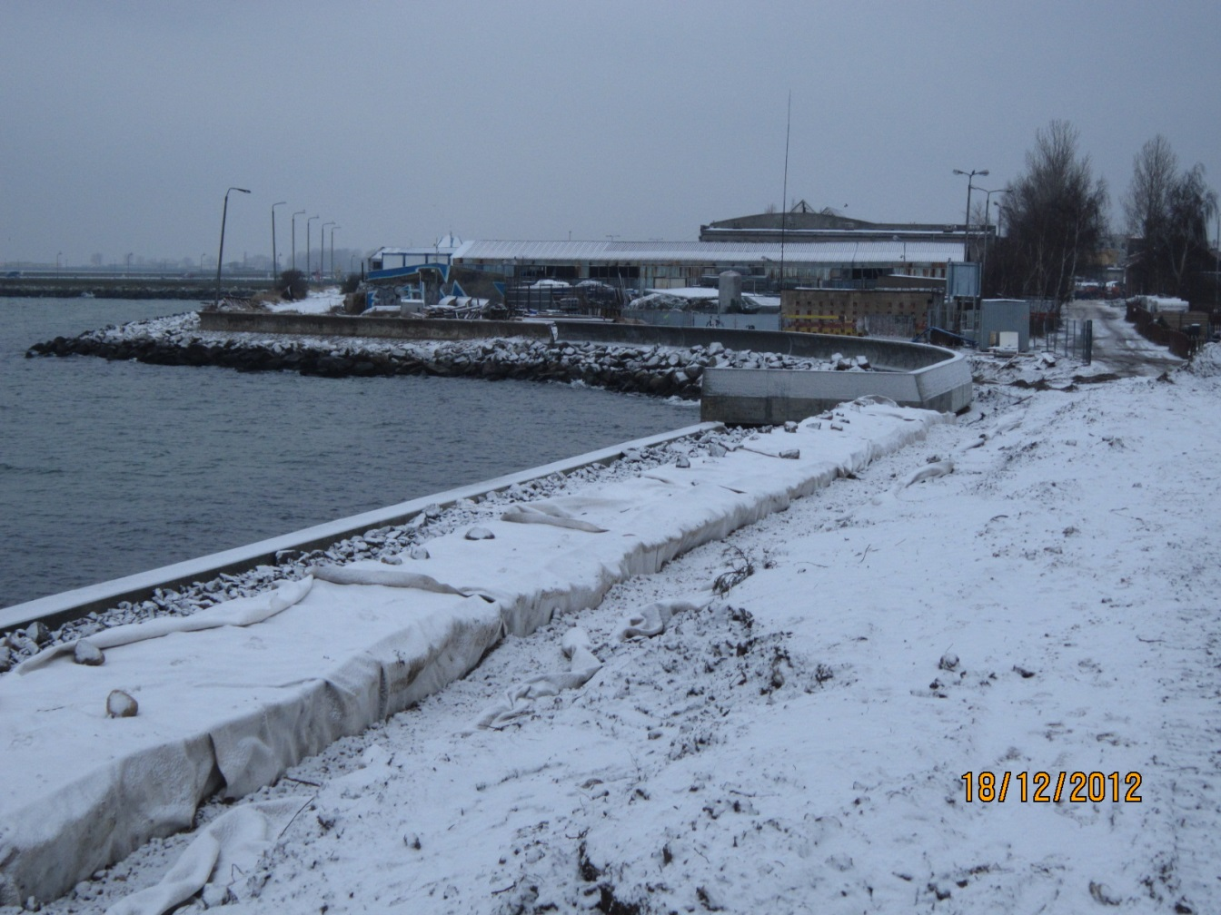
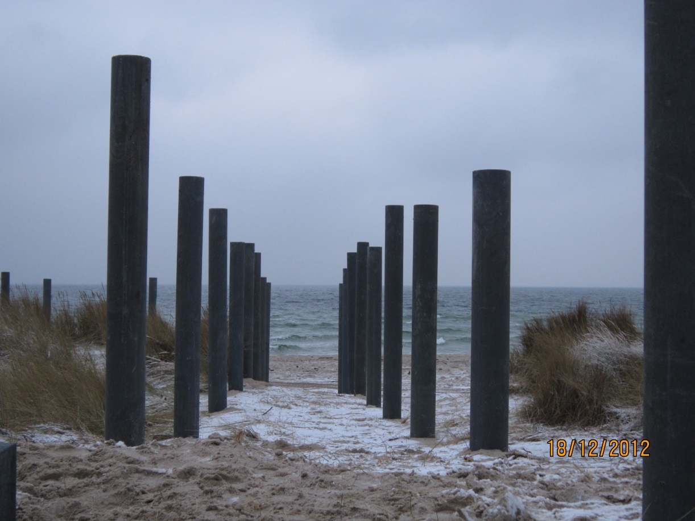
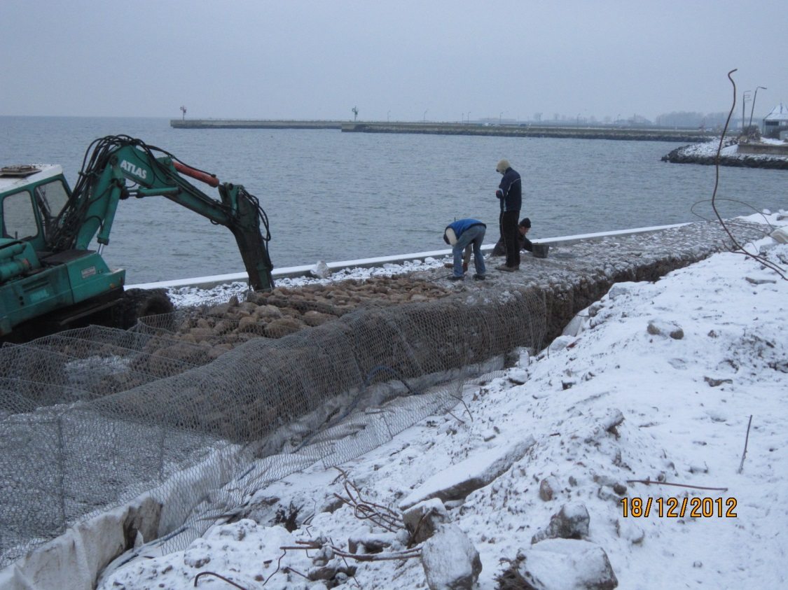
Execution of costal protection at the area of Hel Headland with the associated infrastructure and terrain adaptation
Realization Photos
DECEMBER 2012

Slide 24
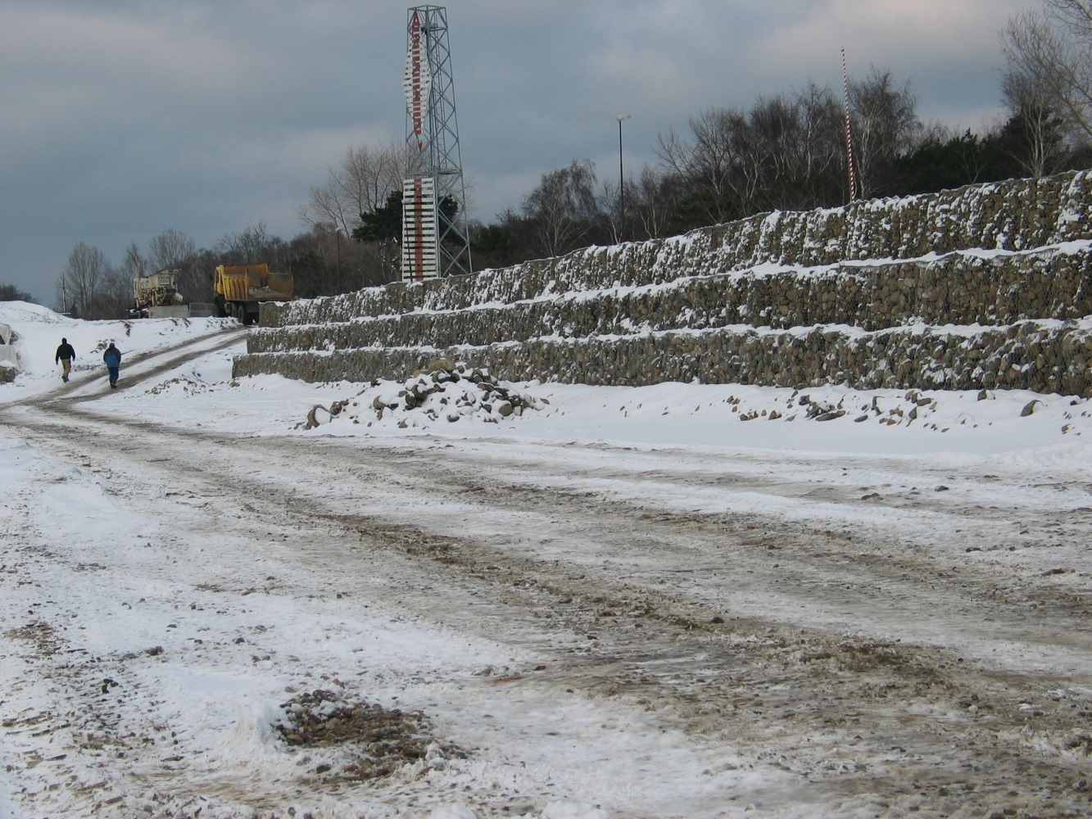
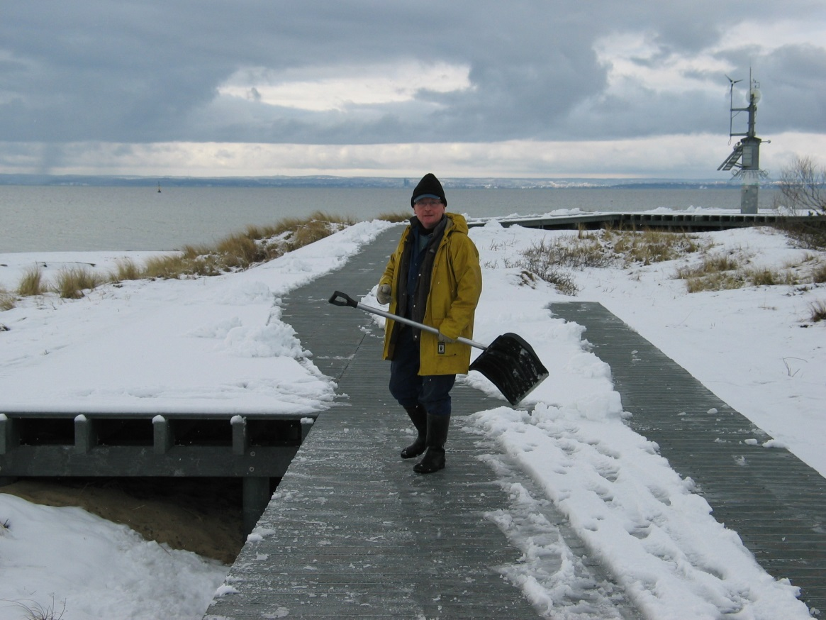
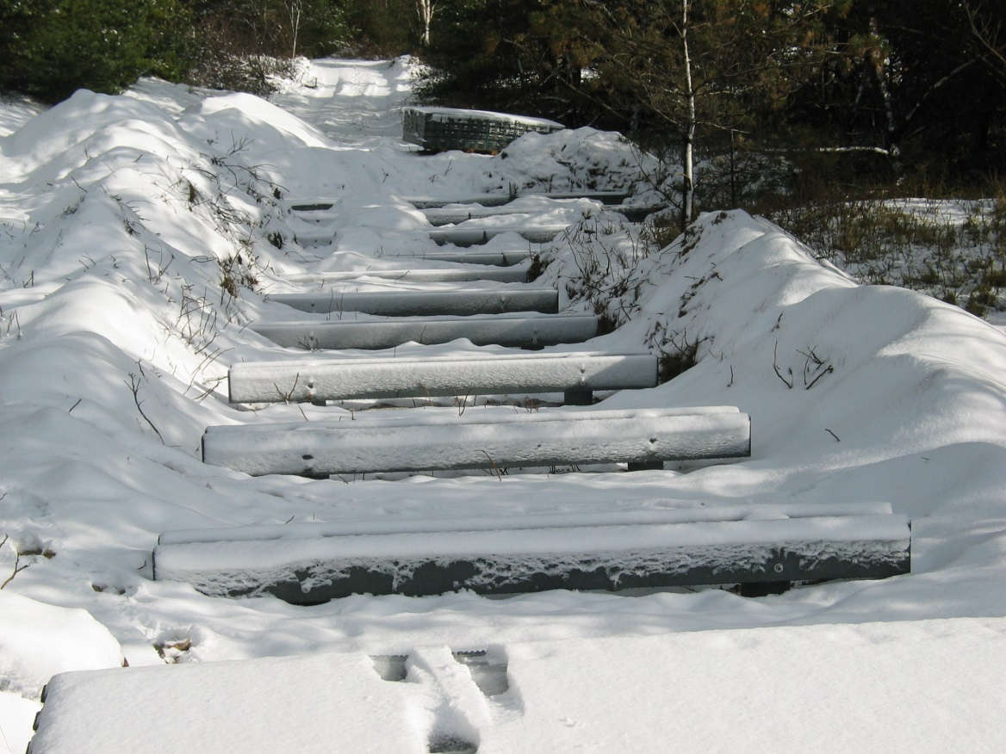
Execution of costal protection at the area of Hel Headland with the associated infrastructure and terrain adaptation
Realization Photos
JANUARY 2013

Slide 25
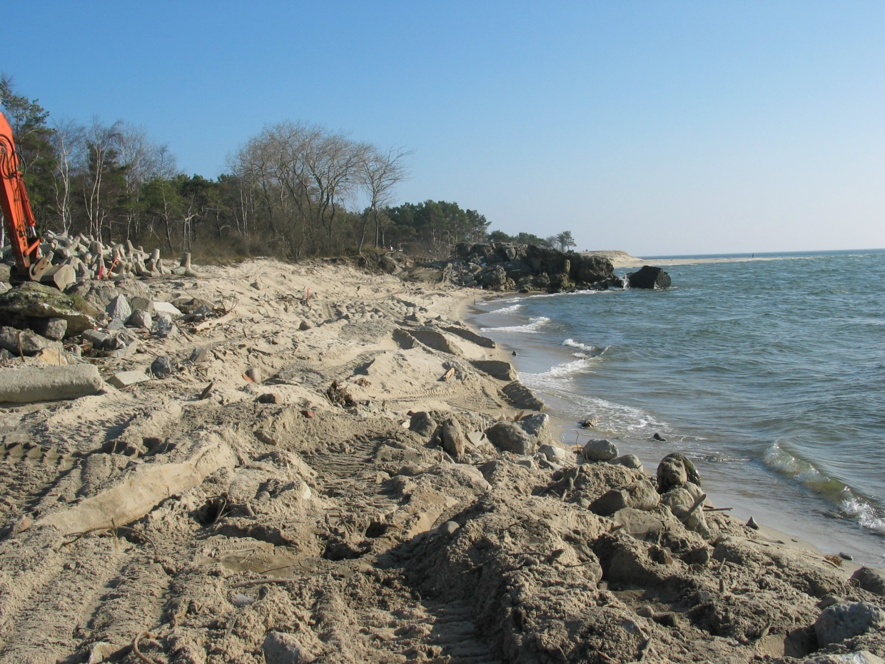
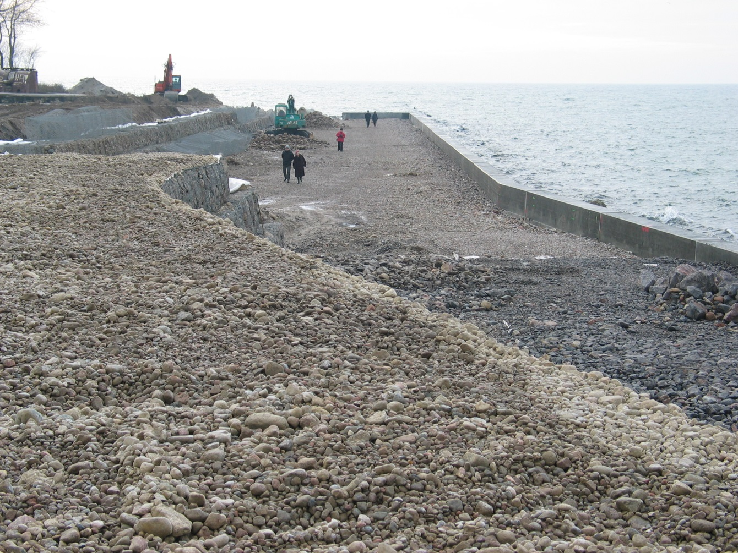
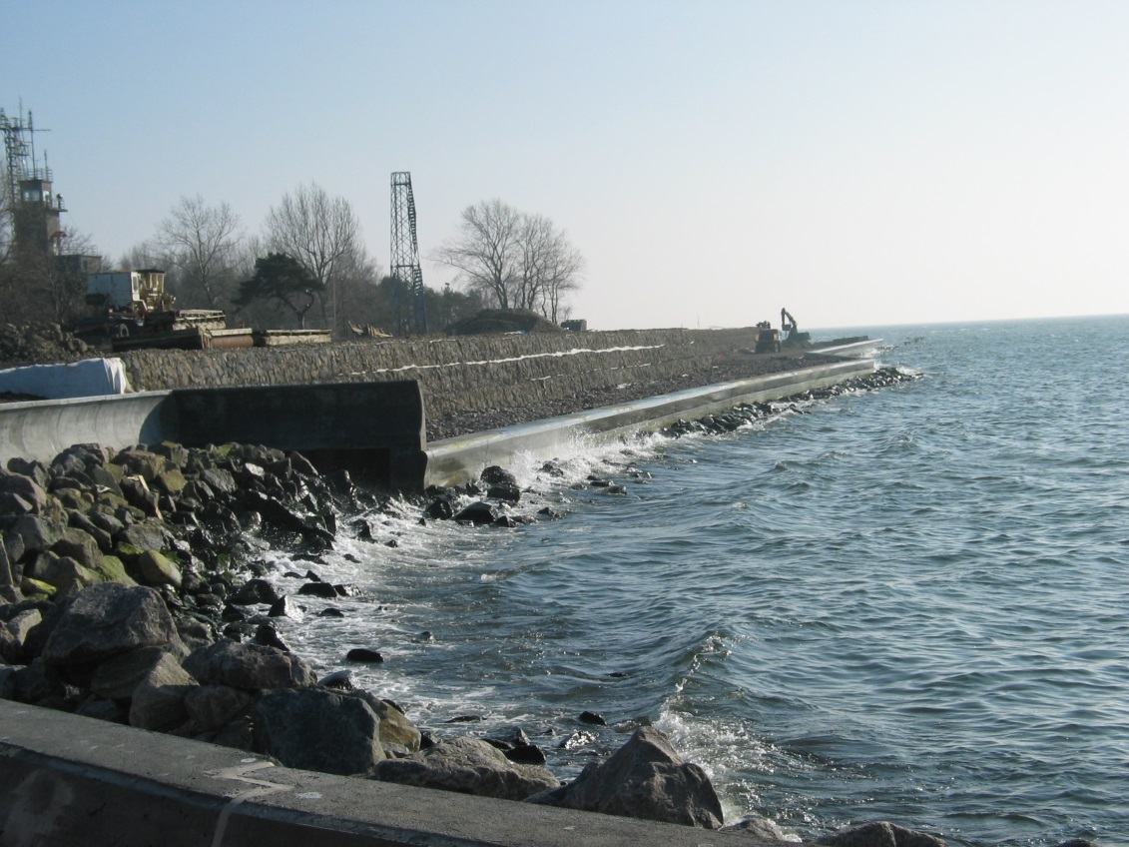
Execution of costal protection at the area of Hel Headland with the associated infrastructure and terrain adaptation
Realization Photos
FEBRUARY 2013

Slide 26
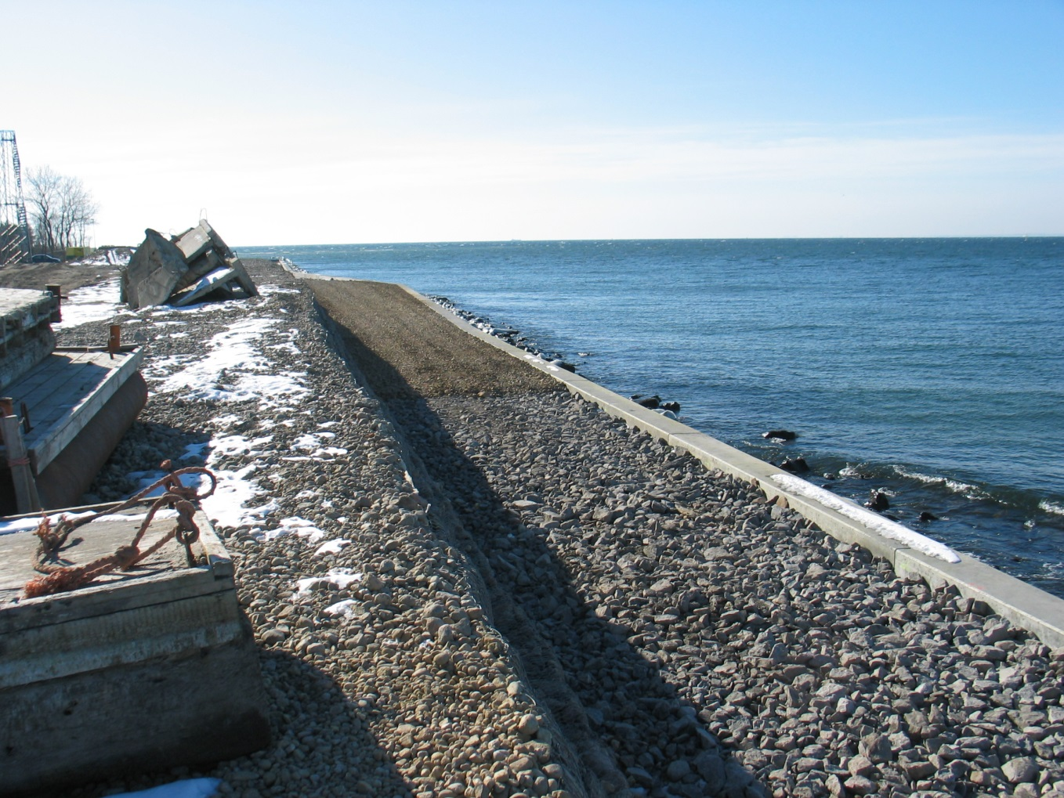
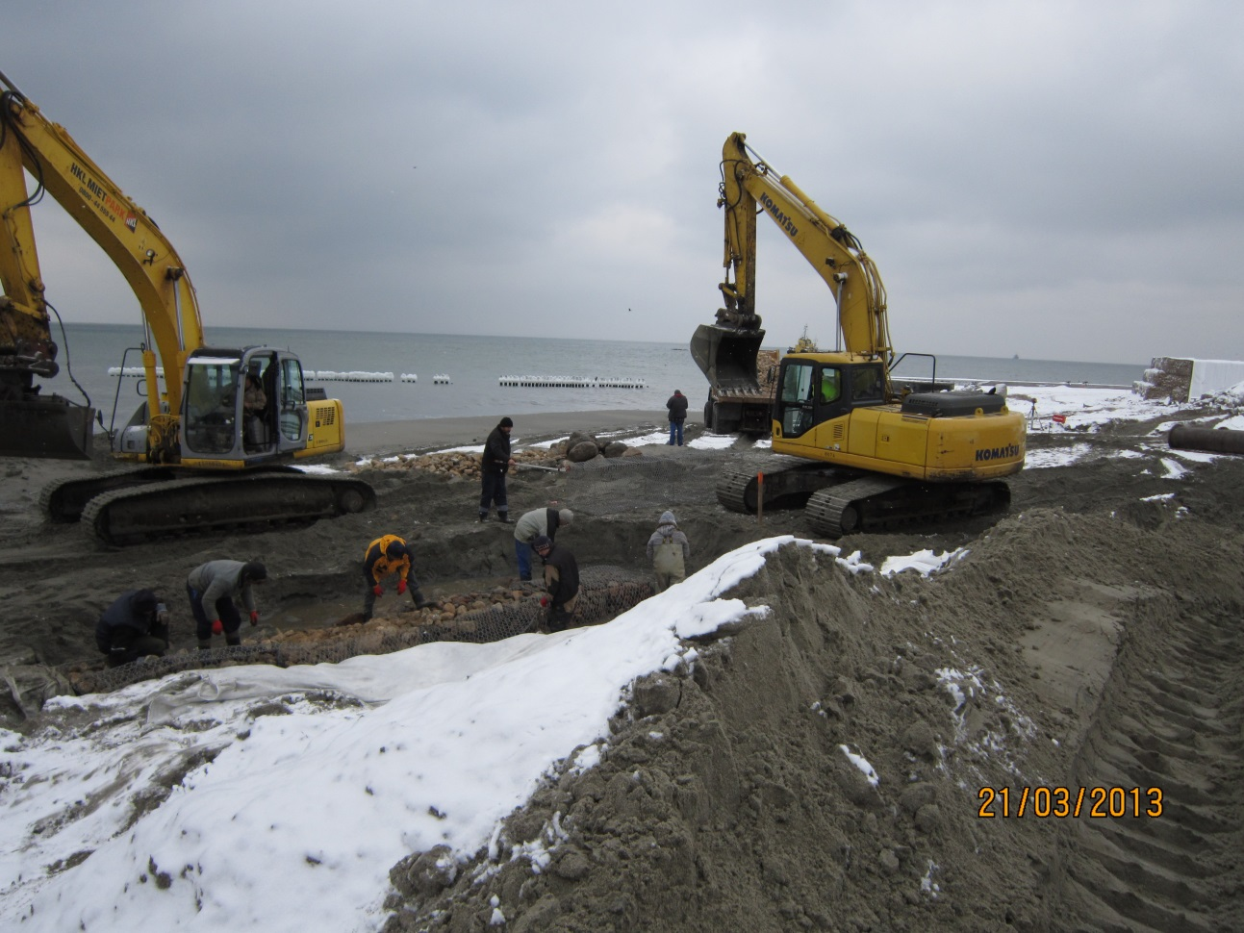
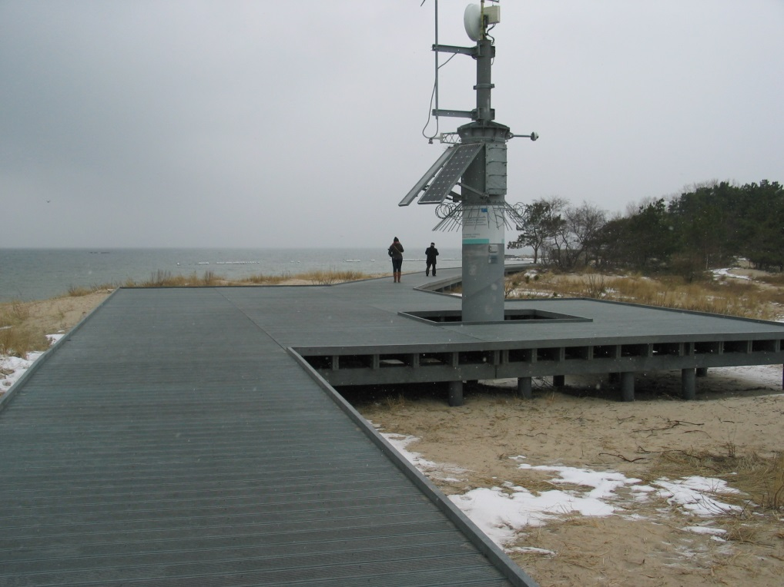
Execution of costal protection at the area of Hel Headland with the associated infrastructure and terrain adaptation
Realization Photos
MARCH 2013

Slide 27
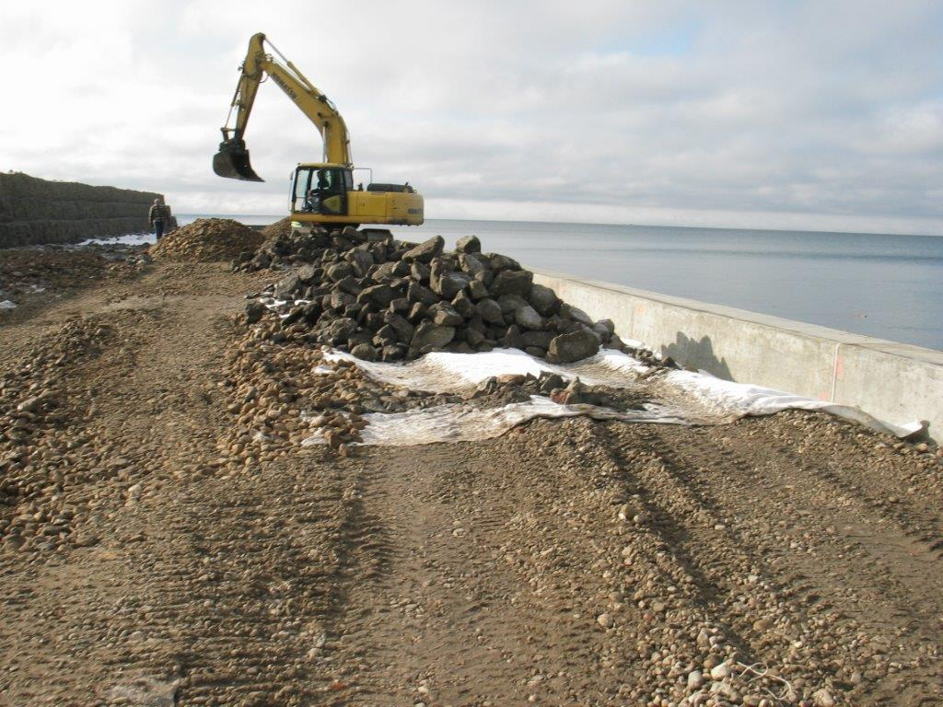
Execution of costal protection at the area of Hel Headland with the associated infrastructure and terrain adaptation
Realization Photos
APRIL 2013

Slide 28
Execution of costal protection at the area of Hel Headland with the associated infrastructure and terrain adaptation
Realization Photos
MAY 2013

Slide 29
Execution of costal protection at the area of Hel Headland with the associated infrastructure and terrain adaptation
Realization Photos
JUNE 2013

Slide 30
Execution of costal protection at the area of Hel Headland with the associated infrastructure and terrain adaptation
FINISH
JUNE 2013

