Slide 1
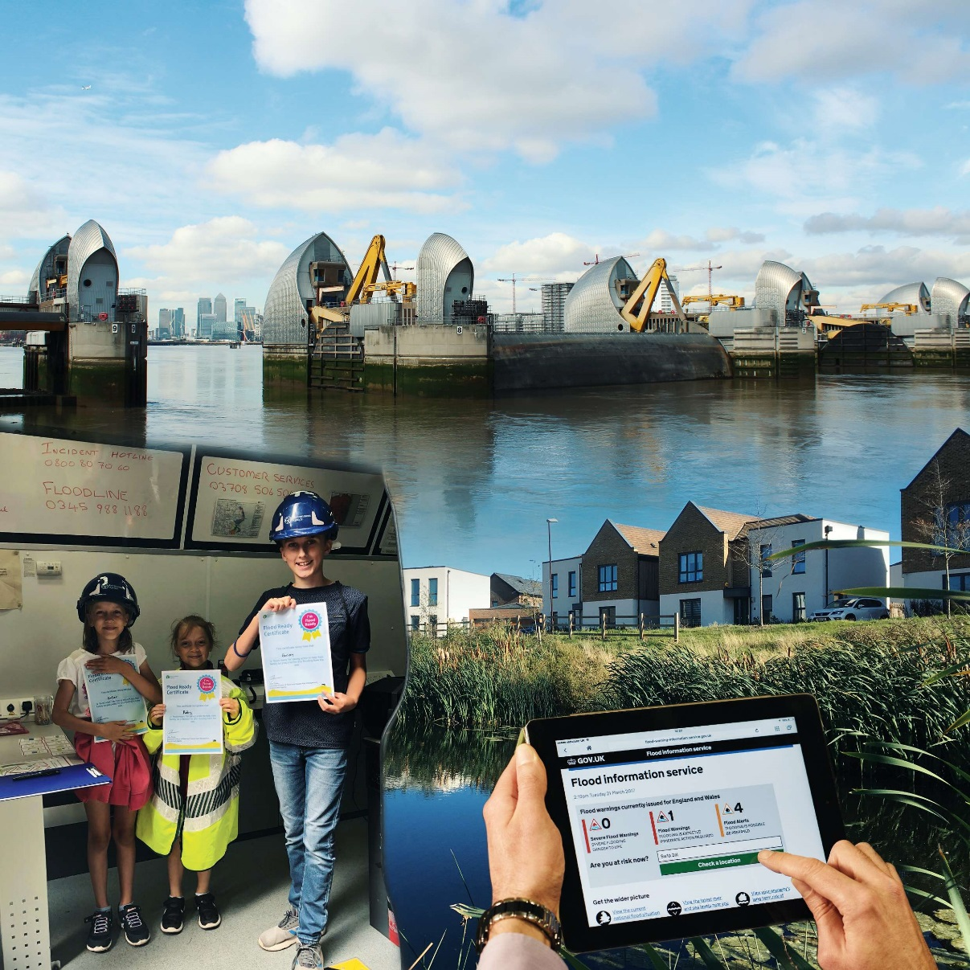
Consultation on draft National FCERM Strategy
Notes:
This slide pack has been designed to help you run a session with colleagues / your networks about the draft FCERM strategy and the questions being asked within the consultation document.
Depending on how long you have and where you want to focus your discussion, please feel free to delete any slides that you don’t need to use.

Slide 2
What we hope to achieve:
Understand:
  The evidence and opportunity, and what the strategy will offer
  How the draft strategy has been developed
  What the consultation is about
  How to respond to the consultation
  How and when the final strategy will be produced
Discuss our views on the consultation
3. Agree how we want to respond to the consultation
A nation ready for, and resilient to, flooding and coastal change
Notes:
This slide sets out some possible objectives, but please amend them if needed to suit your session.
There are 2 main ways to use this slide pack – either as a short briefing (15-30 mins) for people to then go away and respond to the consultation afterwards, or as a briefing plus a discussion session / workshop to gather responses to the consultation in the session. If it is just a briefing session then objective 2 can be deleted. If you are planning a more interactive session to gather ideas and comments on the draft strategy it could be useful to have circulated the draft strategy and the consultation document in advance or printed them out for use during the session.
A more interactive workshop approach could be run over a few sessions, looking at different questions and parts of the strategy each time, or perhaps a half or whole day workshop. The links to the draft strategy, supporting information and the consultation document are provided on slide 13.

Slide 3
The evidence and opportunity
Climate change - the biggest risk we face, already causing more frequent, intense flooding and sea level rise.
What the strategy will offer
A new long-term approach - to improve the resilience of the nation, setting out national ambitions for England that work for every place.
A nation ready for, and resilient to, flooding and coastal change
Notes:
Slide shows the evidence and how the draft strategy offers a long term approach to create a climate resilient nation.
Climate change is the biggest risk we face – the most recent climate change predictions confirm we will experience wetter winters and drier summers, with an increased likelihood of more intense rainfall leading to flooding. (see infographic to pick out key evidence)
We need to move the nation from a concept of protection to one of resilience – traditional flood and sea defences will remain vitally important but we cannot build our way out of future climate risks in many places. In different places we will need a range of tools which enable us to prepare for, respond to and recover from flooding and coastal change.
Our draft strategy sets out a national ambition for England but one that can work for every place. We recognise that every place is different and there is no one size fits all solution to flood and coastal resilience. The only way of doing this is to put people at the heart of decision making.

Slide 4
Developing the draft strategy
Current strategy published in 2011
During 2018, the Environment Agency worked in collaboration with 90 organisations to develop a new strategy
Now want wider input as part of this consultation
A nation ready for, and resilient to, flooding and coastal change
Notes:
Additional notes on what has happened since 2011
The Flood and Water Management Act 2010 requires the Environment Agency to “develop, maintain, apply and monitor a strategy for flood and coastal erosion risk management in England (a “national flood and coastal erosion risk management strategy”)”
Much has changed since then. including significant events such as the 2013 east coastal tidal surge, the 2013 to 2014 winter flooding in the south of England and the 2015 to 2016 winter flooding in the north of England.
There’s growing evidence of the impact of climate change from the UK Climate Change Risk Assessment 2017 and the updated 2018 UK Climate Impacts Projections.
There have been record levels of investment in the management of flooding and coastal change, with £2.6 billion of government funding going towards better protecting 300,000 homes between 2015 and 2021.
The 25 Year Environment Plan has highlighted the need to review the existing strategy.
This is an 8 week consultation.
Additional notes on the collaboration in 2018:
Over 150 people were involved from 90 organisations. These included public, private and voluntary sector organisations
An Advisory Group was set up and continues to oversee and steer the work.
5 Working Groups were set up based on different themes:
Ambition
Water at the heart of decision making
Protection and Funding
Communities and businesses
Roles and Responsibilities
The Environment Agency is very keen to hear the views of a wide range of organisations, community groups and individuals in response to the questions asked in the consultation document.

Slide 5
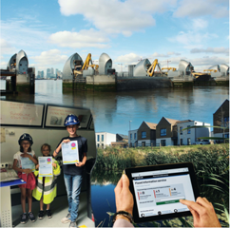
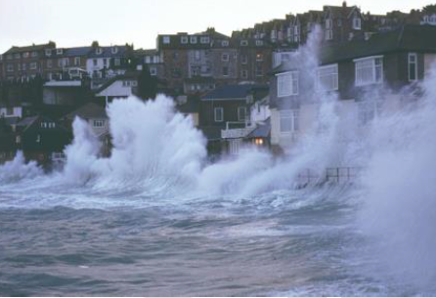
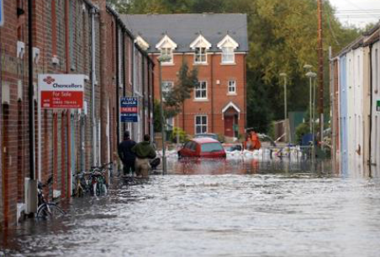
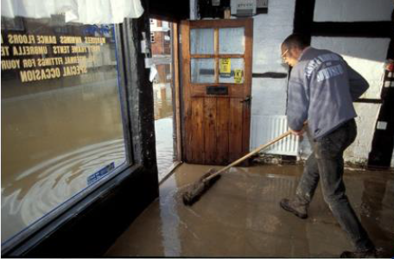
Key documents
Consultation Document
Draft Strategy
Strategic Environmental Assessment
A nation ready for, and resilient to, flooding and coastal change
Notes:
There are three key documents that form the public consultation:
The consultation document - which has specific questions within it.
This should be read alongside the Draft FCERM Strategy.
And a Strategic Environmental Assessment (SEA) Environmental Report.
An Evidence base document will be available shorty after the launch, for information. This was used to inform the discussions during the development phase of the strategy, which is available on request from FCERMstrategy@environment-agency.gov.uk

Slide 6
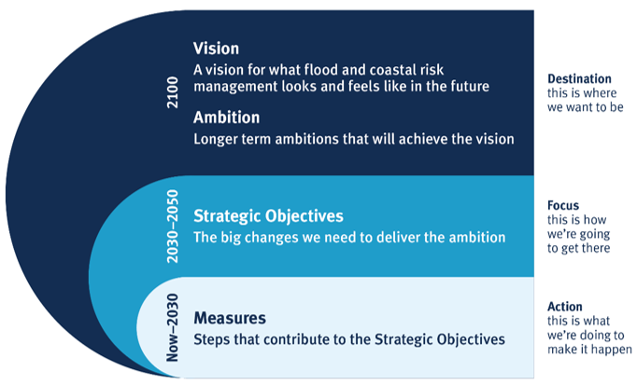
Strategy elements and structure
A nation ready for, and resilient to, flooding and coastal change
Notes:
This slide helps explain the overall structure of the draft strategy
The strategy is based on a hierarchy:
Vision and Ambitions – describes the destination of where we want to be by 2100
Strategic Objectives – describes how we’re going to get there 2030 -2050
Measures – now -2030 what we’re doing to make it happen

Slide 7
Consultation questions - structure
To what extent do you agree with the vision?
To what extent do you agree with the Environment Agency’s proposed strategic overview role?
For each Strategic Objective:
  To what extent do you agree with strategic objective x?
  Please provide comments on the measures described under strategic objective x and tell us about any additional measures you think there should be, and who could implement them.
Please provide any other comments.
A nation ready for, and resilient to, flooding and coastal change
Notes:
This slide provides a brief overview of the consultation questions.
These are based on the way in which the draft strategy is structured i.e. Vision, strategic objectives and measures, with an additional specific question to explore the Environment Agency’s proposed strategic overview role.
There are also consultations questions on the Strategic Environmental Assessment (SEA)

Slide 8
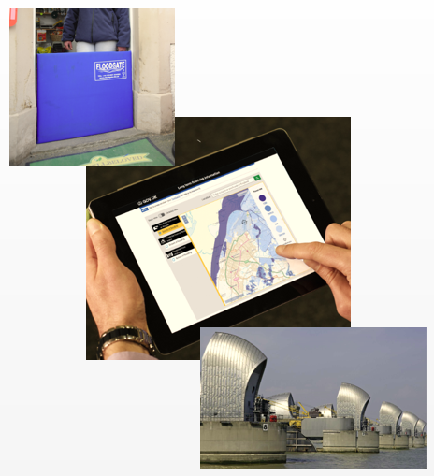
The overall vision is….
… a nation ready for, and resilient to, flooding and coastal change – today, tomorrow and to the year 2100.
A nation ready for, and resilient to, flooding and coastal change
Notes:
The next five slides can be used to explain the vision, ambitions and strategic objectives in more detail and can be used to prompt discussion in response to the consultation questions.

Slide 9



Strategy ambitions
Climate resilient places
Today’s growth and infrastructure resilient in tomorrow’s climate
A nation of climate champions
A nation ready for, and resilient to, flooding and coastal change
Notes:
Our draft Flood and Coastal Erosion Risk Management Strategy has three long term ambitions:
Climate resilient places
Working with partners to explore and develop the concept of standards for flood and coastal resilience as well as a national suite of tools that can be used to deliver flood and coastal resilience in places.
Today’s growth and infrastructure resilient in tomorrow’s climate
Getting the right kind of development in the right places to deliver sustainable growth and working with partners and other agencies to enable infrastructure resilient to flooding and coastal change.
A nation of climate champions
Better preparing society through education and accessible digital information as well as being a world leader in flood and coastal resilience.

Slide 10
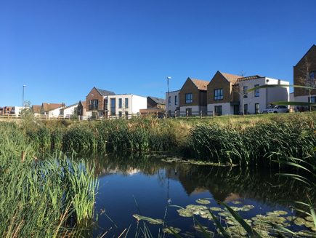
Climate resilient places
Working with partners to explore and develop the concept of standards for flood and coastal resilience as well as a national suite of tools to deliver flood and coastal resilience in places.
A nation ready for, and resilient to, flooding and coastal change
Notes:
Our key messages on this theme are:
We would like to work with risk management authorities and other partners to explore and develop the concept of standards for flood and coastal resilience, and will consider the pros and cons of all options. This will feed into the government’s flood policy statement in 2019.
Flooding and coastal change is not static but constantly changing. It requires an iterative and dynamic approach for places that can be reviewed over time in response to changing risks. Looking out to 2100, we will need to help places plan and adapt to flooding and coastal change across a range of climate futures.
People in every place need to be able to identify the decisions for managing flooding and coastal change that need to be taken now and those which can be made in the future. This will mean government, the Environment Agency and risk management authorities need to be agile to the latest climate science, growth projections, investment opportunities
It is not possible to separate the management of our natural environment from the way we manage and reduce risk of flooding and coastal change. Our natural environment goes through periods of both flood and drought – so we should be looking at adaptive approaches that support them both for the benefit of people and wildlife.
Our draft strategy encourages all those involved in managing water – from risk management authorities, water companies, farmers and landowners – to embrace and embed adaptive approaches to enhance the resilience of our environment to future flooding and drought.

Slide 11
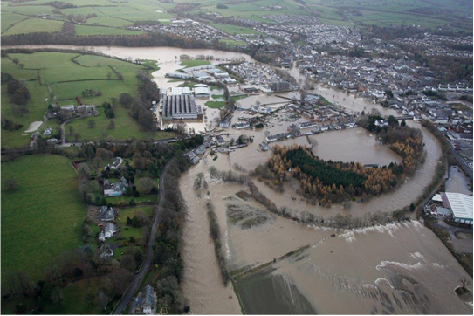
Today’s growth and infrastructure resilient in tomorrow’s climate
Getting the right kind of development in the right places to deliver sustainable growth and work with partners and other agencies to enable infrastructure resilient to flooding and coastal change.
A nation ready for, and resilient to, flooding and coastal change
Notes:
Our key messages on this theme are:
Our draft strategy sets out a long-term ambition for ourselves and risk management authorities to ensure infrastructure is resilient to flooding and coastal change, working with others as needed.
As the population grows, we are likely to see the number of properties built on the flood plain almost double over the next 50 years. We must ensure that all new development is resilient to flooding and protects and enhances the environment - making sure that we have the right property and businesses in the right locations, i.e. the decisions we make now will be sustainable in the future.
We and other risk management authorities have a key role to play in engaging and advising developers and planners to get the right kind of sustainable growth in the right places.
Our draft strategy identifies further ways in which flood and coastal investments can better contribute to local economic regeneration and sustainable growth.
We will work with government, insurers and financial institutions to review the legal, policy and behavioural changes needed to 'build back better and in better places' and improve the resilience of homes and businesses.
In some cases, the scale of flooding or coastal change may be so significant the concept of ‘build back better’ may not be appropriate, as recovery back to the same place is not the best long term solution in the decades to come. For example, coastal authorities can identify through coastal change management areas where to build back better and in better places. Over a period of time, it may be better to support communities to relocate out of harm’s way.

Slide 12
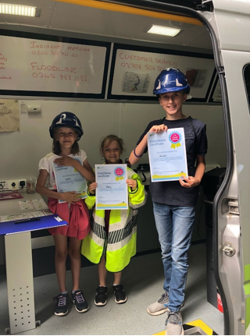
A nation of climate champions
Better preparing society through education and accessible digital information as well as being a world leader in flood and coastal resilience
A nation ready for, and resilient to, flooding and coastal change
Notes:
Our key messages on this theme are:
We need to build a nation of climate champions who understand their risk, are responsible for it and know how to act on it.
We need to inspire people to take action before flooding or coastal change happens. We will do this by educating young people about the risks through the school curriculum and by helping people to understand what action to take and which services they can expect from public bodies.
We already have a world class flood forecasting service. It provides people, businesses and the emergency services with information to help them prepare for a flood. 1.4 million properties are signed up to our free flood warnings. We will continue to develop accessible digital tools to better communicate flooding and increase awareness of the risks people face.
Our draft strategy aims to continue to better join up the organisations involved in providing incident response and recovery to provide a consistent and coordinated service.
We want to ensure that people have the knowledge to deal with the increased risks they are likely to face, in doing this we believe they will be able to take responsibility to help manage their own risks.
We want our nation to be recognised as a world leader in managing flooding and coastal change. We will actively develop the skills and talent we need to create resilient places.

Slide 13
Responding to the consultation
Please respond online at:
https://consult.environment-agency.gov.uk/fcrm/national-strategy-public
All supporting documents can be found on this web page
Deadline for responses: 4th July 2019
A nation ready for, and resilient to, flooding and coastal change
Notes:
This slide contains the link to the online consultation.
Please encourage people to respond to us using the online consultation tool at the link on this slide.
Other options for responding are:
Emailing, or posting a hard copy of, your responses, using the downloadable response form (also found on the same web link). These response options are set out in more detail in the consultation document.
If you are planning to run a session or workshop to collectively respond to the consultation you may want to gather comments and opinion from your group and then formally submit your response on line after the discussion. The downloadable response form would provide a good template for you to gather in responses.
Responses can be submitted on line from an individual or on behalf of a group or sector.
Please remind people to respond by 4th July, or earlier if they can.

Slide 14
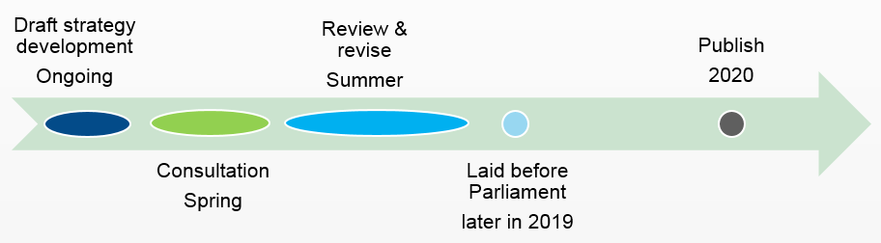
Strategy timetable
A nation ready for, and resilient to, flooding and coastal change
Notes:
The Environment Agency will review the consultation responses and revise the document over the summer of 2019
The final draft strategy needs to be laid before Parliament, and approved by the Secretary of State. This is planned for later in 2019
The final strategy is scheduled to be published in 2020

Slide 15

Thank you
A nation ready for, and resilient to, flooding and coastal change
Notes:
If you have any queries and would like to contact the Environment Agency’s strategy team, please email: FCERMstrategy@environment-agency.gov.uk

