Slide 1



Maintaining the primary flood defence system of the Netherlands

Slide 2
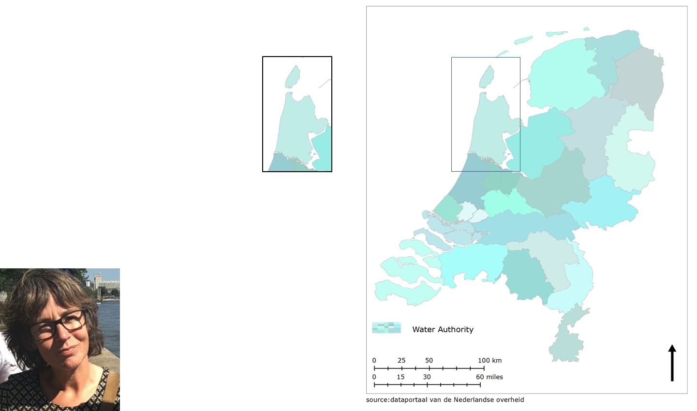
Introduction
Hoogheemraadschap Hollands Noorderkwartier
Marjan Duiveman

Slide 3
The primary flood defence system
The primairy flood defence system in the Netherlands
Maintaining the primary flood defence system:
  Three levels of government :
    National government
    Regional government (province)
    Local government (municipality)
  Water Authority
Two examples
      Dunes
      Dykes

Slide 4
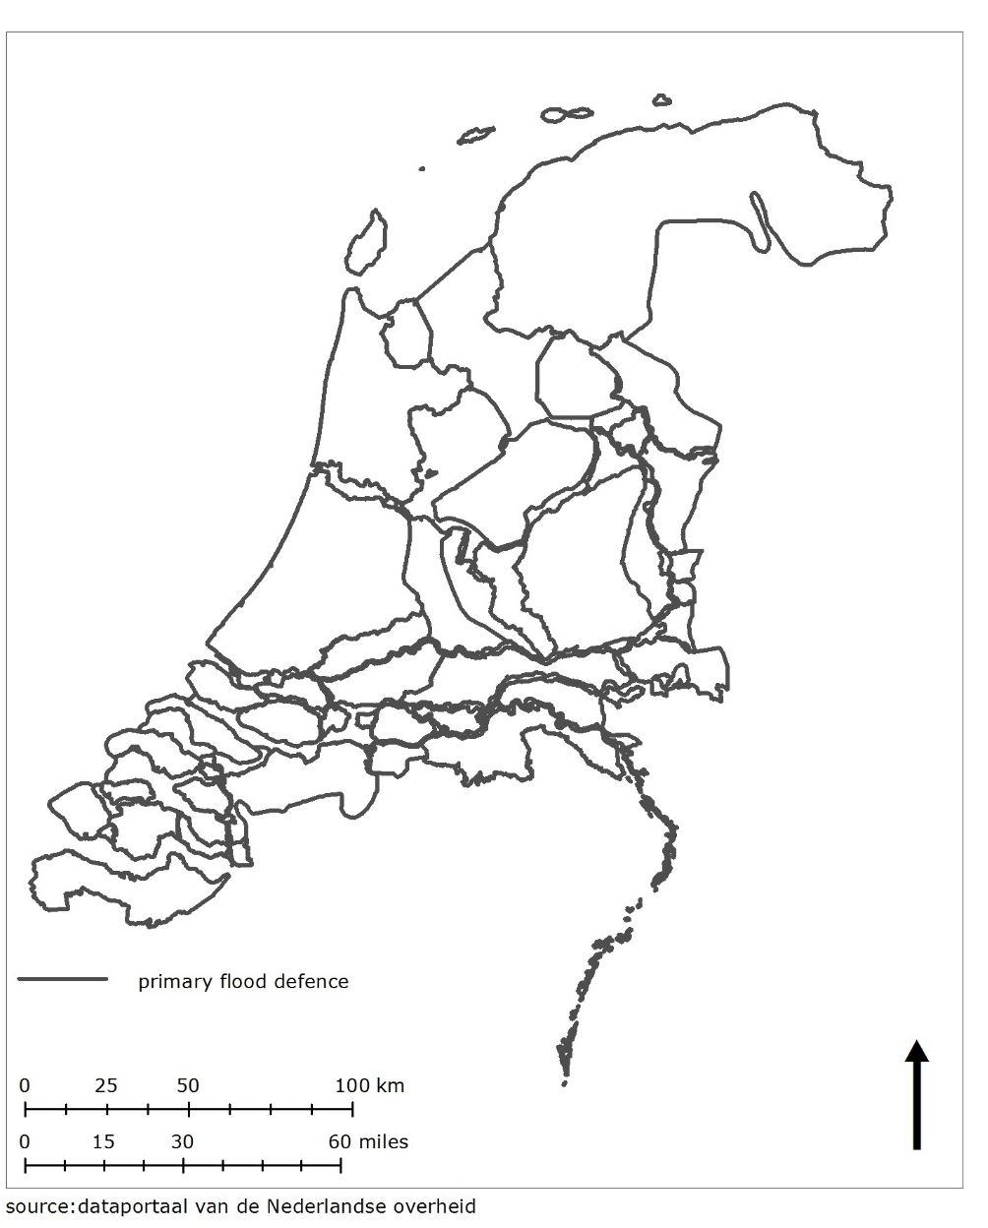
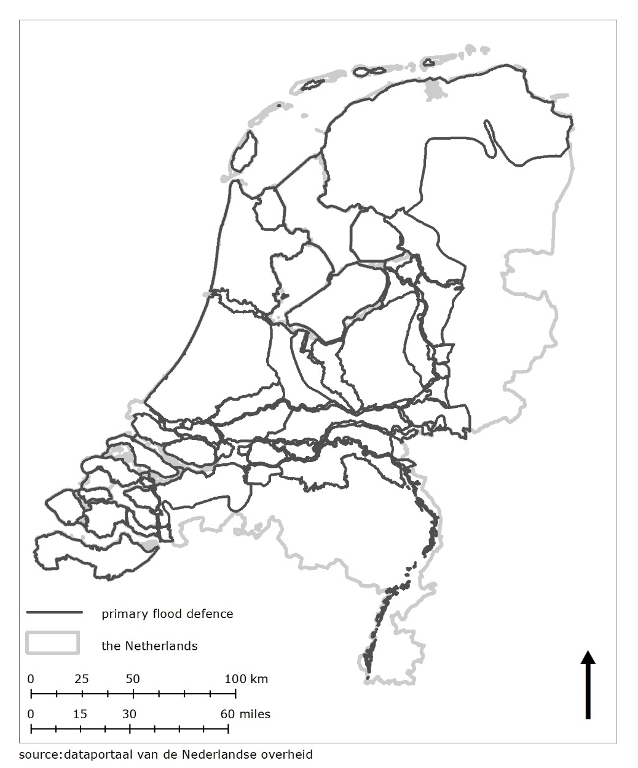
The primary flood defence system

Slide 5
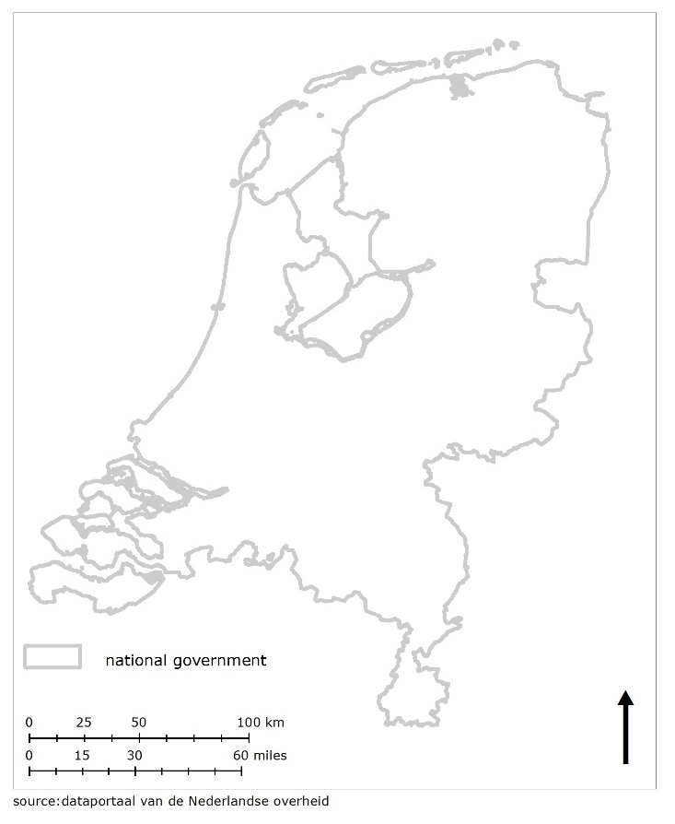
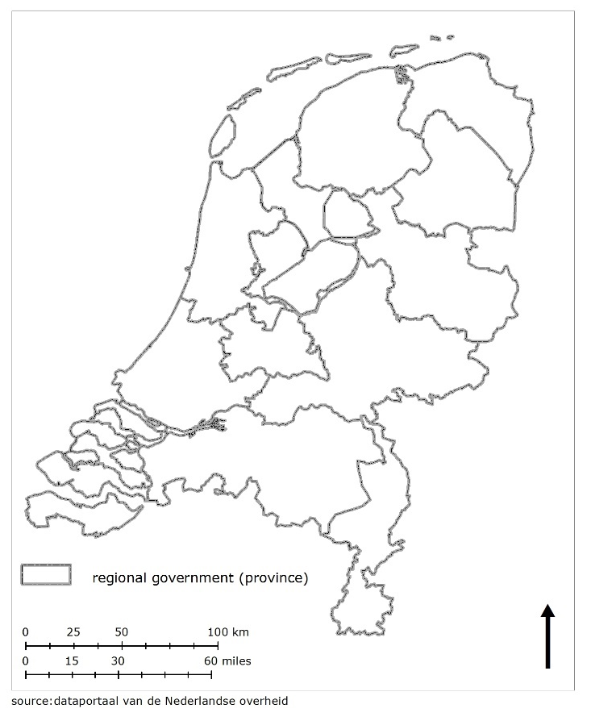
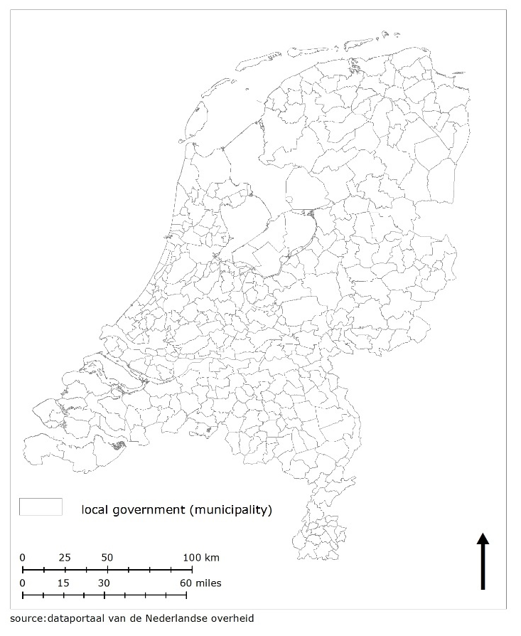
Three levels of government
national province municipality

Slide 6
National government
Role of national government in maintaining the primary flood defence system
Two acts of parliament:
  Water Act (2009)
    Administrator
      Map with areas of regulation
      Register the objects for management and maintenance
      Report the status of the water defence every 12 year.
  Spatial planning Act (2006)
    Structural vision
    Objects of national importance

Slide 7
Regional government (province)
Role of regional government in maintaining the primary flood defence system
Spatial planning Act
  Structural vision
    objects of national importance

Slide 8
Local government (municipality)
Role of local government in maintaining the primary flood defence system
Spatial planning Act
  Structural vision
    With the objects of national importance
  Zone planning (protected by law)
    Map
      with land use zones
        e.g. flood defence system zone
        e.g. agricultural zone
    Regulation.
      on each zones

Slide 9
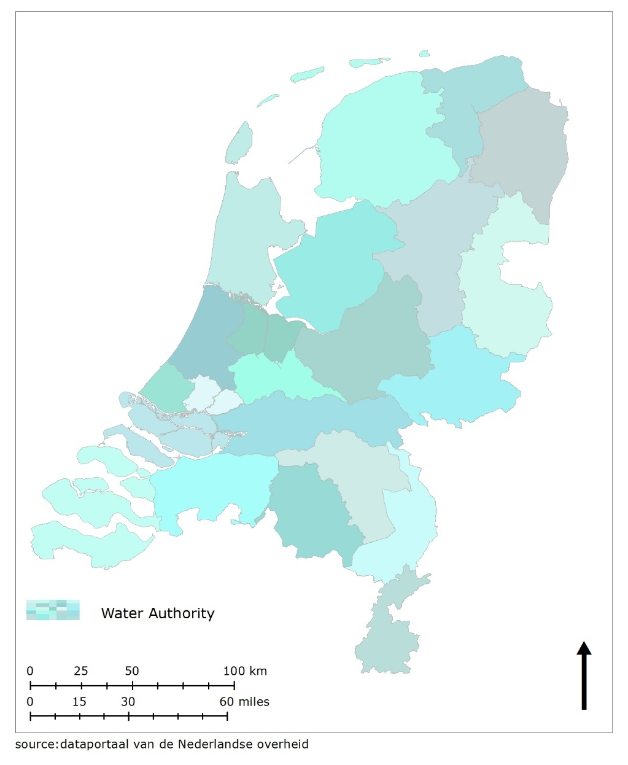
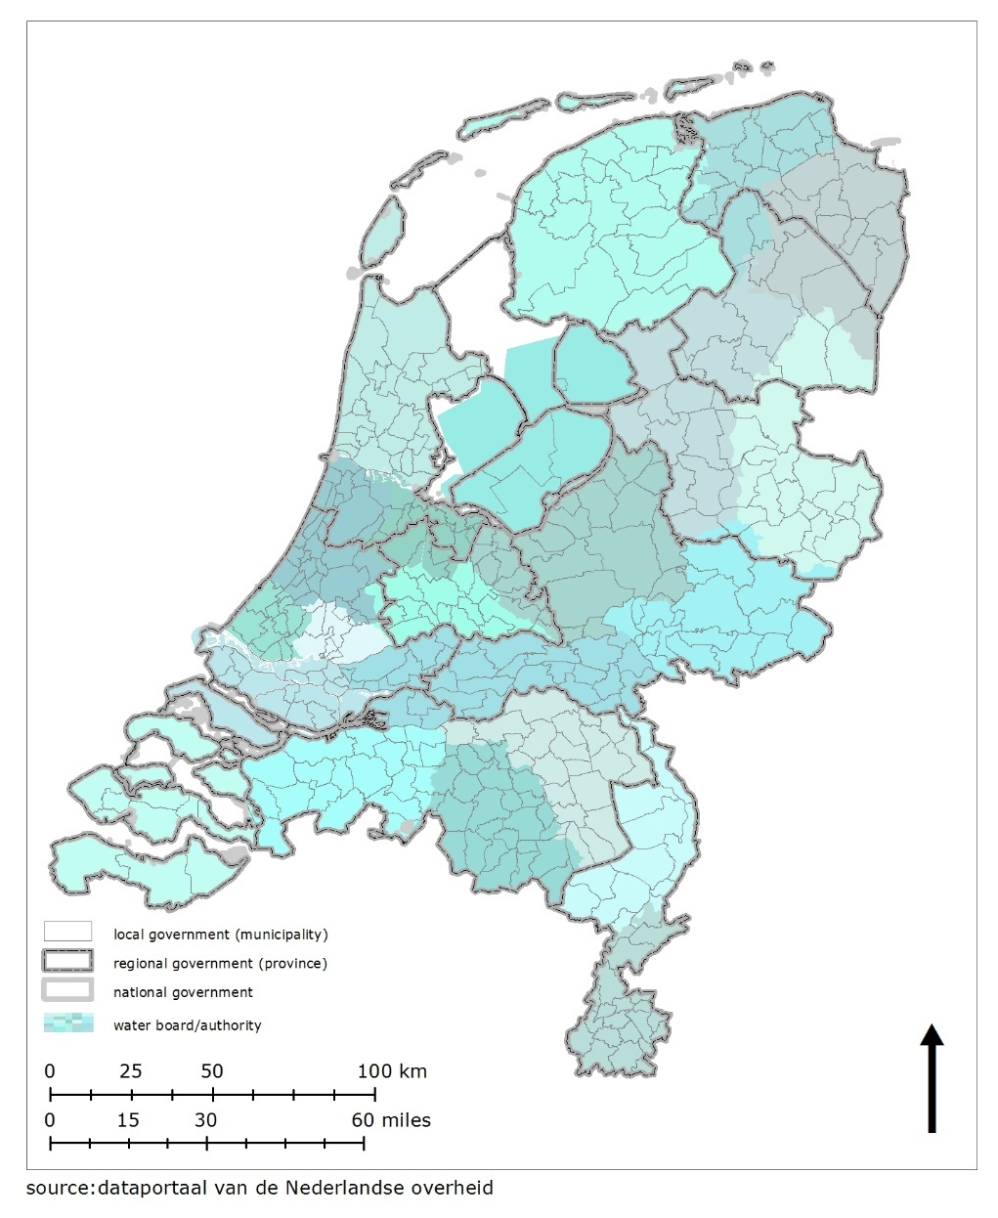
Water Authority

Slide 10
Water Authority
Water Act (2009)
  Administrator provides:
    Mapping areas of regulation
    Registration of objects for management and maintenance
    Reporting of the status of the water defence
Spatial planning Act (2006)
  Administrator provides:
    Map with areas of regulation
      A regional structural vision
      A local structural vision
      Zone planning

Slide 11
Area of regulation
Protect the water defence
Permit
  Development will be tested to regulation set up by the Water Authority and the policy of the Water Authority
Four zones
  Water defence
  Protection zone A and B
  Area needed for the future
    Dykes 100 years
    Dunes 200 years (= protection zone A)
Zones are defined differently for dunes and dykes

Slide 12
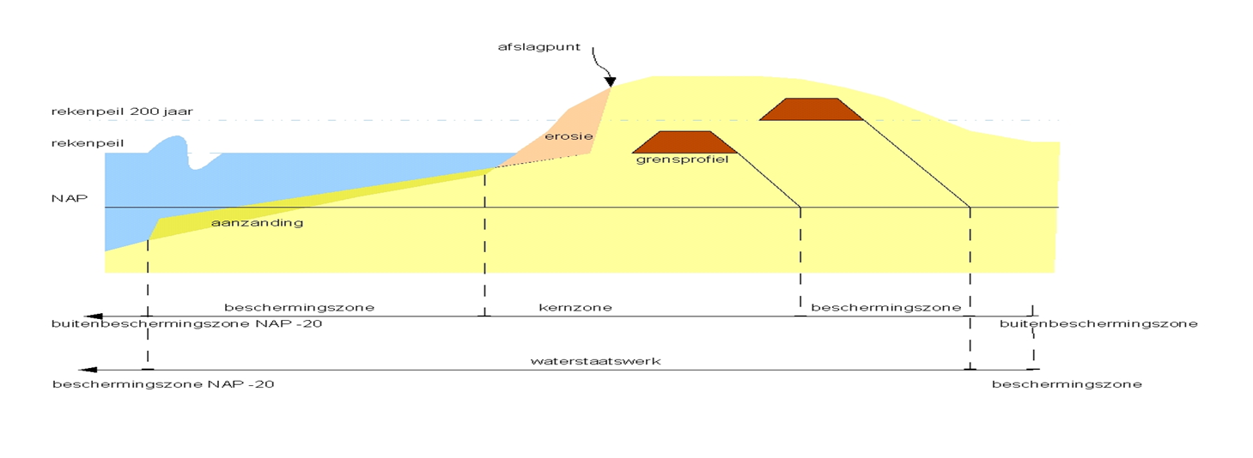
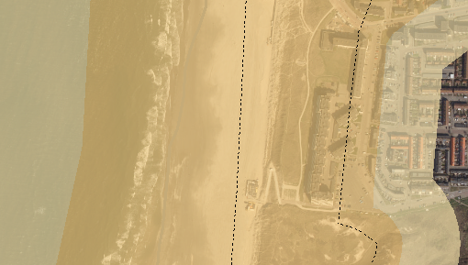
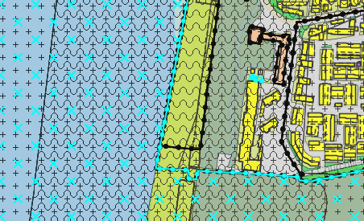
Area of regulation dunes
Defining areas of regulation
Zone protection B
Zone protection A
Zone protection B
Zone protection A
Water defence
Areas of regulation (Legger)
Zone planning

Slide 13
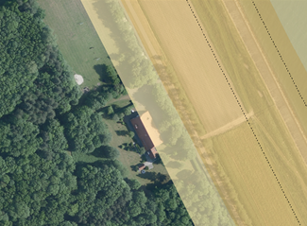
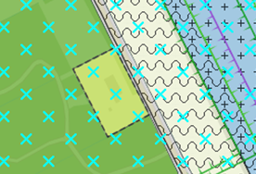
Area of regulation dykes
Defining areas of regulation
Zone protection B
Zone
protection
A
Zone protection A
Zone protection B
Water defence
Areas of regulation (Legger)
Zone planning

Slide 14
The primary flood defence system in the Netherlands
The geography of the Netherlands
The primary flood defence system of the Netherlands set in Law
  Water Act
  Spatial planning Act
Overseen by National Government.
Important to maintain the primary flood defence system

