Slide 1
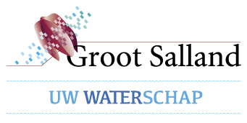



Slide 2

KRING meeting
28-30 September 2015

Slide 3
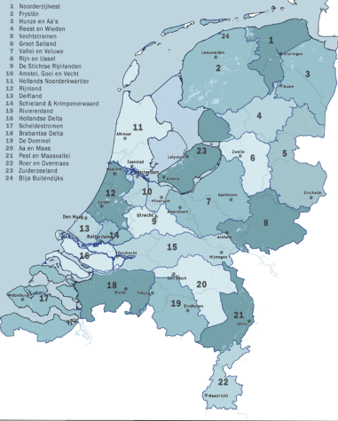

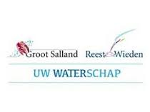
The 24 water boards in the Netherlands
Notes:
Dutch water boards (Dutch: waterschappen or hoogheemraadschappen) are regional government bodies charged with managing water barriers, waterways, water levels, water quality and sewage treatment in their respective regions. These regional water authorities are among the oldest forms of local government in the Netherlands, some of them having been founded in the 13th century.
Around 26 percent of the area of the Netherlands is at or below sea level^{[1]} and several branches of the Rhine-Meuse-Scheldt delta run through this relatively small country. Historically there always was a good deal of coastal and river flooding. Flood control in the Netherlands is a national priority, since about two thirds of the country is vulnerable to flooding, while at the same time it is one of the most densely populated countries on Earth. Natural sand dunes and man-made dikes, dams and floodgates provide defense against storm surges from the sea. River dikes prevent flooding of land by the major rivers Rhine and Meuse, while a complicated system of drainage ditches, canals and pumping stations (historically: windmills) keep the low lying parts dry for habitation and agriculture. Water boards are independent local government bodies responsible for maintaining this system.
An Unie van Waterschappen (the association of Dutch regional water authorities, referring to itself as 'Dutch Water Authorities'^{[2]}) promotes the interests of Dutch water boards at a national and international level. 23 of the water boards are members of this association.
Water is of vital importantce. The Netherlands: 34,000 square kilometres where land meets water. Much of this area consists of artificial land created by man. Without dunes and water barriers, more than half of the Netherlands would be under water. The many dykes, locks, pumping stations, flood barriers, canals and ditches keep the Netherlands habitable.
Local and regional water management in the Netherlands is in the hands of Water Boards. Water Boards are decentralised public authorities with legal tasks and a self-supporting financial system. Water Boards are responsible for flood control, water quantity, water quality and treatment of urban wastewater. Operational task include the management of pumping stations, waste water treatment plants, maintenance of waterways and flood defence structures. Water Boards are embedded in the general democratic structures. In 1850 there were about 3500 Water Boards. Mergers soon reduced this number. By 1 January 2009 there were 27 Water Boards.
We ensure that in West-Overijssel there is enough good quality surface water in the right place. We protect the area against high water levels and flooding.
In practice this means we strive for sustainable management of the water system (both ground and surface water) and the water chain (drinking water supplies, sewage, water purification). In addition, we take account of the sometimes conflicting concerns of nature, agriculture and recreation as much as possible.
The Board of the Groot Salland Water Board is democratically elected, with elections held once every four years. The General Board has 25 members. They represent the residents, landowners, house owners, businesses and institutions. The General Board chooses four of its members to form the Executive Board. Both Boards are chaired by the Dike Reeve, who is appointed by the Crown. Approximately 380 people work for Groot Salland. Approximately 360,000 people live in the area under its control and a great many businesses are also established there.
High water The care of the dams that protect the area against high water is our responsibility. The Water Board improves dikes and quaysides in its area.
Clean water One of our other tasks is to prevent pollution of surface water and to deal with contaminated riverbeds. We have nine water purification plants for purifying the wastewater from housing and industry. The Water Board controls discharge from agricultural and industrial companies by means of a permit system. Groot Salland Water Board is not responsible for drinking water. There is a water company in the area that handles that: Vitens.
Sufficient water We ensure goad drainage and supply of surface water to prevent flooding and also to prevent drying out. To do this there is a system of waterways, pumping stations and dams for controlling water levels

Slide 4
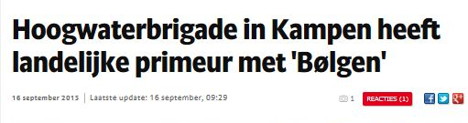
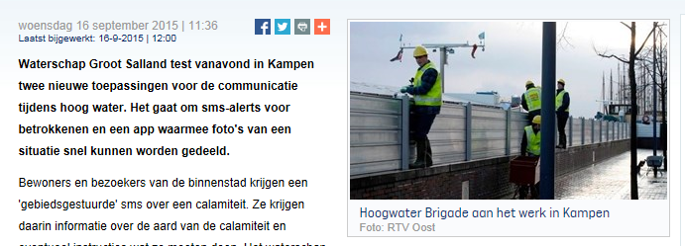
Kampen, the Netherlands
16-17 September 2015
People from UK, Norway, Sweden & NL experience the the flood defence system Kampen exercise
And demonstration of 2 tools for efficient communication
High water brigade in Kampen has national ‘scoop’ with ‘Bølgen’
Waterboard Groot Salland is trying out 2 new tools for communication in flood situations. An SMS alert for inhabitants of Kampen and a free app to share Geo referenced photos and text (crowd sourcing)

Slide 5
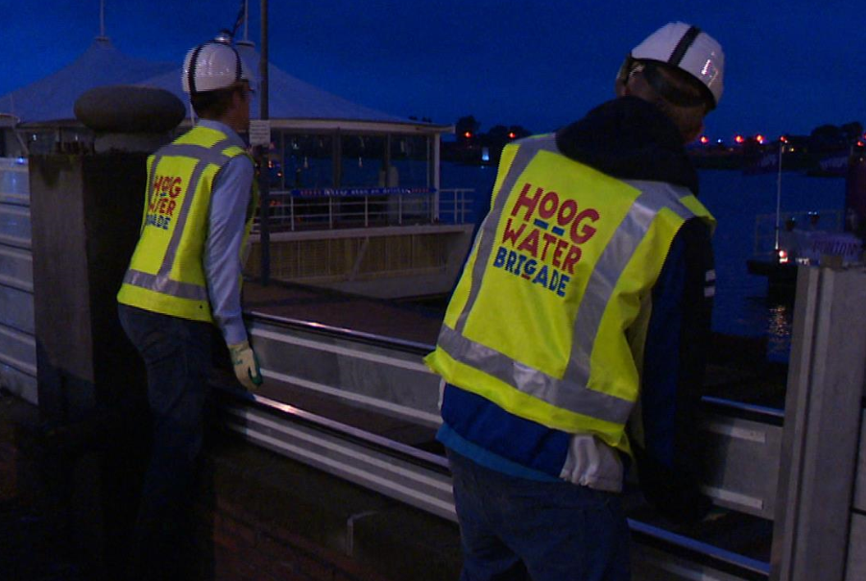
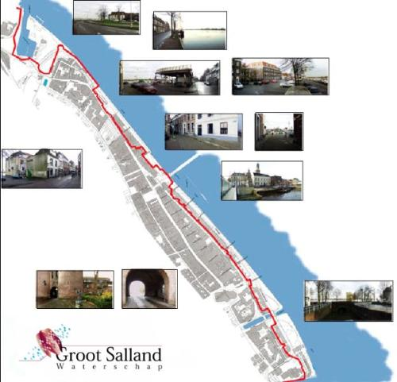
Flood defence system Kampen
Exercise volunteers ‘High
Water Brigade’
Notes:
The High Water Brigade build up the temporary flood defence system. This is a temporary flood protection line / barrier, partly consisting of the old city wall. They practice this once a year.
It has moveable parts, total length is 2 km. 1,5 km is the old city wall is adjusted to the
Kampen is located near the mouth of the Ijssel, where the river flows into the Ijsselmeer. Ijssel is a branch of the Rhine river and one of the three that carries floodwater downstream from Germany. Flooding in Kampen can occur due to adverse winds from the Ijsselmeer as well as from a flood wave flowing downstream. If this occur at the same time, the water level can rise 3 m in only three hours. The advcanxe warning periode is extremely short.
It maintains the historic view of the river from the city despite increasing the hight of the dikes. A new protection line at the water’s edage and use of a lartge section of the old city wall as a barrier. It runs behind the first row of houses that face the river, making it nearly invisible.

Slide 6
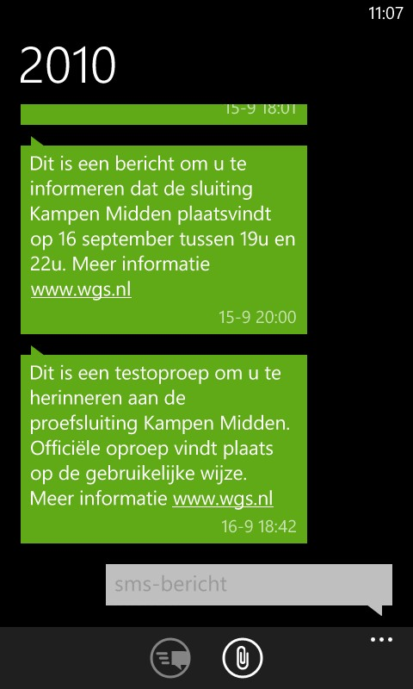
Demonstration
SMS Alert system

Slide 7
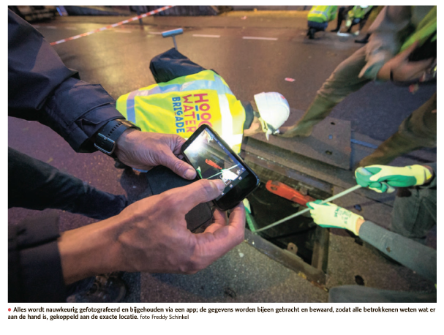
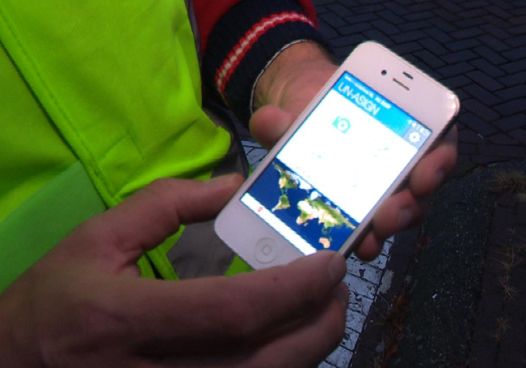
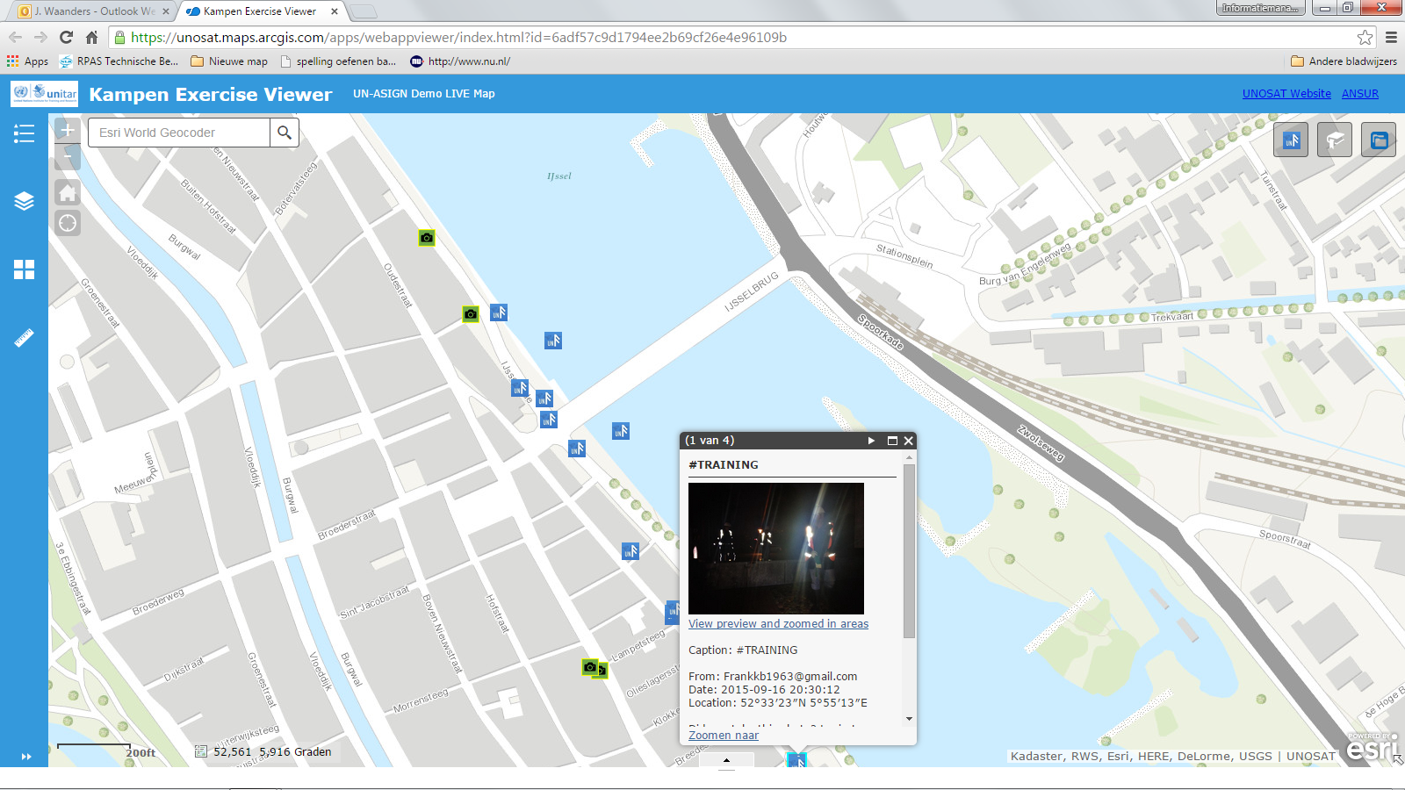
Sharing geo referenced photos & text via
UN Asign crowd sourcing app & live map

Slide 8
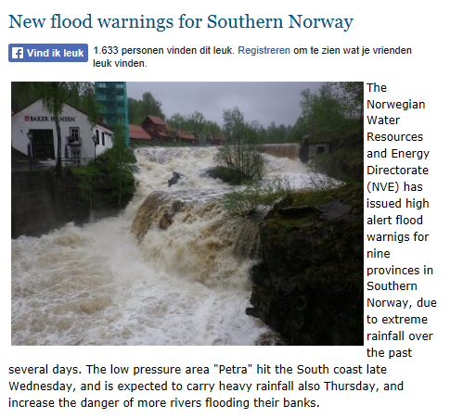
17 Sept, elsewhere in Europe..

Slide 9
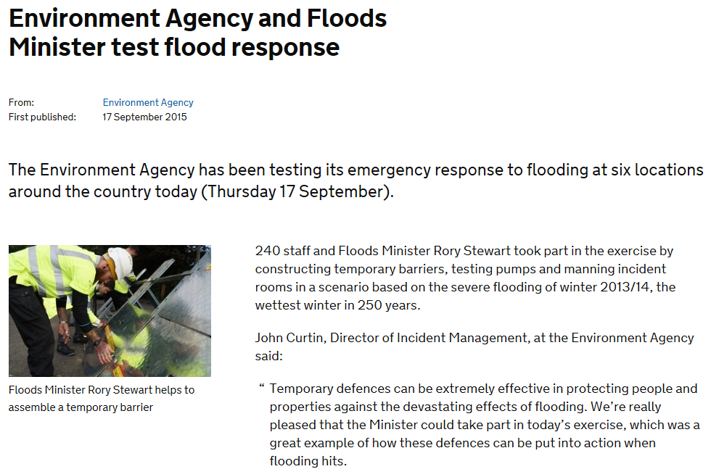

Slide 10
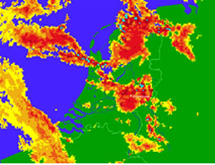

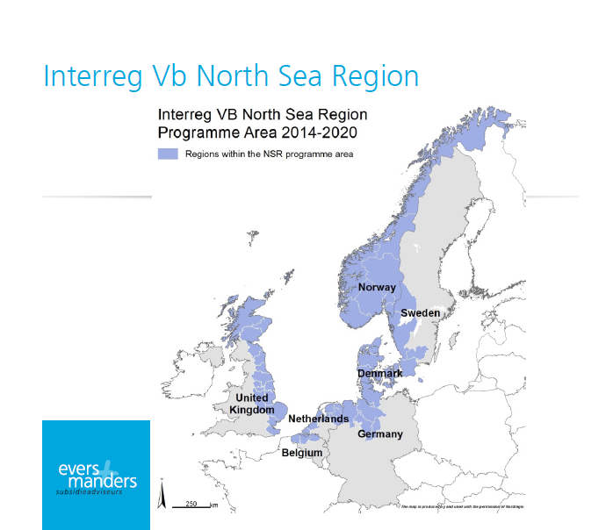
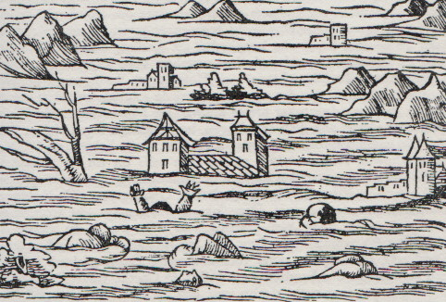
Why?
+
+
Need for improved flood management strategies
Notes:
In recent years, many regions in the NSR region had to cope with extreme weather and climate events that led to serious flooding. Substantial economic impact on infrastructure and assets and also psychological impact on population.
Extreme weather and climate events in the NSR region have increased in frequency or magnitude induced by climate change
To face future climate related events, improved flood management strategies are essential for all NSR countries

Slide 11
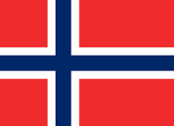
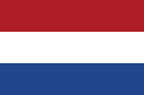

The same or different?
Tafjord 1934, “Bølgen” near future?
1953, 1993/1995
Differences in
types of flooding
significance of flooding
presence of recent experience with flood events
different ways of flood defense, different operational knowledge
e.g.
2014
Flood prevention, protective measures
Flood fighting
Notes:
NSR regions are Facing climate change -> are vulnerable to flooding at least to some extent.
However, there are differences in the types of flooding that occur and the are differences between the countries in terms of the significance of flooding, and related to this, the presence of recent experience with flood events.
As a result, the NSR region countries have organized their flood defences in quite different ways (e.g. in NL flood defence, in UK flood fighting.
For instance, for The Netherlands the large 1953 flood and the 1993/1995 (near) floods were the last major flooding
events, whereas the UK was struck as recent as 2014. In 1934 a 2 mln square foot rock fell into Norway’s Tafjord triggering a 85 meter wave ('Bølgen') which killed 47 people. A similar tsunami is predicted to hit Norway at some point in the (near?) future
For instance, the Netherlands primarily have focussed on realisation of protective measures such as dikes and enforcements. On the other hands, in England the focus is primarily on fighting the immediate effects of flooding events. This also implies that the operational knowledge in case of a serious flooding event varies

Slide 12
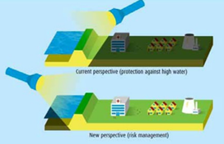
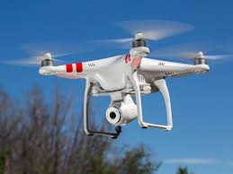


2 Common challenges in Europe North Sea Region
1. Transition to integrated risk management
2. Utilize & embed technological innovations in practices
Notes:
Looking at the future: It is clear that flood risks can no longer be dealt with by focusing solely on flood defences
Need for improved flood management strategies. The need for & a transition to integrated risk management. As illustrated in the next slide
The need to utilize and embed technological innovations in practices and to embed this into comprehensive emergency response systems.
To be prepared, it is essential to join forces and share experiences on flood management strategies and learn of each other.
(building dikes, dams, embankments etc.) as in The Netherlands or flood fighting as in the UK.
For the individual organisations it is simply not possible to cover the wide range of fast changing and innovative developments in monitoring techniques and data

Slide 13
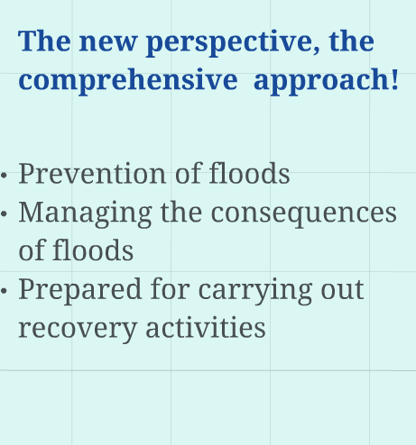
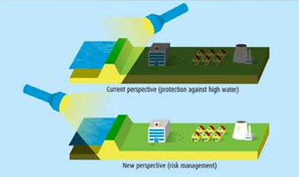
Integrated risk management: multi layer safety

Slide 14
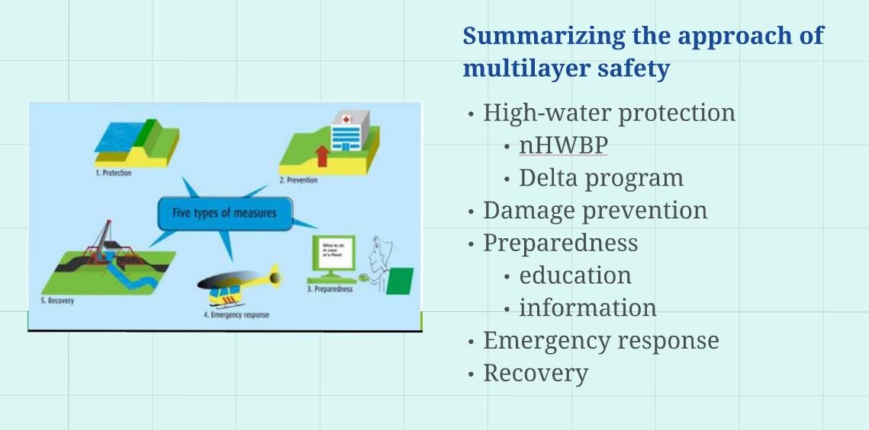
Awareness!
Notes:
It is clear that flood risks can no longer be dealt with by focusing solely on flood defences
(building dikes, dams, embankments etc.) as in The Netherlands or flood fighting as in the UK.
All countries and relevant organisations are facing the need for a transition to integrated risk
Management
CAN BE ILLUSTRATED BY THIS FIGURE
as was already underpinned by the FP7 funded STAR-flood project. To be
prepared, it is essential to join forces and share experiences on flood management and learn of
each other. Actors at various levels within the NSR region wish for and make efforts at a
diversification of Flood Risk Management Strategies, in which multiple strategies are applied
simultaneously and linked together.
Combined with the need to utilize and embed technological innovations in practices and to
embed this into comprehensive emergency response systems, this implies that transnational
cooperation is needed. For the individual organisations it is simply not possible to cover the
wide range of fast changing and innovative developments in monitoring techniques and data
processing. It is benificial and far more cost effective to share knowledge and co-operate in
-- Signed by Erik Jan Langkamp on 30/06/2015 16:35:01 -- 17e25f7997eda068347eb963294f6fcc -- Exported on 30/06/2015 16:35:02 / Page 4 of 7
development of standardised information gatheringimplemented. Active stakeholder participation has to be realised.
All NSR-countries are vulnerable to flooding at least to some extent. However, there are large
differences in the types of flooding that occur. All countries encounter pluvial and fluvial
flooding (although the occurrence of floods has been significantly reduced in Sweden due to the
extensive development of hydropower establishments). Some countries, e.g. The Netherlands,
The UK and Belgium, can also encounter tidal and surge flooding.
There are also huge differences between the countries in terms of the significance of flooding,
and related to this, the presence of recent experience with flood events. For instance, for The
Netherlands the large 1953 flood and the 1993/1995 (near) floods were the last major flooding
events, whereas the UK was struck as recent as 2014. In 1934 a 2 mln square foot rock fell into
Norway’s Tafjord triggering a 85 meter wave ('Bølgen') which killed 47 people. A similar
tsunami is predicted to hit Norway at some point in the (near?) future.In Sweden there is limited
experience with disastrous floods at all.
As a result, the NSR region countries have organised their flood defences in quite different
ways. For instance, the Netherlands primarily have focussed on realisation of protective
measures such as dikes and enforcements. On the other hands, in England the focus is primarily
on fighting the immediate effects of flooding events.
This also implies that the operational knowledge in case of a serious flooding event varies
between NSR countries. For instance, the robustness and resilience of Dutch calamity
organizations is not fully challenged in real emergency situations whilst UK partners have
recent operational experiences.
It is clear that flood risks can no longer be dealt with by focusing solely on flood defences
(building dikes, dams, embankments etc.) as in The Netherlands or flood fighting as in the UK.
All countries and relevant organisations are facing the need for a transition to integrated risk
management, as was already underpinned by the FP7 funded STAR-flood project. To be
prepared, it is essential to join forces and share experiences on flood management and learn of
each other. Actors at various levels within the NSR region wish for and make efforts at a
diversification of Flood Risk Management Strategies, in which multiple strategies are applied
simultaneously and linked together.
Combined with the need to utilize and embed technological innovations in practices and to
embed this into comprehensive emergency response systems, this implies that transnational
cooperation is needed. For the individual organisations it is simply not possible to cover the
wide range of fast changing and innovative developments in monitoring techniques and data
processing. It is benificial and far more cost effective to share knowledge and co-operate in
-- Signed by Erik Jan Langkamp on 30/06/2015 16:35:01 -- 17e25f7997eda068347eb963294f6fcc -- Exported on 30/06/2015 16:35:02 / Page 4 of 7
development of standardised information gathering.
The project set up has been developed in close cooperation between project partners and other
interested organisations, the latter inside and outside the NSR region. During a webinar in March
2015 the urge to work together on new information techniques in preparation towards climate
related flood events was expressed. This issue was worked out in more detail in prepatory
sessions in May and a partner meeting in June 2015.
Next to the partners involved other interested parties from Sweden, Germany and Denmark
have expressed their interest and commitment to the project, but were not able to join the
project as a confirmed partner at this stage.
Also other organisations within the NSR region are interested in the project. Letters of Support
are already available but could not be attateched to this Expression of Interest.
The need for transnational cooperation is also underpinned by the interest from organisations
outside the NSR region (e.g. Padova, Cordo

Slide 15
EU programme: Interreg North Sea Region
Project partners: 9
Application: First step June 2015 / step 2 Feb 2015)
Eligible budget (indicative): € 6.000.000
Opportunity to join the project or to express your interest and support

Slide 16
Focus
Proactively prepare for climate related disasters
Needs of authorities & society
Development of Improved
When event occurs:
“Business as usual”
Data & Information
Interaction between public authorities & society, jointly aiming at improved flood resicilience
Partnerships public & private sector on development innvoation products & services
Risk awareness & communication within society
Flood management strategies
Climate resilience
Notes:
Summary
Bølgen focuses on the needs of the authorities, responsible for water and crisis management to pro-actively prepare for climate related disasters. The challenge is to maximize safety and close the risk awareness gap towards societal stakeholders.
Information management is crucial in this context and Bølgen is innovative as it focuses on the potential of current and new information gathering technologies and active stakeholder involvement.
To face future climate related events, improved flood management strategies are essential for
all NSR countries. Experiences gained on individual aspects of flood management have to be
shared and new information concepts have to be developed and implemented. Active
stakeholder participation is essential.
Bølgen focuses on the needs of the authorities, responsible for water and crisis management.
The challenge is to maximize safety and close the risk awareness gap towards societal
stakeholders. Much is to be gained in pro-active preparedness to climate related disasters.
Information management is crucial in this context and Bølgen is innovative as it focuses on the
potential of current and new information technologies and active stakeholder involvement.
The project's approach in addressing these shared challenges is new as it:
1. provides authorities with the right information at the right time by incorporating
innovative information technologies;
2. links public sector demands to private sector developments;
3. contributes to institutionalized interaction between public authorities and society, jointly
aiming at the realization of improved flood resilience.
Project results relate to NSR program indicators:
1. Capacity of relevant NSR authorities to identify and implement solutions for improving
climate change resilience;
2. Capacity of authorities to increase the scope and quality of innovation in public service
delivery.
Extreme weather and climate events in the NSR region have increased in frequency or
magnitude induced by climate change. The impact of these events is enhanced, due to
increased population and assets at risk. Though each kind of extreme event (e.g. flash floods
and related landslides, storm surges, heat waves, fires, including vegetation fires) can lead to
disaster, the economic and human impact of floods has in recent history shown to be heavily
disruptive in the NSR region (e.g. Great Yarmouth, UK and Southwest Sweden 2013).
In recent years, many regions in the NSR region had to cope with climate events that led to
serious flooding. The economic impact on the infrastructure and assets (both private and
public), but also the psychological impact on the population has been substantial. For instance,
it was calculated that UK GDP had fallen by 0.5% during the last three months of 2010 (worth
about 10 billion€) due to weather constraints.
The North Sea Region should prepare for projected climate changes based on a further
temperature rise of at least 1.5⁰C. This will undisputetly lead to even more extreme weather
and climate events. It’s unrealistic to invest in defense systems and preconditions (building
dikes, dams, embankments etc.), to guarantee that each and every region in the NSR can cope
with every extreme weather event. The magnitude of the events is too severe that the
investment levels to meet these events up to a 100% guarantee are too high.
Therefore enhanced flood resilience is urgently needed. Actors at various levels (international,
national as well as regional) wish for and make efforts at a diversification of Flood Risk
Management Strategies, in which multiple strategies are applied simultaneously and linked
together in a flexible way. These strategies include flood protection, pro-active damage
prevention (e.g. spatial planning, building permits), flood preparation, emergency respons and
flood recovery.
Major challenges are the necessity to organise joint working between relevant actors in an
effective way, to adequately involve stakeholders and to translate general flood risks into a set
of more specific organisational, substantive and procedural provisions. The overall challenge
flood risk governance has to face is the transition and implementation of inspiring bridging
concepts from protection to risk management.
Key operational aspects in managing extreme conditions are time and information quality. The
better information on the actual status of flood defense and infrastructural resources is
available, the better the impact of extreme events can be managed. Over the last decade
significant developments in novel monitoring and information technologies have been realized
and could provide crisis managers with more accurate and especially (near) real time data.
The problem is that these technologies are developed in a technology push environment and
are not well fitted to the specific needs of relevant users. Therefore their actual implementation
and use at the end users has been lagging behind. Embedment in decision making processes,
standards and communicaton still needs to be realized.
The challenge therefore is to utilize and embed technological innovations in practices and to
embed this into comprehensive emergency response systems. Especially authorities
responsible for water and crisis management will benefit in their preparedness to potential
disasters and their communication with all stakeholders involved, before, during and after
disaster.
To meet the challenges the focus of the project is to:
Demonstrate improved measures and technologies to support improved forecasts and
management of flood related disasters;
Develop new or improved knowledge partnerships between businesses, knowledge
institutions, public administrations and end users with a view to long-term cooperation
(post project) on developing products and services;
Stimulate the public sector to generate innovation demand and innovative solutions for
improving public service delivery;
Create awareness and improve risk communication with society.

Slide 17

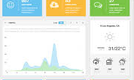

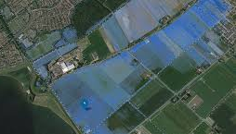

3 main topics
Data gathering
Data management
& presentation
Stakeholder participation
Notes:
1. Data gathering
• which data do we need to be prepared for floods/extreme weather conditions
• how can we use new techniques like drones and satellites and new sources like social
media
• how can we integrate these techniques in our organization.
Also example: Assessment of Critical infrastructure for flood resiliance
2. Data management and presentation
• which information is needed for which target groups
• how can we turn the data into relevant information
• how can we visualize and present the information
• how can we organize and share the information (communication and cooperation
between actors, tools and facilities we need in a crisis center).
3. Stakeholder participation
• what is the risk awareness of the population
• what are the needs of the population if we want them to be more aware and more actively
involved in the management of crises
• in which way can the population be involved
• how can we effectively manage the expectations of the stakeholders and create risk
awareness

Slide 18
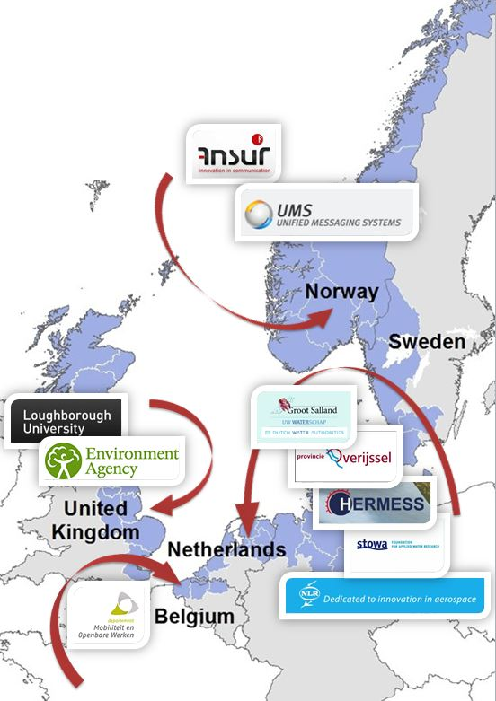
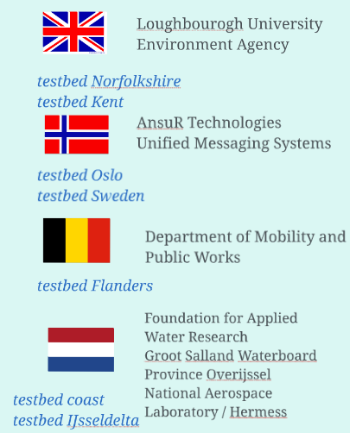
Current partners

Slide 19
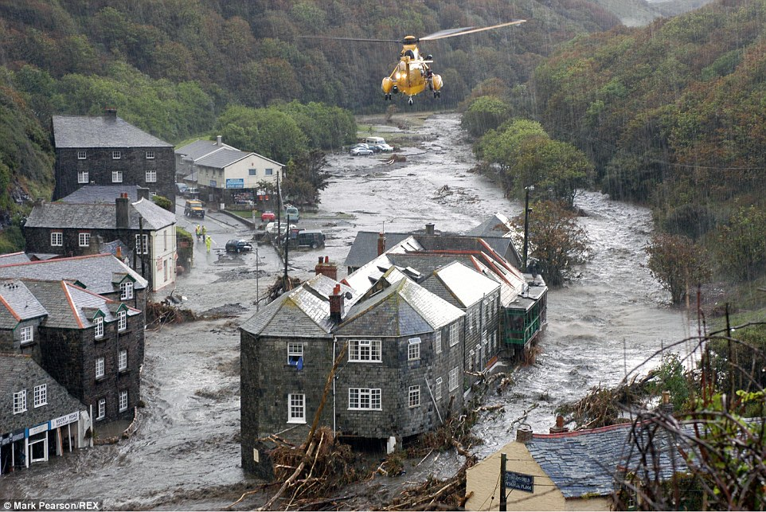
United Kingdom
The Pent Stream, Folkestone, UK
Development of a Flood warning system
River monitoring
Forecasting
Modelling
Community engagement
August 1996
98.6mm of rain fell in two hours
Rapid onset, high hazard flooding
Around 250 properties flooded
Part of harbour wall demolished to allow flood water to drain
Convective rainfall on a summers day

Slide 20
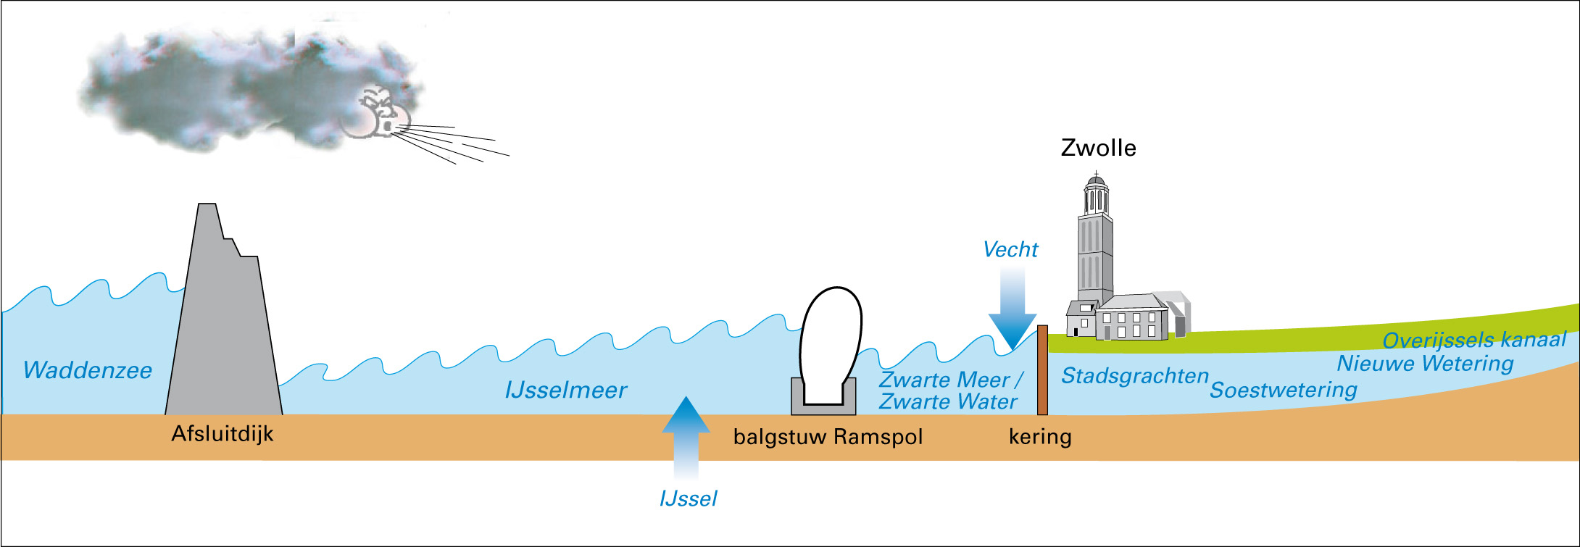

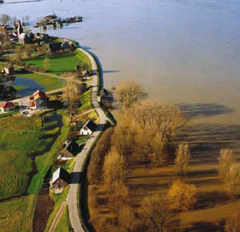
Watersysteem IJssel-Vechtdelta
The Netherlands
Discharge
Storm
Discharge
Gebruik dit tekstvak + kader om meer nadruk op een tekst te leggen. Plak het kader in een andere sheet en verander de grootte naar wens.
Voorbeeld tekst in kader Voorbeeld tekst in kader Voorbeeld tekst in kader Voorbeeld tekst in kader Voorbeeld tekst in kader Voorbeeld tekst in kader Voorbeeld tekst in kader Voorbeeld tekst in kader
Watersysteem IJssel-Vechtdelta
www.floodcontrol2015.com
20

Slide 21
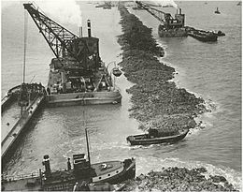
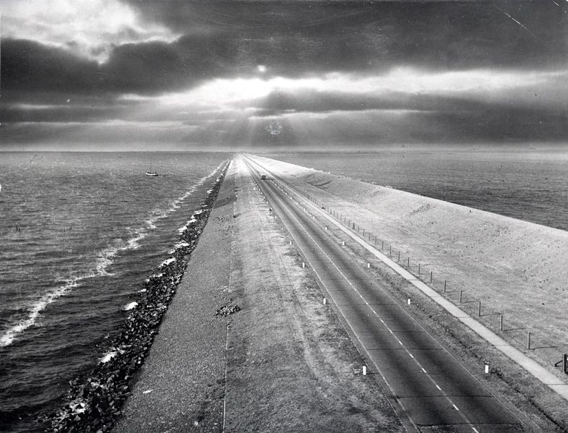
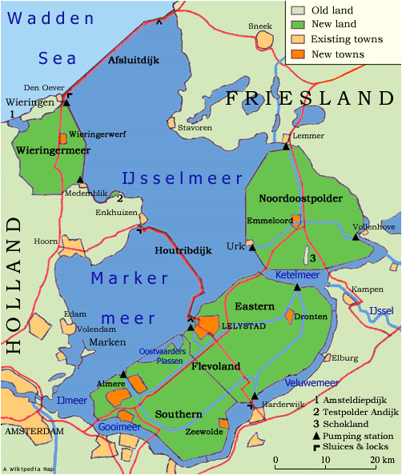
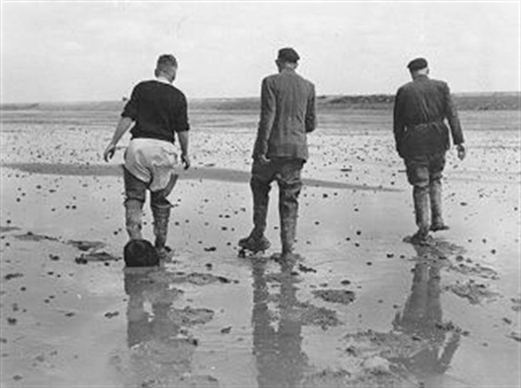
Closure of the Sea (1932) and land reclamations
No more floodings…!(?)
Notes:
The 32 km Afsluitdijk separates the IJsselmeer (right) from the Wadden Sea (left), protecting thousands of km² of land.
The Zuiderzee Works (Dutch: Zuiderzeewerken) are a man-made system of dams and dikes, land reclamation and water drainage works, in total the largest hydraulic engineering project undertaken by the Netherlands during the twentieth century. The project involved the damming of the Zuiderzee, a large, shallow inlet of the North Sea, and the reclamation of land in the newly enclosed water using polders. Its main purposes are to improve flood protection and create additional land for agriculture.
Background[edit]
The concept of making the Zuiderzee docile originated in the seventeenth century. The ambitious solutions suggested were impractical given the technology then available.Plans were developed during the second half of the nineteenth century to protect areas from the force of the open sea and creating new agricultural land. Cornelis Lely (after whom Lelystad is named) was an ardent supporter, an engineer and later government minister. His 1891 plan was the basis for the development of what were to become the Zuiderzee Works. It consisted of a large dam connecting the northern tip of North Holland with the western coast of Friesland and the creation of initially four polders in the northwest, the northeast, southeast (later split in two), and southwest of what would be renamed the IJsselmeer (IJssel-lake). Two major lanes of open water were defined for shipping and drainage. The initial body of water affected by the project was 3,500 square kilometres (1,350 sq mi). Opposition came from fishermen along the Zuiderzee who would lose their livelihood, and from others in coastal areas along the more northerly Wadden Sea. They feared higher water levels as a result of the closure. Other critics doubted whether the project was feasible financially.
When Lely became Minister of Transport and Public Works in 1913, he used his position to promote the Zuiderzee Works and gained support. The government started developing official plans to enclose the Zuiderzee. On January 13 and 14, 1916 the dikes at several places along the Zuiderzee broke under the stress of a winter storm, and the land behind them flooded, as had often happened in previous centuries. This flooding provided the decisive impetus to implement the existing plans to tame the Zuiderzee. In addition, a threatening food shortage during the other stresses of World War I added to widespread support for the project.
Construction of the Afsluitdijk
On June 14, 1918 the Zuiderzee Act was passed.^{[1]} The goals of the Act were threefold:
Protect the central Netherlands from the effects of the North Sea;
Increase the Dutch food supply by development and cultivation of new agricultural land; and
Improve water management by creating a lake from the former uncontrolled salt water inlet.
The Dienst der Zuiderzeewerken (Zuiderzee Works Department), the government body responsible for overseeing the construction and initial management, was set up in May 1919. It decided against building the main dam first, proceeding to construct a smaller dam, the Amsteldiepdijk, across the Amsteldiep. This was the first step in rejoining the island of Wieringen to the North Holland mainland. The dike, with a length of 2.5 km, was built between 1920 and 1924. As with dike building, polder construction was tested on a small scale at the experimental polder at Andijk.
Construction phase[edit]
Afsluitdijk[edit]
The Zuiderzee Works in the Netherlands turned the dangerous Zuiderzee, a shallow inlet of the North Sea, into the tame IJsselmeer, and created 1650 km² of land.
A new study, commissioned after doubts arose over the financial feasibility of the project, recommended that work should continue and be accelerated. The Zuiderzee Works Department initiated the next two major projects at the same time, in 1927. The most important of these was the main dam, the Afsluitdijk (Enclosure Dam), running from Den Oever on Wieringen to the village of Zurich in Friesland. It was to be 32 km long and 90 meters wide, rising to 7.25 meters above sea-level, with an incline of 25% on each side.
Experience showed that till, rather than just sand or clay, was the best primary material for a structure like the Afsluitdijk. An added benefit was that it was easily available; it could be retrieved in large quantities by dredging it from the bottom of the Zuiderzee. Work started at four points: on both sides of the mainland and on two purpose-made construction-islands (Kornwerderzand and Breezanddijk) along the line of the future dam.
From these points the dam was expanded as ships deposited till into the open sea in two parallel lines. Sand was poured between the two dams; as the fill emerged above the surface of the water, it was covered by another layer of till. The nascent dam was strengthened with basalt rocks and mats of willow switch at its base. The dam was finished by raising it with sand and finally clay for the upper surface of the dam, which was planted with grass.
Construction progressed better than expected. At three points along the line of the dam were deeper underwater trenches, where the tidal current was much stronger than elsewhere. These had been considered major obstacles to completing the dam, but proved not to be so. On May 28, 1932, two years earlier than forecast, the Zuiderzee was closed when the last tidal trench of the Vlieter was filled with a bucket of till. The IJsselmeer was born, though the lake was salty.
The dam was not finished. It still needed to be brought up to its full height, and a road linking Friesland and North Holland remained to be built. In addition to completing the dam, work needed was construction of shipping locks and discharge sluices at the ends of the dam. The complex at Den Oever includes the Stevin lock and three series of five sluices for discharging the IJsselmeer into the Wadden Sea. The other complex at Kornwerderzand is composed of the Lorentz locks and two series of five sluices, making a total of 25 discharge sluices. Periodically discharging the lake is necessary since it is continually fed by rivers and streams (most notably the IJssel River, for which the lake is name) and polders draining excess water into the IJsselmeer.
The Afsluitdijk was opened September 25, 1933, with a monument marking the spot where the dam was finished. It used 23 million m³ of sand and 13.5 million m³ of till. An average of 4,000 to 5,000 workers were employed in the dam's construction, relieving unemployment during the Great Depression. Total cost of the dam was about €700 million (2004 equivalent).

Slide 22
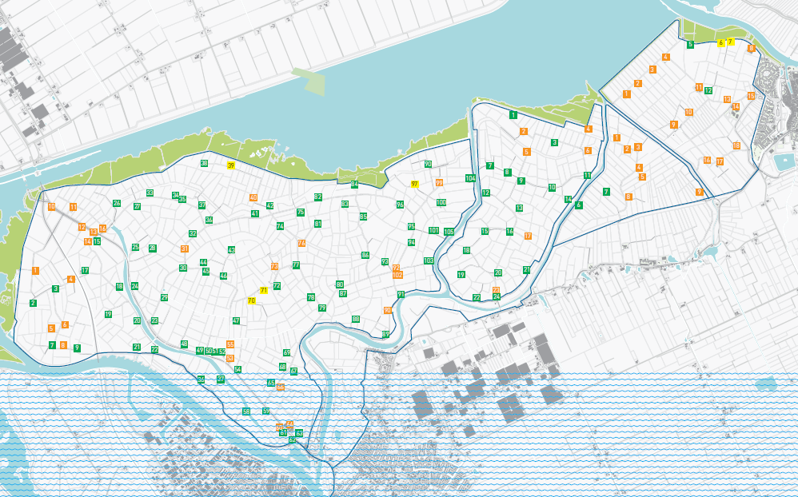
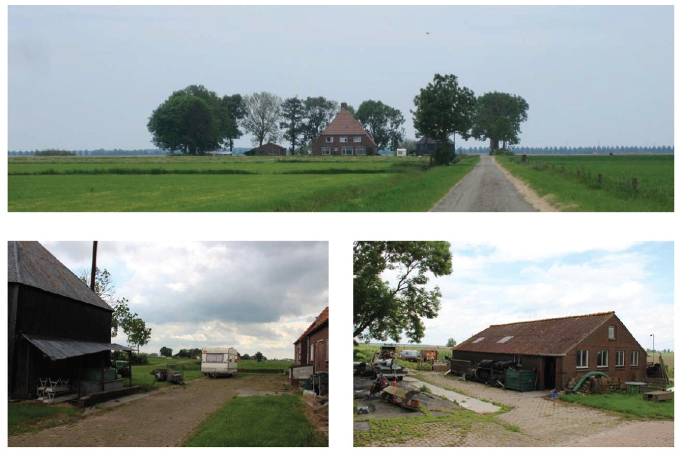
Different perception of flood risk: building at low level
Green = flood proof mounds (historical buildings)

Slide 23
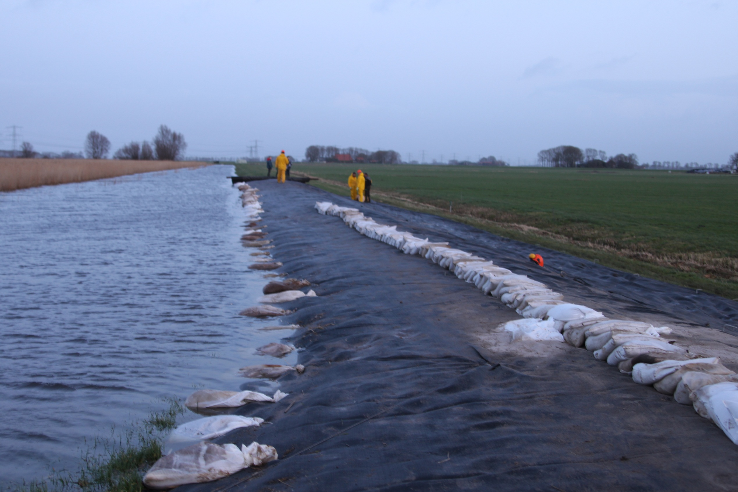
Near flood in 2012,
High waterlevels in 2013, 2014, 2015…

Slide 24
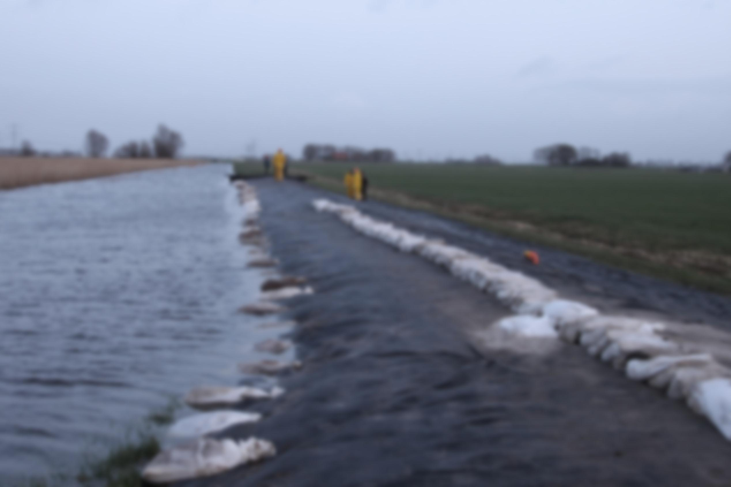


Flood risk warning
More accurate risk communication
Assessment of critical infrastructure for flood resilience
Notes:
In this testbed, we will also undetake an Assessment of Critical infrastructure for flood resiliance
More examples

Slide 25
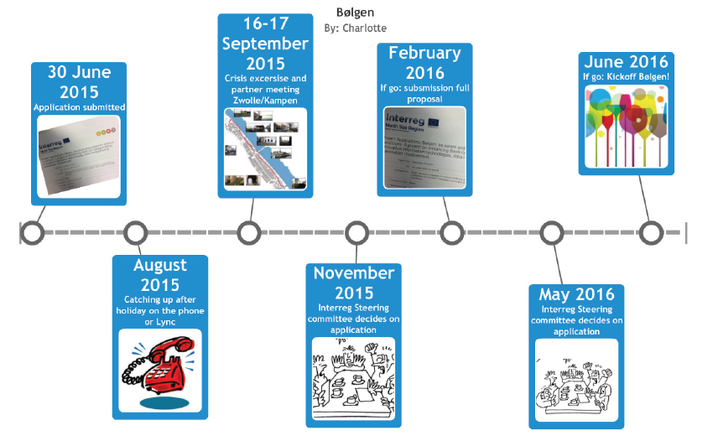
Timeline

Slide 26
Additional partners / observers sought
Conditions to participate:
Additional expertise/ knowledge exchange
Additional country within NSR region
Preferably end users
With a demo/pilot activity
Intended partner costs around €300.000 (at least € 200.000)
Other options: sub partnering to a real partner or observer

Slide 27
Denmark, Germany, Sweden

Slide 28
Bølgen: current partners

Slide 29
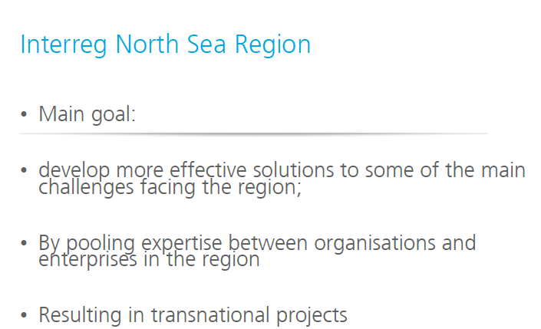

Slide 30
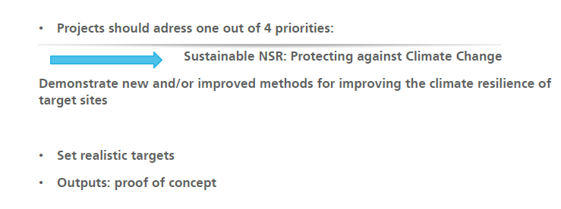
Bølgen & Interreg NSR
NSR program indicators:
Capacity of relevant NSR authorities to identify and implement solutions for improving climate change resilience;
Capacity of authorities to increase the scope and quality of innovation in public service delivery.
Notes:
Project results contribute to NSR program indicators:

Slide 31
Interested? Please contact:
Waterboard Groot Salland
Charlotte van der Gun
+31 38 4556700
+31 6 310 26 225
cgun@wgs.nl
www.wgs.nl

Slide 33
https://www.youtube.com/watch?feature=player_detailpage&v=sIj4v8TfnyU

Slide 34
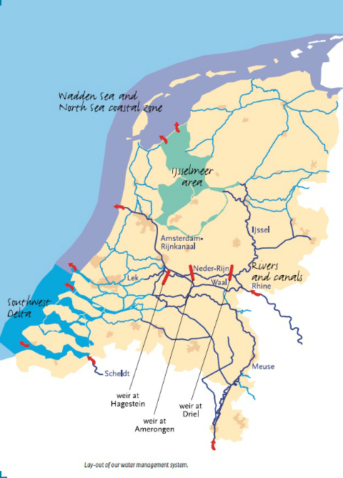
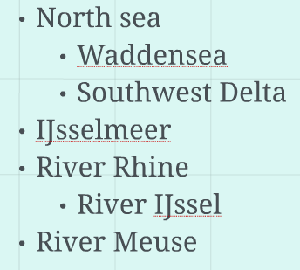
The major water systems of the Netherlands

Slide 35
