Slide 1
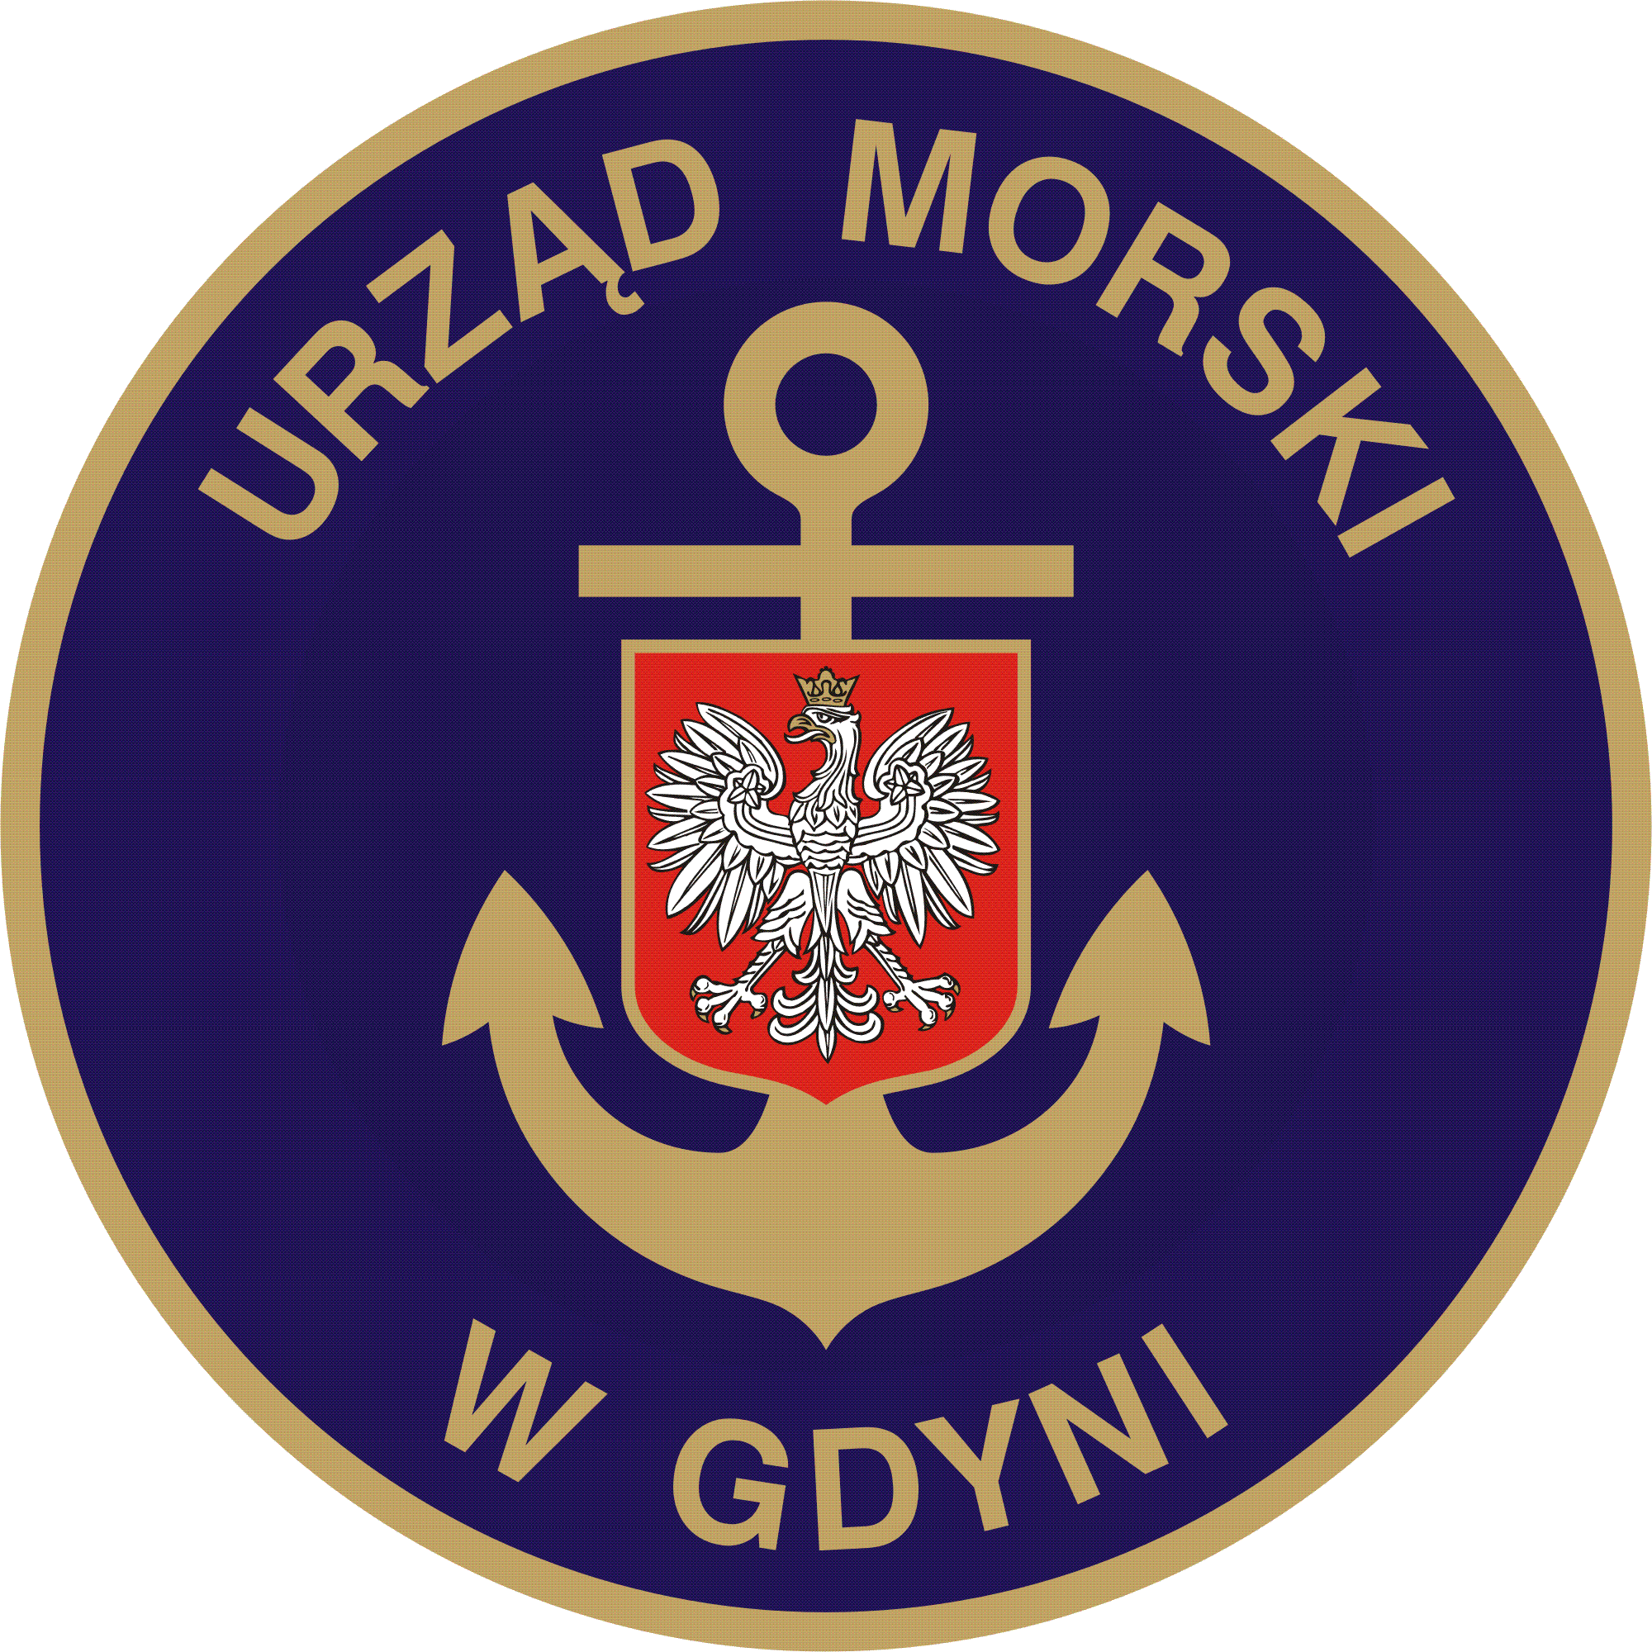
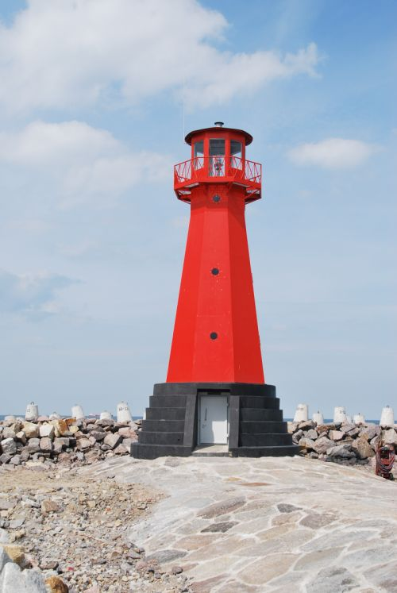
MODERNISATION OF THE ENTRANCE TO THE INTERNAL PORT (in Gdańsk).
STARGE I – RECONSTRUCTION OF EAST BREAKWATER
Project co-funded by the European Union out of the Cohesion Fund as part of the Operational Programme Infrastructure and Environment.
FOR DEVELOPMENT OF INFRASTRUCTURE AND ENVIROMENT

Slide 2
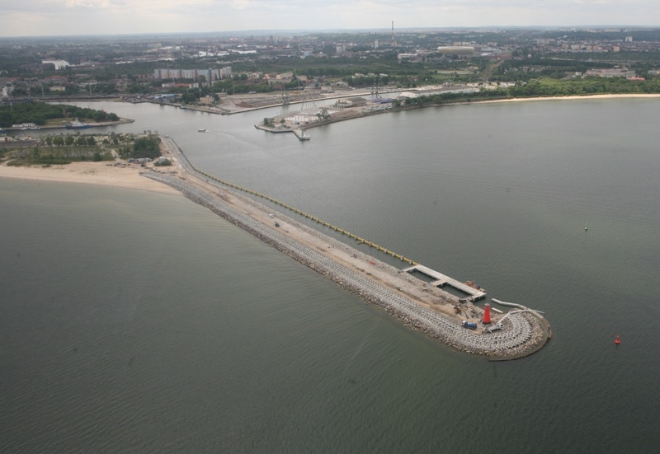
MODERNISATION OF THE ENTRANCE TO THE INTERNAL PORT (in Gdańsk).
STARGE I – RECONSTRUCTION OF EAST BREAKWATER
Design nr POIS.07.02.00-00-012/10
Operation Programm Infrastructure and Enviroment
Priority: VII. environmental-friendly
Transport
Action: 7.2. Development of marine transport
Financial Agreement no POIS.07.02.00-00-012/10-00 from 8th of october 2010
Schedule: October 2010 – September 2012.
Eastern Breakwater after reconstruction - August 2012

Slide 3
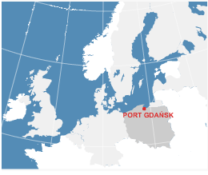
MODERNISATION OF THE ENTRANCE TO THE INTERNAL PORT (in Gdańsk).
STARGE I – RECONSTRUCTION OF EAST BREAKWATER
Location of the sea port in Gdańsk
Investment is located in Pomeranian District, on the area of Community Gdańsk, in direct neighbourhood to internal part of the Port of Gdańsk.
Sea Port of Gdańsk is located in the middle part of south coast of Baltic Sea, on the coast of the Gdańsk Bay, by the estuary of Vistula river.
source: Port Gdańsk data
It is a significant transportation hub with the international importance and one of the key elements of logistical and transpot infrastructure in Poland. Regarding to EU strategy, the Port of Gdańsk is included to the Transeuropean Transportation Corridor no. VI that connects scandinavian with south and west european countries.

Slide 4
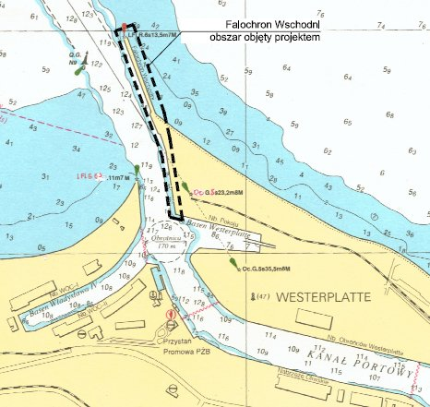
MODERNISATION OF THE ENTRANCE TO THE INTERNAL PORT (in Gdańsk).
STARGE I – RECONSTRUCTION OF EAST BREAKWATER
The Port of Gdańsk is divided to two areas, located on the two sides of the Martwa Wisła. Areas on its west coast are called the Internal Port. On the east coast of Martwa Wisła there is located the Northern Port, that has direct connection to the Gdańsk Bay.
Subject of the Project – the East Breakwater; it is located on the entrance to the internal Port, what is shown in the picture below.
Location of the East Breakwater
Source: Design of the modernisation of the East Breakwater in the port of Gdańsk

Slide 5
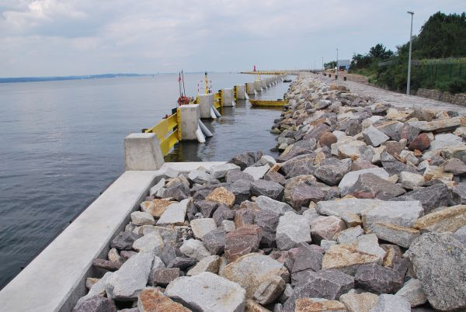
MODERNISATION OF THE ENTRANCE TO THE INTERNAL PORT (in Gdańsk).
STARGE I – RECONSTRUCTION OF EAST BREAKWATER
Project Aims
Improvement of Internal Port’s competitiveness by enabling enlargement of vessels’ tonage in the Internal Port of Gdańsk
Improvment of safety level of vessels, entering the Internal Port of Gdańsk
Increased width of the water way, improves shipping safety during leading big vessels and other big floating units, especially because of limited movement possibilities of big vessels leaded by the stern to the port, using the tugboats.
Changing of the directrix construction and its’ navigation aids ensure additional safety increasement for smaller professional shipping units (pilotships, barges) and recreational and sport units (protection against contact with underwater construction of the breakwater)
Modernisation of the entrance to the Internal Port affect directly on activity of Gdańsk Shiprepair Yard. It allows to use the production potential of Gdańsk Shiprepair Yard.

Slide 6
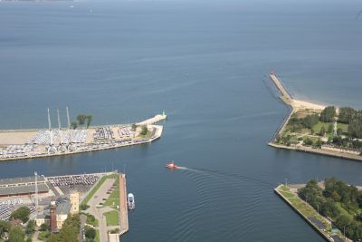
MODERNISATION OF THE ENTRANCE TO THE INTERNAL PORT (in Gdańsk).
STARGE I – RECONSTRUCTION OF EAST BREAKWATER
Influence
The East breakwater before modernisation.
The area of direct influence of the project is internal Port in Gdańsk. Area, that directly covers the Project is the passing section of the water way to the exit from directix „Brzeźno” to the turning basin next to Wladyslaw IV Basin and Westerplatte in the Internal Port.
Indirectly, Project will affect:
locally – on the economy development of city areas next to port and development of transport
potential of the city.
regionally – on the enhancement of competitiveness of Pomeranian District by improving
accessibility of comunication to the Port of Gdańsk from the sea side
overregional – It is the most important area of the Project, appropriate to a very high degree of
significance Port of Gdańsk in the national transport and logistics. Safe for users, modern infrastructure of
access to the port has an indirect impact on the conditions of the enterprise, including Polish import and
export, and thus on tens of thousands of Polish entrepreneurs

Slide 7
MODERNISATION OF THE ENTRANCE TO THE INTERNAL PORT (in Gdańsk).
STARGE I – RECONSTRUCTION OF EAST BREAKWATER
The material scope
Material scope of work included the implementation of the following elements:
Renovation of the existing structure of the breakwater, used as a skeleton structure of the breakwater,
Strengthen the construction of the breakwater head along with the implementation of the outside wave absorbing and dissipating construction, by raising the elevation height of the breakwater overhead to + 4.2m - length 754 meters,
Execution of wave dissipating construction on the west side of the breakwater (from the fairway) - length of 650m,
Execution of the wharf for the hydrographic ship's service of the maritime administration - the length of 63 m.
Construction of a new breakwater directrix and its equipment,
Installation of a modern system of aids to navigation buoys
Execution of underwater stone covering,
Execution of dredging works.

Slide 8
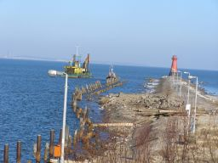
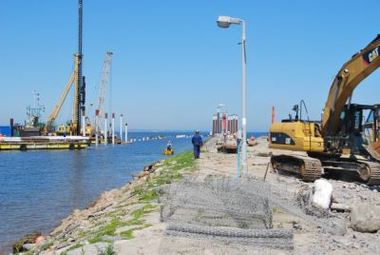
MODERNISATION OF THE ENTRANCE TO THE INTERNAL PORT (in Gdańsk).
STARGE I – RECONSTRUCTION OF EAST BREAKWATER
Project realisation
JUNE 2011
MARCH 2011

Slide 9
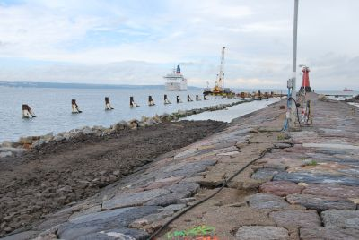
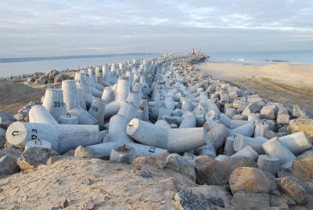
MODERNISATION OF THE ENTRANCE TO THE INTERNAL PORT (in Gdańsk).
STARGE I – RECONSTRUCTION OF EAST BREAKWATER
NOVEMBER 2011
SEPTEMBER 2011

Slide 10
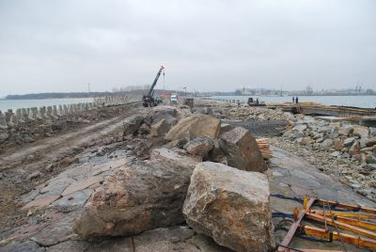
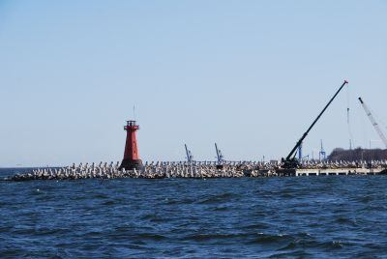
MODERNISATION OF THE ENTRANCE TO THE INTERNAL PORT (in Gdańsk).
STARGE I – RECONSTRUCTION OF EAST BREAKWATER
MARCH 2012
JANUARY 2012

Slide 11
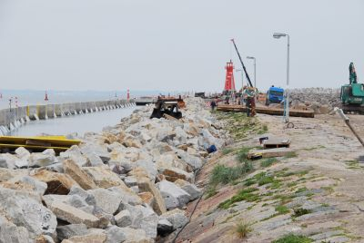
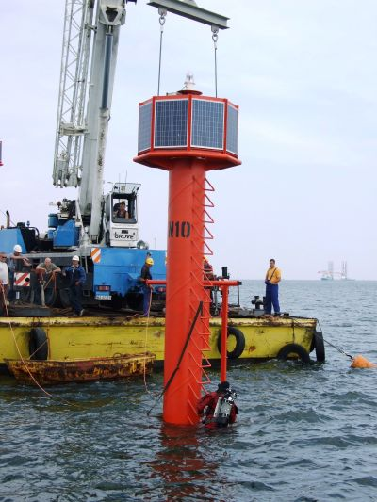
MODERNISATION OF THE ENTRANCE TO THE INTERNAL PORT (in Gdańsk).
STARGE I – RECONSTRUCTION OF EAST BREAKWATER
JULY 2012
MAY 2012

Slide 12
MODERNISATION OF THE ENTRANCE TO THE INTERNAL PORT (in Gdańsk).
STARGE I – RECONSTRUCTION OF EAST BREAKWATER
As a result of work execution:
Dredging works on the waterway were executed on the section from the head of eastern breakwater to its base, 754 m (in the axis): Width 100-150 m , depth of -12,2m
Reconstruction of the breakwater on the length of 754 m (in axis) , by rising
the elevation on the bay-side from +1,4 to 4,2 m,that prevents crossing the wave over
the breakwater during high water levels,
650 m long wave absorber was built,
Wharf for the hydrographic ship's service of the maritime administration conducting maintenance and inspection on the breakwater - the length of 63 m was built,
Construction of the navigation buoyes on the passing water
way and navigational aids on the directrix of the breakwater were changed .

Slide 13
MODERNISATION OF THE ENTRANCE TO THE INTERNAL PORT (in Gdańsk).
STARGE I – RECONSTRUCTION OF EAST BREAKWATER
Quantities of choosen works
Lp | Opis robót | Jednostka | Ilość
Demolition works
1 | Cutting the wooden piles | pcs. | 2 034,00
Piling works
1 | Steel micropiles execution ø508mm, L=16÷22m | pcs. | 110,00
2 | Steel micropiles execution ø356mm, L=15m | pcs. | 134,00
3 | Execution of micropile anchors TITAN | m. | 1 199,50
Stone covering
1 | Dredging works | m³ | 23 659,10
2 | Placing the geosynthetic material on the bottom | m² | 29 161,94
3 | Placing stones | m³ | 52 726,04
4 | Placing accropodes | pcs. | 2 305,00
5 | Placing gabions | pcs. | 679,00
Ferroconcrete constructions
1 | Overwater construction of the layover wharf, reinforced concrete construction, pile wall | m³ | 686,50
Fixing of existing breakwater
1 | Układanie covering pipes ø110mm | mb. | 2 958,48
2 | Execution of concrete joints | mb. | 22 517,67
Reconstruction of red entry tower and lattern
1 | Execution of steel tower construction in connection with navigation aid lattern | pcs. | 1
Dredging works
1 | Dredging works | m³ | 47 180,00
2 | Excavation works | m³ | 26 315,00
3 | Alignment of the stone covering | m² | 12 200,00

Slide 14
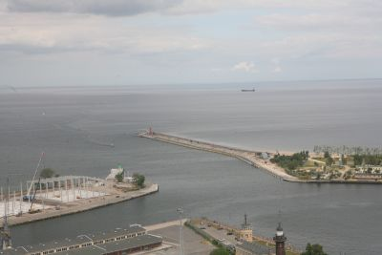
MODERNISATION OF THE ENTRANCE TO THE INTERNAL PORT (in Gdańsk).
STARGE I – RECONSTRUCTION OF EAST BREAKWATER
Beneficjent – Dyrektor Urzędu Morskiego w Gdyni,
ul. Chrzanowskiego 10, 81-338 Gdynia, tel. 58 355 33 33 www.umgdy.gov.pl
Instytucja Zarządzająca – Ministerstwo Rozwoju Regionalnego www.mrr.gov.pl
Instytucja Pośrednicząca I stopnia – Ministerstwo Infrastruktury www.mi.gov.pl
Instytucja Pośrednicząca II stopnia – Centrum Unijnych Projektów Transportowych www.cupt.gov.pl
Project co-funded by the European Union out of the Cohesion Fund as part of the Operational Programme Infrastructure and Environment.

